Slide 1
Proper use of overrides for Earned Income

Slide 2
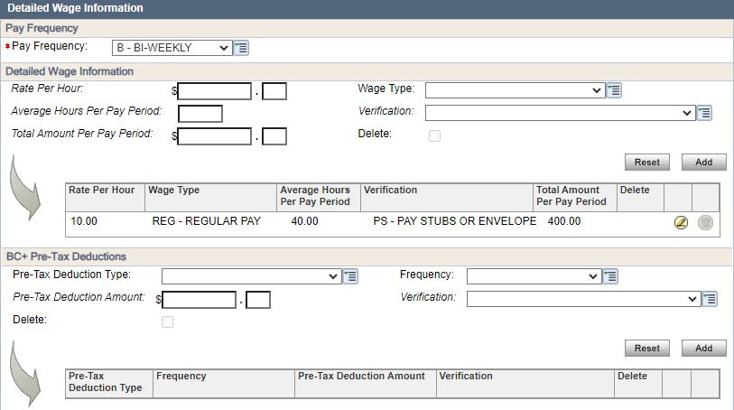
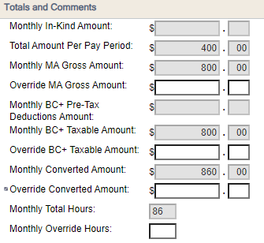
Anatomy of an Employment page: Income
This is referred to as the Dynalist. Information here will be automatically recalculated to a monthly format for each program.
Non-MAGI HC
MAGI HC
Monthly amounts will be displayed here
FS/CC/W-2

Slide 3
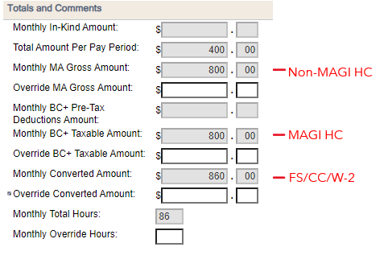
Each monthly total has a corresponding override field.
Override
Any number entered in the override field will be used to determine eligibility for that program, INCLUDING expedited issuance for FS. Any info in the Dynalist for that program will be ignored by CWW.
Override
Override

Slide 4
SO…
When should we use overrides?

Slide 5
Good times to use overrides:
When income cannot properly be counted by using the Dynalist
When using actual income for a backdated or final month
When there is no income information reported or found. Ex. New Hire with no FDSH/SWICA info is found.
When we need to temporarily zero income for unpaid leave or seasonal work

Slide 6
When we shouldn’t use overrides:
When income CAN properly be counted by using the Dynalist
When there is new or changed income, and amounts have been reported or found
Reminder – Zero in an override field can generate Potential Errors, prevent system checks like Reasonable Compatibility, and affect Expedited FS issuance. Use caution when putting Zero as an override to avoid over verification or incorrect issuance
6

Slide 7
Remember that the system is running checks in the background and sometimes we don’t need verification, even if something has not yet been verified. Examples:
HC cases that meet “Reasonable Compatibility” per process help 10.3.5.5, BC+ handbook 9.12, or Medicaid handbook 20.3.8.1
BC+ cases where all eligible members are on an extension
Income has ended in a month prior to the ongoing month being tested. Ex. Income ended 07/05/23, when running the case on 07/10/23 we are looking at 08/2023 forward so no verification of 07/2023 Income is needed
Assistance Group is failing
If you are unsure why a case is passing or failing when you believe it should pend, please check with a lead or supervisor. DO NOT enter overrides at $0 or Q? income that is not truly questionable just to get a case to pend

