Slide 1
BRITS Referrals
Last Updated August 2019

Slide 2
Today:
Referral basics
Gatekeeper Office
Fraud vs Claim vs UAD vs AE
BRITS Comments
Change Reporting Rules for FS
SWICA

Slide 3
The Life Cycle of a Fraud Referral
Fraud referral created
Referral goes to county of residence
Referral assigned to investigator
Investigation starts
(Review case, review information available, telephone interviews, request verification)
Update case, if appropriate
Investigation ends
If overpayment, refer to OP Specialist
If fraud found, IPV (FS/CC only)
Referral is closed
Notes:
Worked in chronological order
Investigation could take 1-90 days
No IPV for BC+ - only applies to FS and CC (higher burden of proof)

Slide 4
The Life Cycle of a Claim Referral
Claim referral created
Referral goes to county of residence
Referral assigned to OP Specialist
Investigation starts
(Review case, review information available, request verification)
Update case, if appropriate
Investigation ends
Overpayment entered
If possible IPV (FS/CC only), assigned to Fraud Investigator
Referral is closed
Notes:
Worked in chronological order
Investigation could take 1-90 days
No IPV for BC+ - only applies to FS and CC (higher burden of proof)

Slide 5
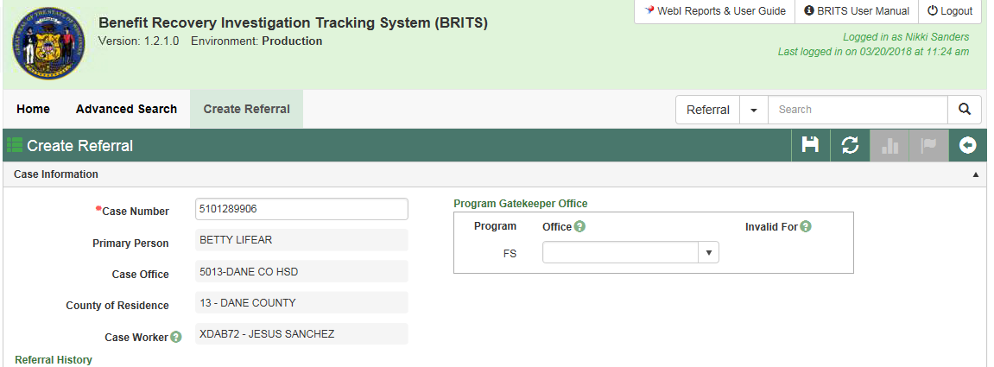
Referral Basics
DANE COUNTY
In general, Program Gatekeeper Office should match the County of Residence
Notes:
In general - County of Residence matches Gatekeeper office
Exception – Gatekeeper office should match the county in which the OP/Fraud occurred, so at times you might select an Office that doesn’t match current county of residence.

Slide 6
Referral Basics
FRAUD
CLAIM
When clients are potentially violating program rules to get benefits they aren’t entitled to
Misusing benefits
Failure to report at multiple times: APP, renewal, SMRF
Examples: AP in home, forgery, QUEST card trafficking, withholding income information
Majority of SWICA and earned income referrals
Primarily involves getting employment wage info
Client didn’t follow change reporting rules
Examples: SWICA, new hire matches, un/under-reported income, duplicate issuance (not agency error)
Notes:
When in doubt, ask – don’t guess – err on the side of claim if unsure between these two. The OP can always switch it to Fraud.
Claim – majority of the time is not going to involve any investigation

Slide 7
Referral Basics
UNRESOLVED AGING DISCREPANCY (UAD)
Low $$$ amount
BC+ only with premium related overpayment
CC overpayments only for co-pay adjustment
SWICA matches only for 1 or 2 quarters
FS cases with monthly allotment of less than $100
Potential OP period of 6 months or less
Questionable ABAWD exemptions
Notes:
UAD: We are using this code as a work around, because BRITS doesn’t have a priority filter.
Historically have not yielded high dollar, if any, overpayment amount
When sending a referral with this tag, it is going to a queue that is low priority.
If you want to make a SWICA referral, but a UAD referral already exists, create a new one – but now this second one is NO LONGER low priority, and you should code it normally (SWICA)
If people ask why?
Because it’s easier to find, sort, run reports
If a second referral comes through, and we process the OP, we will see the UAD past referral, and will pull that in and include it in the OP, if possible.
If pressed for a $ amount <$1,000 for non-fraud related OP, and non duplicated, and not agency error

Slide 8
Referral Basics
Swica – in general…..
Refer SWICAs as Claim Investigation, using SWICA as Source Code.
Including referrals made based on quarter matches without a SWICA discrepancy
Higher dollar OPs = 2 or more consecutive SWICA matches
Low dollar OPs = 2 or less consecutive SWICA matches
For Low Priority (i.e. low dollar) OPs, add UAD tag
Multiple jobs – change jobs frequently – probably not worth it

Slide 9
Regular SWICA

Slide 10
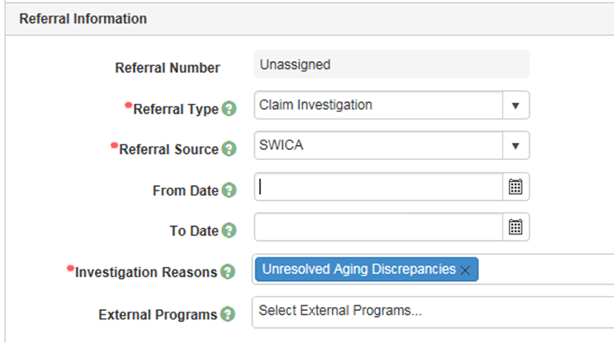
Low Priority SWICA
Notes:
LOW PRIORITY
You can choose more than one reason code
If you come across a low priority that isn’t SWICA, you can code it properly choosing UAD

Slide 11
Referral Basics
Agency error
Stay with county of origin
If you are not sure, ask for help in determining if it’s Agency Error or other referral type
Agency Error Code cannot be changed once you save the referral
Example: budgeted weekly hours incorrectly as bi-weekly
Notes:
County of Residence not by worker who made the error.
Give example of Agency Error Coding problems. Example – once you use it, you can’t go back!
If not sure, or it could involve both agency error and client error, use other code (Claim/Fraud)

Slide 12
BRITS Comments
Who, what, where, when, & why??
Give a detailed summary – you have up to 3,000 character limit
DO
type more than just “AP possibly in home” – what makes you suspect this?
type more than just “first quarter match” – who was it for? Who was the employer?

Slide 13
FS Change Reporting Rules
Reduced Reporting Rules for FS Only
Only required to report if income exceeds 130%
Not if they move out of state
Not if their children move out
Not if they go to jail
However, if a change is reported or becomes known, we must act on it
If they are already over 130%, no need to report until SMRF or renewal
Check Client Notices for 100% or 130% amount
The one just before the change happened
Notes:
Make sure we stress that it’s just for FS – not CC, HC
Understanding the Reduced Reporting Rules for FS is very error prone
6.1.1.2
The 130% of the FPL reduced reporting level is based on the food unit size determined at the most recently completed certification

Slide 14
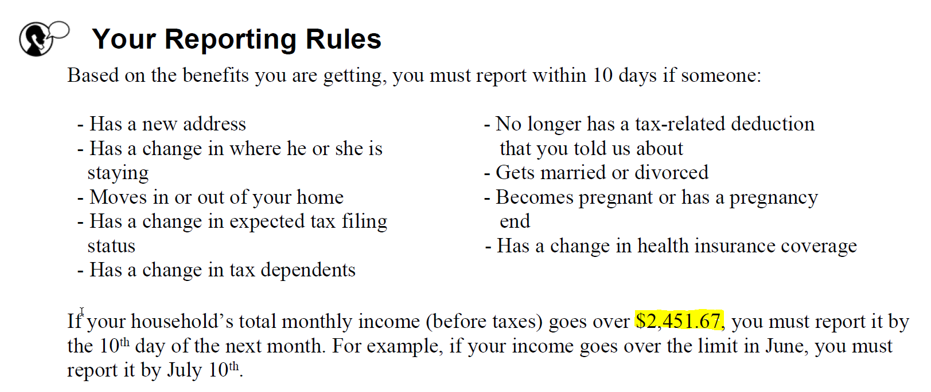
Look at the highlighted amount
This is either 100% FPL, or 130% FPL, depending on open programs
What is the first month the client went over this amount?
Consider this: if income goes over in May, they have until June 10, to report, so it won’t affect benefits until July. Is the job still current? Are they still over?

Slide 15
Unable to Create a New Referral?
Two alerts
“Referral already exists…” – you cannot create another referral
“The following Data Exchange Referral…”– you can create another referral
Existing referral?
Add comments if existing referral is normal priority
DO NOT add comments to an existing Low Priority Referral. Create a new referral.
When in doubt, ask
Notes:
Most UAD are data exchange referrals (SWICA), so there should be an ability to create a new referral w/o adding comments.

Slide 16
Remember This
Before referring, be sure there’s an OP
What programs? Change rules?
Update case correctly going forward
Choose the correct Gatekeeper office
County of Residence at time of OP
Use correct codes on your referrals
Fraud vs. Claim vs. Agency Error
Code Low Priority Referrals as UAD
When in doubt, ask for help

