Slide 1
CAPER TRAINING
Jeremiah Cook
last updated 08/2019

Slide 2
CAPER Knowledge Pretest
What is a CAPER?
A CAPER is a review of a negative agency action for the FoodShare program that resulted in the termination of benefits or a denial of FS eligibility.
Stands for Case and Procedural Error Rates
The purpose of the CAPER review is to verify through documentation contained in the case record whether the agency’s action to deny, terminate or suspend Foodshare benefits was valid.

Slide 3
What Actions Are Subject to Review?
Any action to:
deny initial benefits;
deny benefits at certification;
terminate benefits;
shorten a certification period;
suspend a household’s benefits, including suspended households whose benefits were later restored

Slide 4
CAPER Example 1
At the time of application, a client on a case has a drug conviction in the last 5 years. The client was asked to provide a drug test result, which she did not. She was QV’d, which meant that her income should have been deemed to the other FS unit members.
Even though the cause of this error was systemic, it is still an example of errors that occur on the agency review.

Slide 5
CAPER Example 2
A client conducted a FS review 09/01 with a due date of for the review on 09/30. On 09/11 action was taken by the agency to terminate FS for failure to return the verification. There is evidence that the verification was returned on 09/11 but was not available to the agency until 09/12.
Although this is no one’s fault (since the information was not available for us to see), the State QC review still counts this as an error.

Slide 6
Additional Potential Instances of CAPERs
Failure to send an appointment letter or a Notice of Missed Interview when required.
Failure to provide expedited benefits when required.
Denial of benefits prior to the 30th day from date of application when verification was requested.
Denial of benefits of an application after the 30th day when the case was not properly pended.

Slide 7
Common errors from the review
Miscalculation of EI from paystubs
HSUA errors (counting WHEAP incorrectly)
Incorrect due dates for verification request

Slide 8
Common CAPERS Errors by Gatepost
Current Demographics, 77 errors, 27% of total
Household Members, 53 errors, 18%
Permanent Demographics, 34 errors, 12%
Employment Screen, 21 errors, 7%

Slide 9
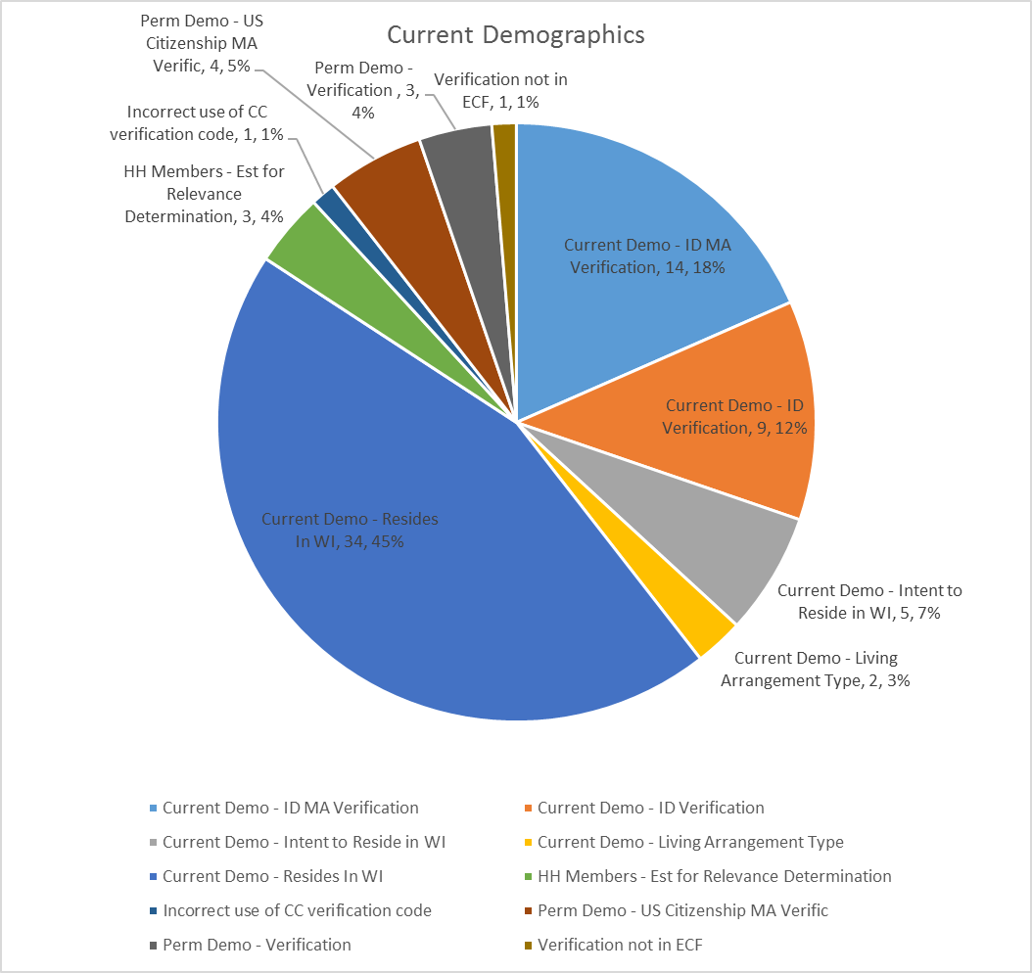

Slide 10
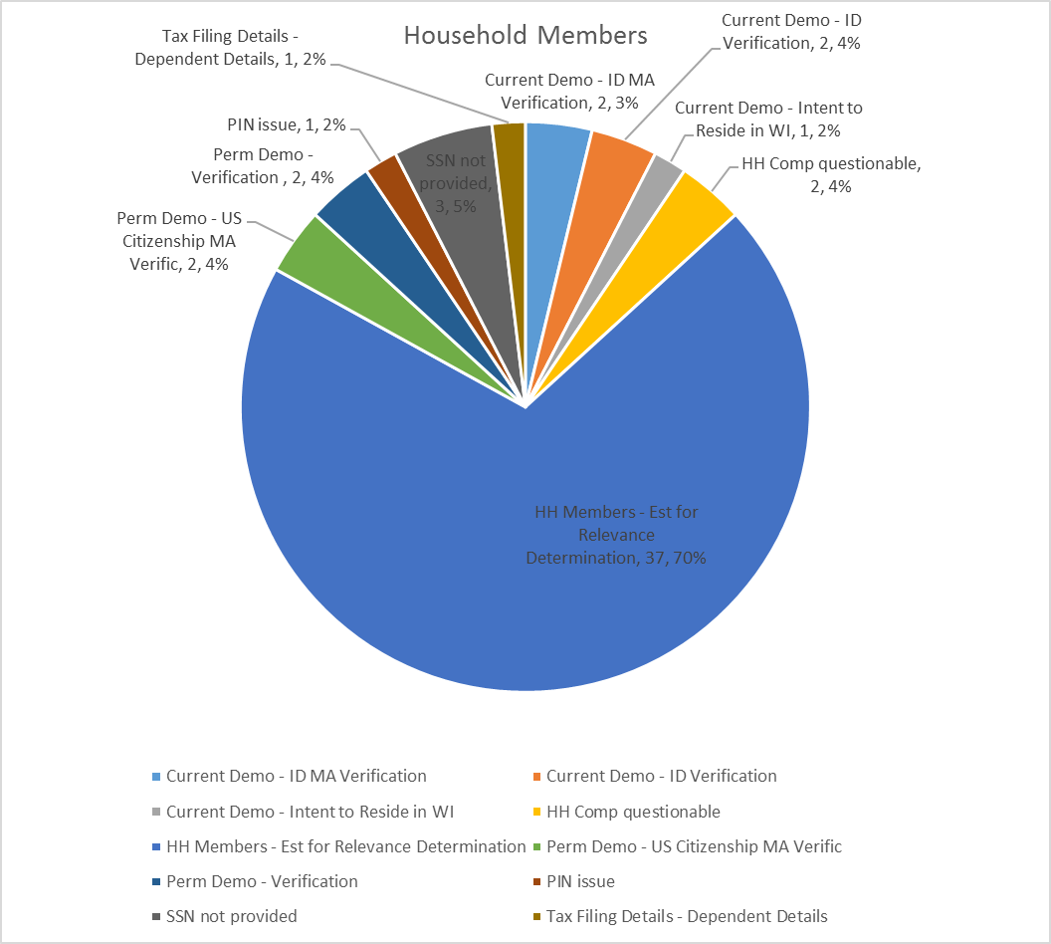

Slide 11
How to prevent CAPERs
Check the electronic case file
Review timeliness
Review all Potential Errors
Review the eligibility run results reason codes
Review all budget pages in detail
Review data exchanges

Slide 12
Check the Electronic Case File
Is there verification in ECF that was moved without being processed?
If verification was requested, did the appropriate notices go out?
Ensure dates for verification are accurate before proceeding with the eligibility determination

Slide 13
Review timeliness
Check due dates for accuracy whenever sending a verification checklist.
Make sure applications are denied on the 30th day from the date of application.

Slide 14
Review all Potential Errors
Each potential error contains a checklist of action items for the IM worker to complete when reviewing the error. Make sure to go through each before resolving the error and proceeding with the eligibility determination.

Slide 15
Review the eligibility run results and reason codes
Are the reason codes correct?
Is the determination result accurate and are the proper denial/termination notices being sent?
Have an expected result in your mind. If you don’t see it, go back and check the case.

Slide 16
Review all budget pages in detail
Is the income being correctly counted?
Are the correct deductions being allowed?

Slide 17
Review Data Exchanges
SOLQ, Birth Query, DMV website, KIDS

Slide 18
QC Plan
Improve accuracy and timelines of benefits to our customers.
Adjust QC activities based on our shared workload model, where multiple workers may touch the same case during periods of application, review, change, etc.
Evaluate effectiveness of training and communication activities.
Analyze QC data from multiple sources.
Communicate QC results to staff.

Slide 19
QC Plan (continued)
Design training and communication to disseminate information and train on appropriate policy and procedure.
Work with Supervisory staff, Lead Workers and ESS to change or implement procedures to improve accuracy.
Work with staff in groups and individually to address case errors.

Slide 20
Who is on the Capital Consortium QC Review Team?
Robyn Johnson
Ed Sheskey
Antonio Esterrich
Michelle Chiuchiolo

Slide 21
Capital Consortium Review Team’s Focus:
Checking cases for completeness, accuracy and timeliness
Inform staff and supervisors regarding QC findings
Monitor cases in which errors have been found to ensure corrective action is taken
Analyze error trends and deviations of agency policy.

Slide 22
Questions?
See Ed or Robyn

