Slide 1
Caretaker Supplement
June 13, 2023

Slide 2
Table of contents
3) Introduction to CTS
5) SSI
6) Non-financial Eligibility
12) The Exception, or Buening
16) Financial Eligibility
17) Income
18) Child Support Intercept
19) Income Tests
21) Begin Dates
23) Issuing Retro Payments
24) ACMP screenshot
25) ACMP instructions
27) Payment Cycle
28) Payments
29) ForwardHealth & CTS
33) State SSI Details
34) Additional Mainframe screens
37) Authorization for Retroactive Payment

Slide 3
Caretaker Supplement, or CTS, is a payment made to parents who receive SSI. The parent, or caretaker, receives money for qualifying children. Prior to W2, SSI parents could receive AFDC for qualifying children. These parents were moved to CTS as AFDC was “sunset.” Initially, EDS (now known as ForwardHealth) processed the program, but it was later decided that Economic Support Specialists should handle it.
Introduction to cts
We will examine the policy in a condensed, need to know basis. The CTS Handbook will always be the arbiter of any policy disputes. We will also discuss the screens in Forward Health that will help you with any questions regarding CTS payments.

Slide 4
Currently, SSI parents receive $275 for the first eligible child, and $165 per child for all others. The payment for these children is added to the recipients State SSI check. Economic Support processes the CTS eligibility, but the checks are paid by Forward Health. It is important to note that the client must be receiving State SSI. If they are not, CTS will not be issued, despite the fact that CARES has found them eligible and issued notices to the client informing them that they are eligible.

Slide 5
State SSI is received by all SSI recipients in Wisconsin. Forward Health receives the information through an interface with Social Security. If the federal SSI closes, the State SSI will also close. It is important to note that we are talking about Supplemental Security Income. Social Security Disability, Retirement, Survivor’s benefits or other Social Security programs do not qualify. We do have recipients who receive a combination of SSI and Social Security who eventually lose their SSI due to COLA (cost of living adjustments) increases. They also lose their CTS after the SSI is ended. There is no grandfather clause.

Slide 6
Non-Financial Eligibility
In a single parent household, the parent must receive SSI to qualify for CTS.
They must also have children of their own in their care.
Any children that receive SSI are not eligible.
If there are two parents in the household, both parents must receive SSI to qualify for CTS as a household. If one parent does not receive SSI, the household is not eligible. There is an exception to this rule which we will discuss later.
Base eligibility is similar to our other programs: they must be a citizen, they must be a Wisconsin resident and they must be cooperating with social security number and child support requirements.
CTS renewals and applications no longer need to sign a paper application. Telephonic signatures are now allowed.

Slide 7
One glitch that we see in addressing CTS questions is that the household relationship screen is not correct.

Slide 8
The “Is filling Parental Role for” question must be yes. CARES does not include a child if that question is left as no. If that question is not answered correctly there is no denial code in the non-financial result to alert you to that fact. The grant will simply not add up correctly. The “Is Caring for” question must also be yes. It is a good practice to answer both of those questions yes for dependent children for all cases.

Slide 9
Another issue that comes up is that of the eighteen year old child. Technically, they are not eligible for CTS unless they are still in high school AND will graduate before their nineteenth birthday. The worker will receive this alert when a CTS child is turning eighteen and we do not have graduation information completed: 094 TURN 18 GRAD AFTER 19 RUN ELIG. If you see that alert on a CTS case, you will need to request verification that the eighteen year old is in school and when they are scheduled to graduate. If you receive verification, enter the expected graduation date and their enrollment status. They will not be eligible if they will not graduate before they turn nineteen or they are not in school. Eligibility also ends for eighteen years once they graduate.

Slide 11
328 6 MONTHS OLD CHILD WITHOUT SSN is another alert that you will see with CTS cases. When you receive this alert, please check KIDS to see if they have the number. You may also want to call the casehead and obtain the information over the phone. If you can not reach the client by phone, send a verification request with a note explaining that we need the child’s number. CARES will remove children without social security numbers from the grant after they turn six months.

Slide 12
The Exception, or Buening As I mentioned earlier, there is an eligibility exception for some CTS cases. It is rooted in a lawsuit involving CTS’s predecessor, AFDC. These exceptions occur in two parent households. The parents are not married. They have a child in common. The child of the non-SSI parent and the child in common make the group ineligible for CTS.

Slide 13
Buening cases occur in two-parent households in which the parents have a child in common and the income of the non-SSI eligible parent and the child in common causes any child(ren) of the SSI parent to be financially ineligible for CTS. See 5.4 Illustrations, Scenarios 12 and 13 for a visual depiction of a Buening case configuration. The ruling states that any half-siblings and their associated parent are to be excluded from the SFU if it is determined that the half-sibling, his/ her full siblings and his/her parent are not needy. To meet the definition of needy, three conditions must be true:

Slide 14
The child of the non-SSI parent is deprived and
The income and assets for the non-SSI parent and child(ren) are below the AFDC eligibility limits and
The child is under the care of a qualified relative
A child is considered deprived when a parent is disabled. If all three conditions are true, the child(ren) in common is considered needy. The whole group is considered one SFU and remains together. If at least one of the three criteria is not met, the child(ren) in common are not considered needy. The child(ren) in common and their non-SSI parent must be excluded from the CTS SFU and financial testing to allow the SSI parent’s child(ren) to be tested for CTS alone.

Slide 15
BUENING SOCIOGRAMS from cts policy handbook 5.4

Slide 16
Financial eligibilIty
Assets
The first rule to remember for CTS financial testing is that all of the SSI recipient(s) income and assets are exempt. The income and assets of the rest of the group are to be considered.
The important thing is to remember to go through the asset questions for a CTS application. We normally do not ask those for family cases.
Also remember that CTS cases need to be monitored for divestment. See the CTS Handbook if you suspect a case of divesting assets.
Members are allowed to have one irrevocable funeral trust and burial plot per applicant/recipient. All other types of irrevocable trusts are not counted. If there is a question regarding the availability of an asset, send it to your corporation counsel.
We do not need to verify assets. If they report assets that would put them over the asset limit, go ahead and close them. We do not need to verify the amount. If the client disputes the amount, tell them to provide verification of the asset amount.

Slide 17
Income
Another point to remember is that child support is not counted for CTS. If the amounts are small enough, it is not an issue. The worker can enter the support and it will not affect the CTS and be counted correctly for other programs.

Slide 18
Child Support Intercept
If an absent parent for a CTS case is paying support, the first 25% will go to the state to reimburse Wisconsin for the CTS paid. The remaining 75% will go to the client. If federal taxes are intercepted for past due support, up to 25% may go to the state. There is a hierarchy for payments received from intercepts, and CTS is down that list a bit.

Slide 19
Income tests
There are two income tests for CTS. The first is a gross income test. The second is a net income test. Clients must pass both to qualify for CTS.
If they pass the first test, they receive a $90 work related expense for each member who is employed or self-employed, a dependent care deduction up to $200 for each child under 2 and $175 for each incapacitated adult or child older than two, an earned disregard of $30, or $30 and 1/3, and child support paid out.
The budget screenshot below shows the case receiving a $50 disregard for child support received. Remember that child support is not counted for CTS.

Slide 21
Begin dates
The first thing to remember with begin dates is that there is no proration of the monthly benefit. Whether the application date, review date or baby add is the last day of the month or the first, the client qualifies for the full benefit for that month.
Reviews will always go back to the first of the month if they complete their review in the month after they’ve closed (close 7/31 for no review, complete the review on 8/31, restarts effective 8/1).
In the previous example, if they complete their review on September 1, they are not eligible for August. Please also remember that CTS reviews are due once per year and that they also receive a grace period of one month.

Slide 22
We can backdate CTS eligibility if their SSI has begun in a month earlier than the current one AND that they had to have an open case going back to that date. If there were breaks in eligibility, we are able to begin their CTS in the month their case reopened.
The worker can also backdate a person add when the birth of a baby is reported on an ongoing case.

Slide 23
Issuing retro payments
Retro payments are issued in five steps.
Ensure in ForwardHealth that client had state SSI.
Run with dates for all desired months.
Complete Mainframe screen ACMP.
Enter case comments.
Complete the “Authorization for Retroactive Caretaker Supplement” form and fax it to ForwardHealth. The number (608/221-0991) is on the form.

Slide 25
ACMP
Enter the primary person number where it says Care-taker. The person name and number at the bottom of the screen.
Type in the payment month and amount.
Add the line numbers for the children that you are issuing the supplement on the Eligible Children line.
Add comments
If you come to this page and there is a screen com-pleted for a prior month, hit F16 (shift F4) to create a new screen.

Slide 26
Please do not attempt to expedite a payment by issuing the retro form. Do not tell the client you can do so. If it was confirmed in CARES without running with dates, it will be issued in the normal cycle. If you send the form, ForwardHealth will reject it.

Slide 27
payment cycle
All CTS approved after the second date until Adverse Action will be issued on the first of the month following adverse action.
Adverse
Action
CTS approved in the week between Adverse Action and one week later will be issued in the month following the next month.
One week after adverseaction

Slide 28
payments
All CTS payments are issued by Forward Health. The payment is attached to their State SSI payment.
If they are not receiving State SSI in a given month, they will not receive CTS for that month.
If you confirm CTS for a month in which the client does not have State SSI, a notice will be sent from CARES but the client will not receive a check.

Slide 29
Forwardhealth & cts
CTS and State SSI payments may be found in ForwardHealth.
To do so, select iC funtionality and then member search. You can use the client’s MAID from CARES.
The SSI payment history normally appears under the customer’s information.

Slide 30
Click the search key. You do not need to enter anything in the Financial Cycle Date nor the Benefit month fields.

Slide 31
This is what you will see after the search is done.
Note the status: C01 is paid. N01 is a non-pay status.
If you click on the Financial Number, you may obtain details about the payment, shown in the next slide.

Slide 32
This is the SSI Payment detail screen.
Payment type shows that is an EFT.
This shot is from the third line of the prior screen. It shows that $40 is being recouped from her CTS for an overpayment.
EFTS will always show as cashed.
Paper checks will tell show cashed or not.

Slide 33
STATE SSI DETAILS
The address information for the casehead comes from SSI.
If a client reports a new address to us, and is on CTS, please remind them to call Social Security.
When a client moves from another state, they must report their address to Social Security. This will start the process for State SSI. We can not do anything about it.
Please remember that State SSI is a Wisconsin program. Federal Social Security doesn’t know anything about it.
Do not have the client call Social Security for State SSI or CTS check issues. They should call ForwardHealth (1-800/362-3002) and ask for the STATE SSI unit

Slide 34
CTS Mainframe Screens
Two screens exist in the Mainframe to help you determine pending payments.
One is for current payments: CPRG
One is for retroactive payments: CPRB

Slide 35
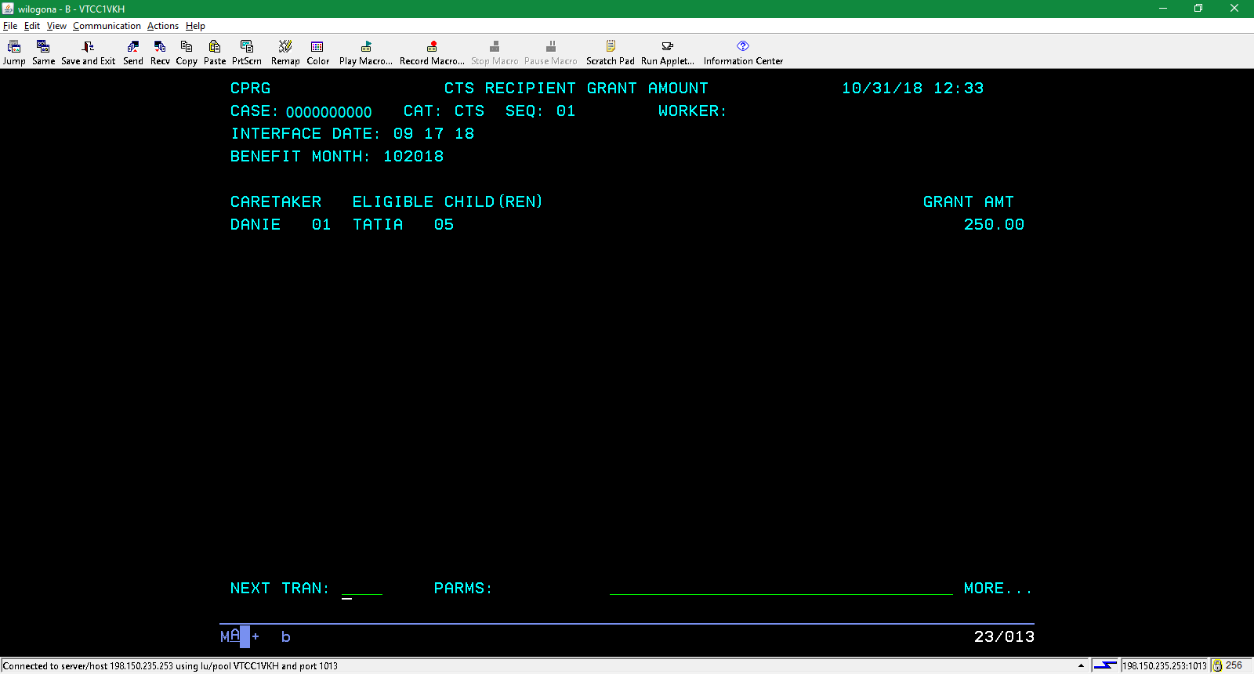

Slide 36
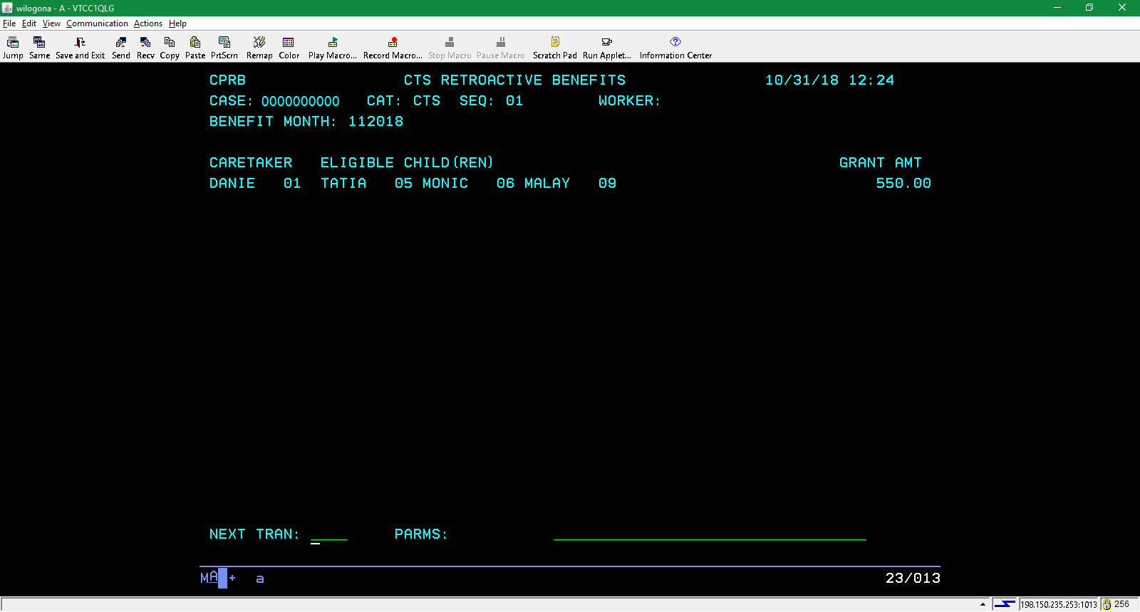

Slide 37
This form is available in the State Forms repository.
Don’t forget to complete mainframe screen ACMP when you do this form.
You will need to complete one line per month per child for the backdated payment.
The fax number is near the top of the page.
Your supervisor and you must sign.

Slide 38
Why now?
Effective June 24, the state will be attempting to increase CTS enrollment.
Telephonic signatures allowed!!!
CTS request will added to the ACCESS application. It will display when the application is for FS or medical, there is a primary caretaker, there is a parent and at least one parent is receiving SSI.
The ACCESS summary will have new language regarding CTS.
The request will follow health care filing date rules.

Slide 39
The inbox will include CTS requests.
Certain assets will pend on the Asset Gatepost page if not currently populated.
CARES will identify potentially eligible CTS cases and a yellow banner will display, reminding workers to ask about CTS.
A line for CTS will be added to the signature page. Prompts will include CTS language.
A letter will be issued to potentially eligible CTS households advising them to to apply. This will run every month but a letter will be sent to each case once per year.

