Slide 1
FOSTER CARE
AND
KINSHIP CARE
WISCONSIN SHARES

Slide 2
Wisconsin Shares Child Care does not allow Categorical Eligibility for any groups of family types.
Foster care, Subsidized Guardians, Interim Caretakers, Tribal Placements, and Relatives with Court-Ordered Placement who receive the Kinship Care payment must all complete the same eligibility determination process including verification of approved activity just as all other families are required to do.
Notes:
Discuss that they do not need to verify their income .

Slide 3
Out of Home Placements
Foster Care or Subsidized Guardians
Court Ordered Kinship
Non-Court Ordered Kinship
Foster Care children do not have a Wisconsin Shares copay. (They still may have a parent share.)
Financial eligibility is based on the biological/adoptive parents’ income at the time of removal.
Natural Parents Income is verbally obtained from CPS.
Children with a Court Ordered Placement AND receive a Kinship Payment do not have a Wisconsin Shares copay. (They still may have a parent share.)
Financial eligibility is based on the biological/adoptive parents’ income at the time of removal. This is obtained verbally from CPS.
Children with Court Ordered Placement and do NOT receive a Kinship Payment, Financial eligibility is based on the Kinship Family’s income and will have a minimal Wisconsin Shares copay.
Children that do not have a Court Ordered Placement will have a minimal Wisconsin Shares copay.
Financial eligibility is based on the Kinship Family’s household income, regardless of whether they receive a Kinship Payment.

Slide 4
Not all Foster Care homes are licensed by local County Human Services.
Some are licensed by private agencies, such as Lutheran Social Services, Catholic Charities’ or Children’s Hospital.
Worker should contact the child placing agency for the natural parent's income and placement information.
Ask them for name of their social worker and worker will email social worker to get verification of the FC/KC placement and natural parent’s information.

Slide 5
Eligibility

Slide 6
Mandatory Verification Items for
Wisconsin Shares
Identity for all parents in the assistance group
Date of birth verification for the entire assistance group
Citizenship or qualified immigration status for children which Wisconsin Shares is requested for
Social Security number or proof of an application for all children which Wisconsin Shares is requested for
Wisconsin Residency and Residence (home address)
Approved Activity participation of all parents in the assistance group
Foster/Kinship Care child’s birth/adoptive family income at time of placement
Foster/Kinship Care Placement
Kinship Payment

Slide 7
Exemptions to Cooperating with the Child Support Agency
Foster Parents, Relatives or Non-Relative adults caring for a child are not required to cooperate with the Child Support Agency for a child that is not their biological or adopted child.
Do not refer to Child Support on the Absent Parent page in CWW

Slide 8

Asset Testing
Foster Parents, Subsidized Guardians, Interim Caretakers, Relatives with Court-Ordered Placement who receive Kinship Care payment, and children in tribal placement homes under a substantially similar Wisconsin tribal law, are not subject to the asset test.
If Wisconsin Shares Child Care subsidy is needed for any of their biological children, the asset test will be part of the eligibility determination.

Slide 9
Financial Eligibility

Slide 10
Financial Eligibility
Financial eligibility for Foster families, Subsidized Guardians, Interim Caretakers, and Relatives with Court-Order Placement who receive a Kinship Care Payment is first based on the natural parent’s income, which is tested at 200% of the Federal Poverty Level (FPL);
If the natural parent income exceeds that limit, financial eligibility is then based on the caretaker household income and is tested at 185% FPL.

Slide 11
Financial Eligibility Exception
Parents requesting Wisconsin Shares Child Care do not need to provide verification of their earnings if they are requesting care for only out-of-home care placement children.
Workers must obtain the biological or adoptive parent income and family size at the time the child was removed from the home. This information is available from Child Protective Services (CPS) or placement agency.
If the CPS worker is unable to provide the biological or adoptive parents’ income and AG size, the child shall be considered financially eligible.

Slide 12
This Financial Eligibility determination and
Verification Process is separate from the
requirement that all parents Must Verify
Participation in an Approved Activity as stated
in Section 1.7.

Slide 13
Non-Financial Eligibility

Slide 14
Non-Financial
Identity for all parents in the assistance group
Date of birth verification for the entire assistance group
Citizenship or qualified immigration status for children which Wisconsin Shares is requested for
Social Security number or proof of an application for all children which Wisconsin Shares is requested for
Wisconsin Residency and Residence (address)
Approved activity participation of all parents in the assistance group.
Foster /Kinship Care Placement
Receipt of Kinship payment

Slide 15
Verifying Child Placement
Any out of home placement of a child must be verified with the court order or temporary CPS placement paperwork
This does not apply to adults acting in place of a parent and/or those without a court ordered placement.
Verification supports the type of eligibility determination that will be used and any special policies for which the family may be eligible.
Court Orders from states other than Wisconsin are acceptable.
Letter from CPS agency must contain: name and address of placement parent, name and date of birth of child, date placement began, end date of placement (if applicable), name and telephone number of case worker, and date the letter was completed.
DCF Form DCF-F-5190-E.

Slide 16
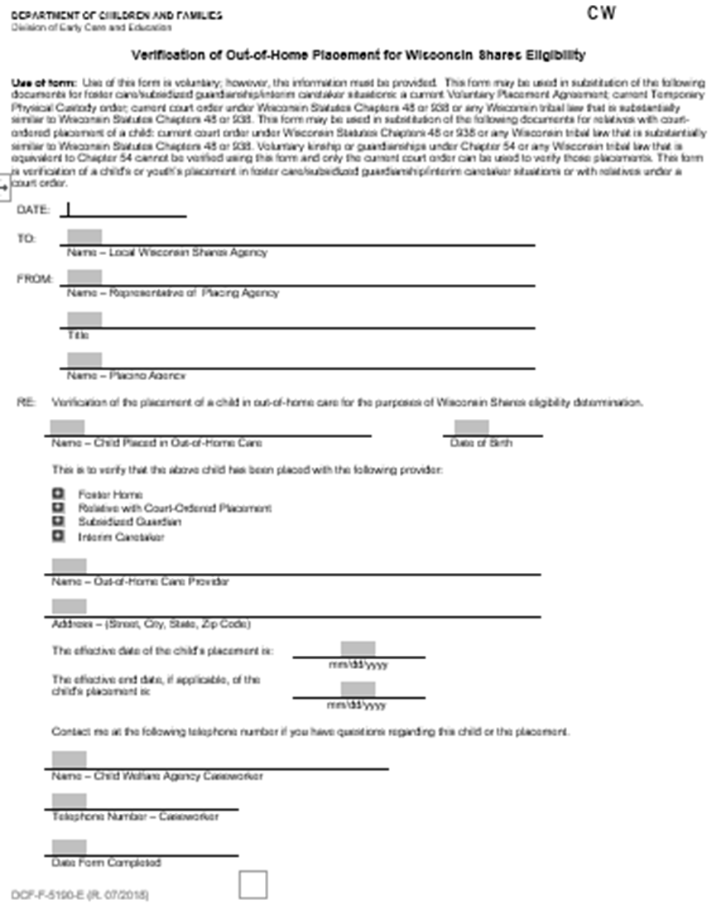

Slide 17

To verify Employment or Self Employment as an Approved Activity
Paystubs
an EVFE
FDSH(with parents verbal approval)
Tax Returns
SEIRF’S (in limited circumstances)

Slide 18
Coding Foster Care and
Kinship Care
Correctly in CWW

Slide 19
The following CWW pages are used in Child Placement situations.
Entries on these pages affect eligibility determination:
Household Relationship
Benefits Received
Manual Child Care Eligibility
The Kinship and Foster Care questions must be answered correctly on the Benefits Received page in CWW in order for CWW to determine financial eligibility correctly and to assign the correct copay type in CSAW.

Slide 20
Household Relationships
The AG is determined by how members of the household are related to each other and to the applicant or by who is caring for or filling a parental role of a child.
If entries are not correct, the AG is not determined correctly.
Reminders for this page for ALL child placements:
  Correctly identifying who is filling a parental role of a child is crucial in correctly determining the correct assistance group for a child placement case.
  Foster parents, Relatives, subsidized guardians, and interim caretakers must be indicated as <Filling Parental Role>.

Slide 21
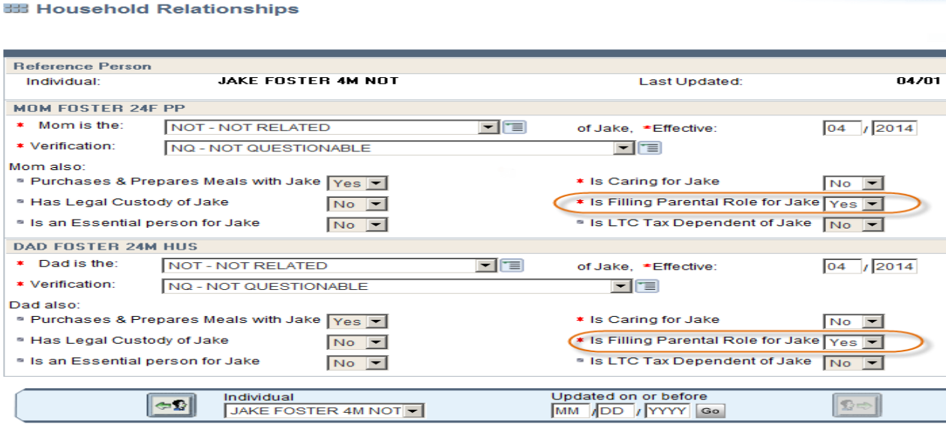
FOSTER CARE
Select: NOT- Not Related – to indicate the relationship (unless they are related)
Select: YES- For Filling the Parental Role

Slide 22
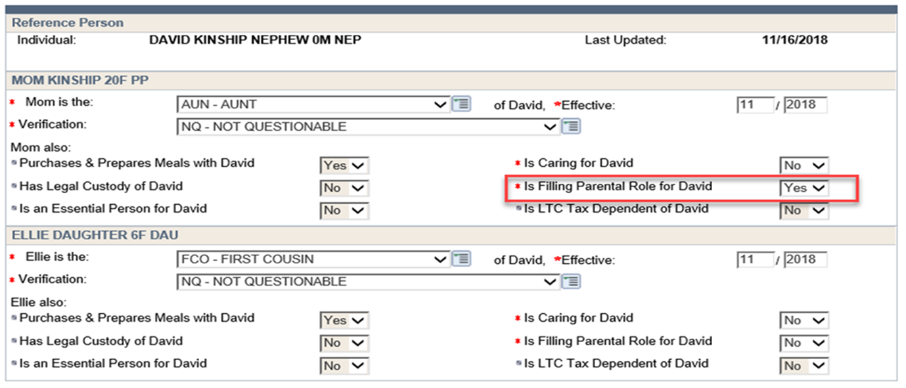
KINSHIP CARE
Indicate how the Kinship Parent is related to the child
Select: YES- For Filling the Parental Role

Slide 23
BENEFITS RECEIVED PAGE
Entries on this page are very important!
The Kinship and Foster Care questions must be answered correctly on the Benefits Received page in CWW in order for CWW to determine financial eligibility correctly and to assign the correct copay type in CSAW.
Verification of a court order and kinship payment affect how eligibility is determined and the subsidy amount.
CWW does not currently pend or fail for verification of placement
Only indicate kinship or foster information for the child who has the relationship.
Kinship Care payment must be verified if received.
The Manual Child Care eligibility page is triggered and the biological parent’s income is tested at 200% FPL when:
YES is entered for foster/guardianship and foster court order; or
YES is entered for Kinship Relationship, Kinship Court Order, and Kinship Payment

Slide 24
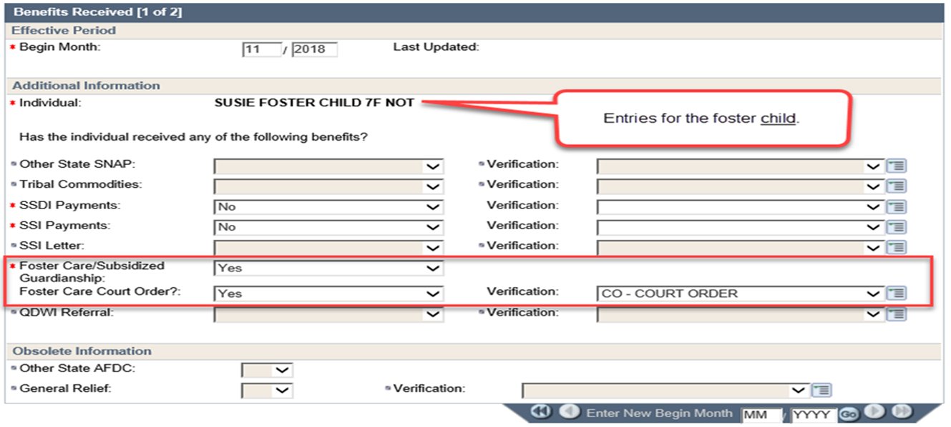
Benefits Received (1 of 2): Foster Care
Foster Care children do not have a Wisconsin Shares copay and financial eligibility is based on the biological/adoptive parents’ income at the time of removal.

Slide 25
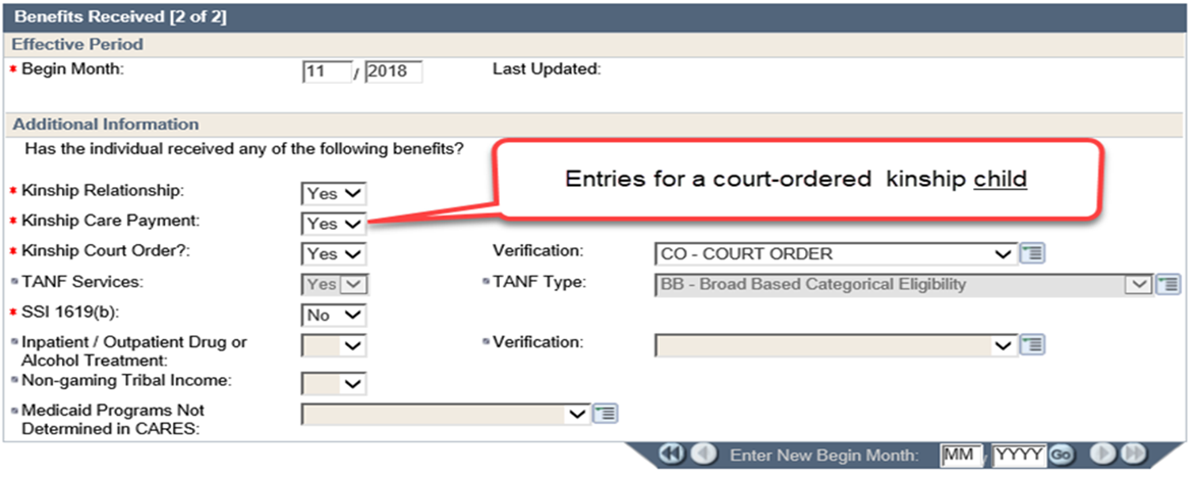
Benefits Received (2 of 2): Kinship Care
Court Ordered Kinship children
Children with a Court Ordered Kinship Placement and receives a Kinship Payment do not have a Wisconsin shares copay and their income is based on the natural parents income at the time of removal.

Slide 26
Court order Kinship Children and No Kinship Payment
Children with a Court Ordered Kinship Placement and do not receive a Kinship Payment will have a minimal Wisconsin shares copay and their income is based on the Kinship Relative's household income.
No Kinship Care Payment
No

Slide 27
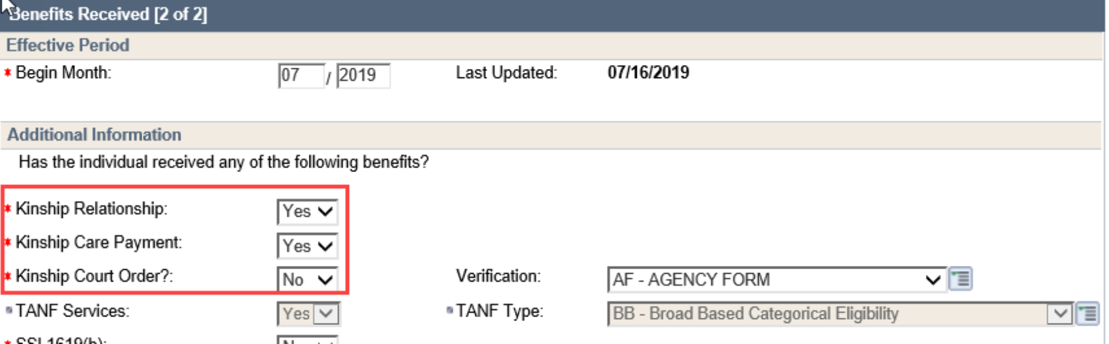
Non-Court Ordered
Kinship children
Children that do not have a Court-Ordered placement do have a minimal copay and their financial eligibility is based on the Kinship Family’s household income, regardless of whether they are receiving the Kinship Care Payment

Slide 28
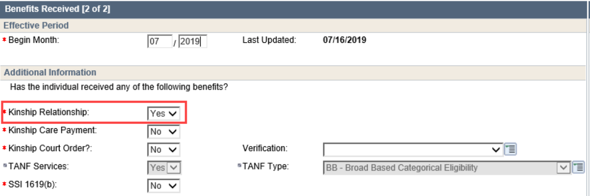
Non-Court Ordered
Kinship children continued
Children that do not have a Court-Ordered placement do have a minimal copay and their financial eligibility is based on the Kinship Family’s household income

Slide 29
Out of Home Placement of a child must be verified with the Court Order or temporary CPS placement paperwork
This does not apply to adults acting in place of a parent and/or those without a Court Ordered placement.
Pending for Child Placement
CWW will not pend the case if <? – Not Yet Verified> is entered for the Foster Care/Kinship Court Order.
Work around: On the General Case Information page, enter <? – Not Yet Verified> under Household Composition.
Add comments to the Verification Check List detailing the verification required.

Slide 30
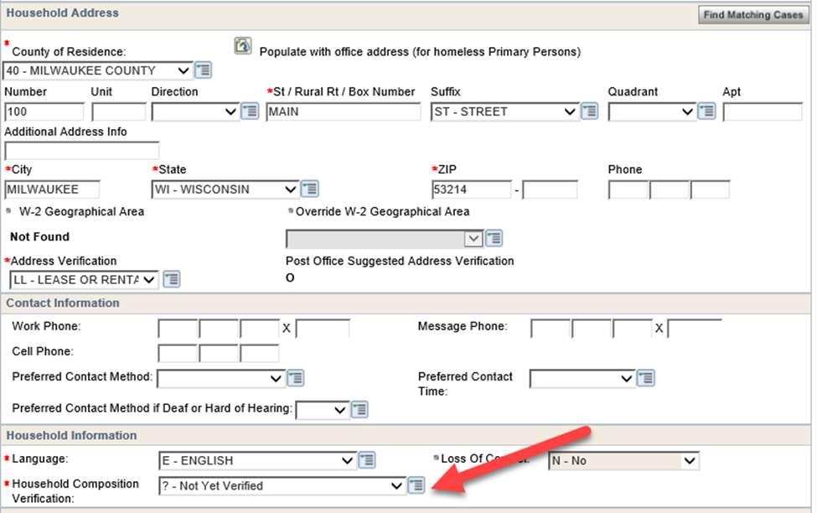

Slide 31
Manual Child Care Eligibility
Income must be verified for the biological/adoptive parent.
The biological/adoptive parent’s income can be obtained through CPS if the child is placed through the local agency.
If the child is placed through a private entity, the ESS worker should contact the placement parent’s social worker to obtain the information.
This is the household income at the time the child was removed from the home.

Slide 32
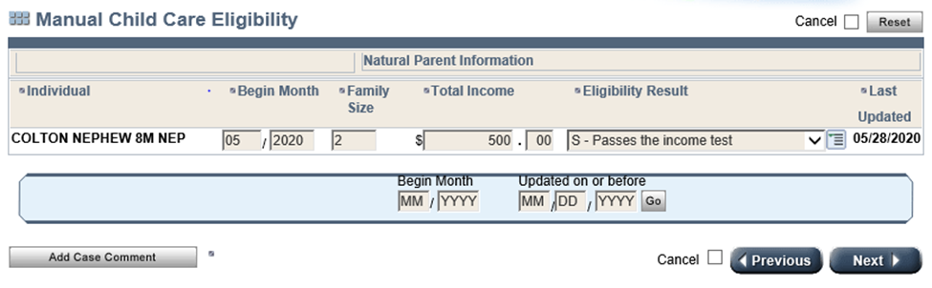
Manual Child Care
Eligibility Page
NOTE: When a passing code is selected the case will pass regardless of the income entered in the income field
Application Month
Biological family size just before child was removed
Monthly Income of biological parents just before child removed. Verifiable through CPS or social worker
Use the Income Limits listed in the CC Handbook 1.7.1 to manually determine eligibility against 200% FPL for family size

Slide 33
Manual Child Care Eligibility Page Process
If the CPS worker involved in the child’s case is able to provide the biological or adoptive parents’ income and AG size, the agency worker must enter the information on the Manual Eligibility page in CWW.
The agency worker must manually determine the FPL based on the income amount and AG size.
If income is 200%FPL or less, the worker must enter “S – Passes the income test” as the Eligibility Result.
If the income is more than 200% FPL, the agency worker must enter “F – Fails the income test” as the Eligibility Result. Eligibility is then systematically tested against the caregiver household income at 185% FPL.
If the caregivers’ household income exceeds 185% FPL, there is no eligibility for Wisconsin Shares Child Care subsidy.
If the CPS worker is unable to provide the biological or adoptive parents’ income and AG size, the agency worker must leave the Family Size and Total Income fields blank and enter “S – Passes the income test” as the Eligibility Result. The agency worker must enter a Case Comment that the CPS worker was unable to provide the information.

Slide 34
Reminders !
When a child is adopted or no longer placed in the home, entries on the Household Relationships and Benefits Received pages must be changed.
The Manual Eligibility page must be updated to
<N-No longer a Court-Ordered Kinship or Foster Care child> and then the case will no longer pass under Manual Eligibility.
If the child was adopted, then the case will be subjected to the 185%FPL income test like an application--this is the case if they were not under 185% when they originally applied (based on caregiver's income); if the FC/KC parent's income was under 185% when they applied, then it tests them at 85% SMI
Notes:
Reminder that this page follows the child so if the page is not updated, if the child returns home could create an error on that case

Slide 35
KINSHIP CARE REMINDERS
For the purpose of Wisconsin Shares policy, approval to receive the Kinship Care payment qualifies as receiving the Kinship Care payment.
Being on the Kinship Care payment wait-list does not qualify as receipt of a Kinship Care payment.
Proof of Kinship Care approval may be provided by written confirmation or collateral contact with the Kinship Care Coordinator.
Note that the confirmation must state that the Kinship Care payment has been approved. Stating that the family will probably receive the Kinship Care payment does not qualify as approval to receive a Kinship Care payment.
If the agency worker verifies this information through collateral contact, the agency worker must enter a case comment that includes the following: the name and title of the individual that the agency worker spoke to, the date and time of the conversation, and whether or not the family has been approved to receive the Kinship Care payment.

Slide 36
Child Care Budget and Results Pages
The Child Care Budget page displays the income for the assistance group. Normally, CSAW will use this page to calculate copayment, but in the case of foster and court-ordered placements, the copay is zero.
Use the Child Care Budget page to double-check that financial eligibility is being calculated correctly, using the current household income for the Non-Court Ordered placement cases.

Slide 37
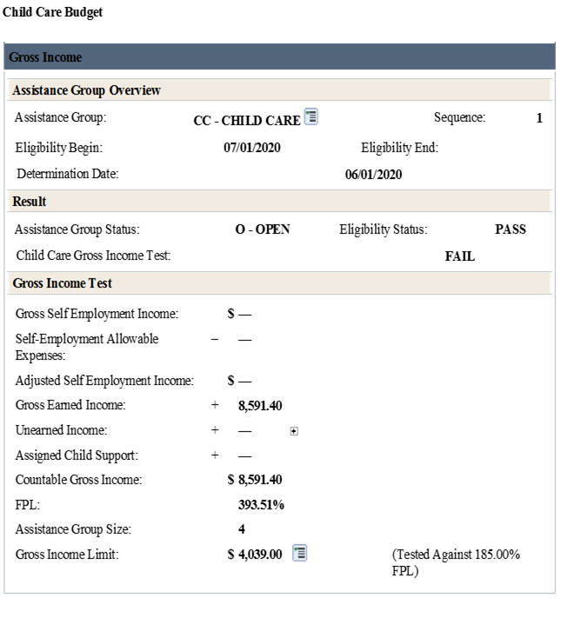
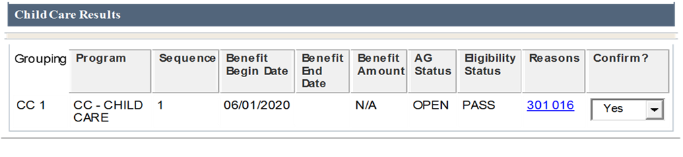
Child Care Budget and
Results Pages
Verify that the Eligibility Status is PASS. Also, check that the AG size is accurate and includes the placement parent(s) and placement child(ren).

Slide 38
Note that if the Foster Care/Court-Ordered placement with Kinship Payment placement parents’ income is less than 185% of the gross income limit, then the case will show as regular Wisconsin Shares.
Foster Care/Court-Ordered placement with Kinship Payment cases should show reason codes 301 and 016.
Code 301-that the AG failed. Manual Child Care Eligibility for KC/FC children
Code 016- Income exceeds the gross income limit

Slide 39
CSAW will automatically select the Copay Type based on the entries on the Benefits Received page in CWW.

Slide 40
If the incorrect copayment type is assigned, the Benefits Received page will need to be updated in CWW and eligibility will need to be run and confirmed again in order for CSAW to pick up the new copayment type.

Slide 41
SELF EMPLOYMENT
AND
AUTHORIZED HOURS
Foster Care parents, Subsidized Guardians, Interim Caretakers, and relatives with court-ordered placement receiving Kinship Care payment are not subject to the authorization limits described in Section 2.4.3.6 for the children placed in these homes. Justification for authorized hours must be documented in CSAW comments.
The authorization limits for self-employment continue to apply to authorizations for the biological or adopted children in these families.

Slide 42

KNOWN WORK AROUNDS
IN CWW

Slide 43
FOSTERCARE OR KINSHIP CARE PLACEMENT
NATURAL PARENT’S INCOME
INCOME
KINSHIP PAYMENT

Slide 44
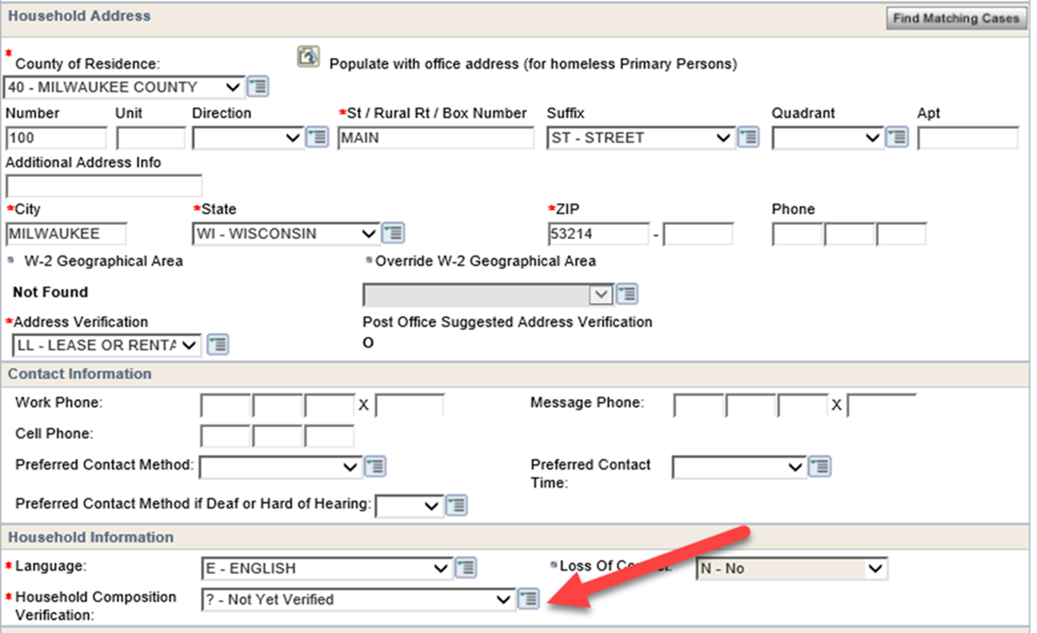
Foster Care/Kinship Placement
The Benefits Received page under the child’s name will not pend for this.
Worker will need to enter ? on the General Case Info page under the Household Composition and write comments on the Verification Check List detailing what verification is required.

Slide 45
Natural Parents Income
On Manual CC Eligibility Screen enter the natural parent’s family size, income and Eligibility Result--- Pass if lower than 200%FPL or Fail if income is above 200%FPL
Remember to ask the placement parent for their social worker contact information, worker is suppose to assist in getting this information
There is not a place to pend for income on the Manual Child Care Eligibility page.
On the General Case Information page, enter <? – Not Yet Verified> under Household Composition.
Enter comments on the Verification Check List detailing what verification is required.
When verification is received, update the Manual CC Eligibility page

Slide 46
Income
ERRORS ON THE HOUSEHOLD RELATIONSHIP PAGES COULD CAUSE A CASE TO FAIL INCORRECTLY FOR OVER INCOME
Some cases might fail for over income if the correct income is entered on the EI page if there are other errors on other pages.
When several items on the case are pending and CWW can’t determine what type of case it is yet

Slide 47
Kinship Payment
CWW will not pend the case if a ? Is entered on an Unearned Income Page and/or on the Benefits Received Page.
On the General Case Information page, enter <? – Not Yet Verified> under Household Composition.
Add comments to the Verification Check List detailing the verification required.
Email Sarah Kasel in the Kinship Unit Sarah Kasel@countyofdane.com to get the required verification

Slide 48
Out of Home Placements and
Other Benefits

Slide 49

FoodShare
If Foster parent is applying for Food Share, it is up to them if they want their foster child in the FS group, if they do then the Foster Care Income is budgeted.
If a Kinship Care parent is applying for Food Share then everyone in the household is in the FS group. Process it as normal.

Slide 50
FOOD SHARE case where the FOSTER child is not in the FoodShare assistance group
ON FOODSHARE REQUEST PAGE ENTER <NO> UNDER THE
CHILD’S NAME

Slide 51
Both pages need to be updated in order to not include the foster child in the AG
ON HOUSEHOLD RELATIONSHIP PAGE MARK <NO> TO PURCHASES AND PREPARES MEALS

Slide 52

BADGERCARE PLUS
Children or youth placed into any of the following placements are Categorically eligible for Foster Care Medicaid:
  Foster Care
  Subsidized guardianship
  Court-ordered Kinship Care
Eligibility determinations for Foster Care Medicaid are not the responsibility of the IM income maintenance agency
Child welfare agencies determine eligibility for Foster Care Medicaid when a child has been removed from the home and enters an out-of-home care placement
Caretakers may apply for health care for themselves
Non Court-ordered Kinship care cases will need to apply for BC for the child(ren)

Slide 53
RECAP OF WHAT
WE LEARNED

Slide 54
Foster, Subsidized Guardianship, and Interim Caretaker
Verify child placement
Faxed CC application form from CPS can be used. The date received determines the RFA date, not the date signed by the foster parent
Not required to Cooperate with the Child Support Agency
Allowable to take up to 30 days to provide verification
Copay Type: FOS
Self-declared need for ongoing self-employment authorized hours
Not subject to the Asset Test
CWW Entries
HH Relationships:
  Enter Not - Not Related or actual relationship if applicable
  Enter Yes for Filling Parental Role
Benefits Received:
  Foster Care/Subsidized Guardianship: Yes
  Foster Care Court Order: Yes
Manual CC Eligibility:
Enter biological/adoptive parent's income and family size just before child was removed. Manually Test income at 200% FPL.

Slide 55
Court-Ordered Placement with Kinship Payment
Verify child placement
Verify Kinship payment
Faxed CC Application form from CPS can be used. The date received determines the RFA date, not the date signed by the placement parent
Not required to Cooperate with the Child Support Agency
Authorization can backdate to first of RFA month
Copay Type: KIN
Self-declared need for ongoing self-employment authorized hours
Not subject to the Asset Test
CWW Entries
HH Relationships:
  Enter actual relationship
  Enter Yes for Filling Parental Role
Benefits Received:
  Kinship Relationship: Yes
  Kinship Payment: Yes
  Kinship Court Order: Yes
Manual CC Eligibility: Enter biological/adoptive parent's income and family size just before child was removed. Manually Test income at 200%FPL

Slide 56
Court-Ordered Placement,
No kinship Payment
Verify child placement
Faxed CC Application form from CPS can determine the RFA date, not the date signed by the placement parent
Not required to Cooperate with the Child Support Agency
Copay Type: KIN
Subject to the Asset Test
Subject to the Net Income limit test for ongoing
self-employment
Financial eligibility is determined by the Kinship Relative’s household income
CWW Entries
HH Relationships:
  Enter actual relationship
  Enter Yes for Filling Parental Role
Benefits Received:
  Kinship Relationship: Yes
  Kinship Care Payment: No
  Kinship Court Order: Yes

Slide 57
Non-Court-Ordered Placement
(with or without kinship Payment)
Copay Type: NCK
Not required to Cooperate with the Child Support Agency
Subject to the Asset Test
Subject to Net income limit policy for ongoing self-employment
Financial eligibility is determined by the Kinship Relative’s household income
CWW Entries
HH Relationships:
  Enter actual relationship
  Enter Yes for Filling Parental Role
Benefits Received:
  Kinship Relationship: Yes
  Kinship Care Payment: Yes or No
  Kinship Court Order: No

Slide 58

QUESTIONS

