Slide 1
Customer Service

Slide 2
Our Customers: Who are They?
IM clients on the phone
IM clients at the front desk
Co-workers
Consortium Partners
Supervisors
Managers
Directors
FNS, DHS, DCF

Slide 3
Things to Consider
Each customer and their current situation is unique; avoid making assumptions or stereotyping
Frustration with their current situation and
may impact how they interact
with you
Difficult or embarrassing
to talk about their situation
or ask for help

Slide 4
Customer Service Tips
Friendly greeting and appropriate closing
Full attention to customer; acknowledge and explain
Focus on pertinent information and relevant questions
Use a calm tone of voice and speak in a professional manner
Actions and expressions should portray that you care about helping
Avoid acronyms or terms customers are not familiar with

Slide 5
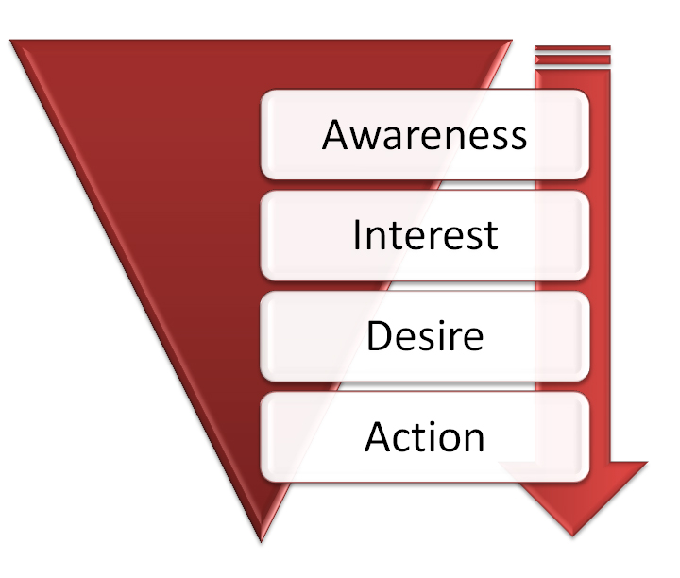
Customer Service Tips
Ask and Listen
“How can I help you?”
“Just so I understand, you are saying…”
“I understand you are frustrated”
“I really want to help you, so let’s see what we can do”

Slide 6
Customer Service Tips
Apologize and Empathize
“I’m sorry that you were not given that information”
“I’m sorry the issue has not been resolved for you, but let’s try to take care of that today”

Slide 7
Resolution
Let the customer know that you want to help and solve the problem
Be honest if you cannot solve it
“I will check with my Lead/Supervisor and call you back”

Slide 8
Customer Service TIPS
Appropriate Closing
“Do you have any other questions, or is there anything else I can help you with”
“Thank you for contacting us with this information”

Slide 9
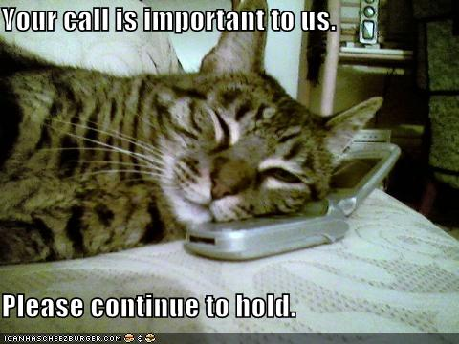
Telephone Tips
Introduce yourself and the agency
Explain why if you need to
transfer a customer
Avoid holds if possible
Use hold button in CCA if
needed so the customer
will hear music

Slide 10
Telephone Tips
Check back with a customer on hold within two minutes
Apologize and thank the customer for holding
Ask the customer if they prefer a call back
If a call is dropped, attempt to call back

Slide 11
Working with Difficult Customers
Remain calm when the customer is angry and speaking loudly or yelling
Explain that you are there to help and that your main goal is to solve the problem
Actively listen and engage the customer: give them time to explain the issue or concern without being interrupted

Slide 12
Working with difficult customers
Show empathy, apologize when appropriate
Keep the conversation focused on the issue at hand
Focus on what you can do for the customer, not what cannot be done
If you cannot completely resolve their issue, search for and offer alternatives

Slide 13
Try to De-escalate
Voice and body language
Lower your voice instead of raising it when the customer is getting upset
Be aware of your facial expressions
Do not show the customer that you are getting impatient or frustrated
Stay engaged and explain again if necessary

Slide 14
Empathize but remain appropriate
Keep the conversation about the customer, not yourself
Be careful about sharing personal information
Avoid telling the customer about something similar you went through; they should feel like the focus is on helping with their situation

Slide 15
Your most unhappy customers are your greatest source of learning

Slide 17
Avoiding escalation is easier than trying to de-escalate after the customer has become upset
Using techniques that will prevent escalation will make the workplace safer for you and all of your customers

Slide 18
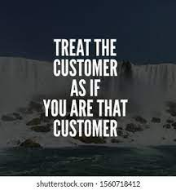
Try to avoid the escalation completely
Listen carefully
Put yourself in their shoes
Refer to correct person or resource the first time
First Contact Resolution to avoid multiple
calls or interactions that may lead
to frustration
Look for signs or clues that things
may escalate and take action to avoid
that escalation

Slide 19
Take control to create a good experience
Discuss notices, verification items required, and due dates
Make sure the customer
is clear on what actions
they need to take and
what they need to provide

Slide 20
Take control to create a good experience
Enter case comments: what was done, what is still needed, other relevant information
Follow through and give an estimated time of resolution or when you will call them back if needed

Slide 21
Breaking the Cycle
Social media causing less personal interaction time
The lost art of customer service
Challenge yourselves to break that cycle and make good customer service a priority
Commit as an individual
worker, so we can
commit as
a consortium community

Slide 22
Customer Service with Co-workers
Be mindful of how you are talking to and interacting with co-workers
Provide a foundation for stronger relationships
Work culture that people value and want to uphold
Connections with one another develop stronger ties to work
Higher levels of motivation and morale
Trust and a collaborative spirit, rather than negativity
***Teamwork makes the dream work***

Slide 23
Effects of the pandemic
Remember that the COVID-19 pandemic has had a negative impact on many of our customers
Economic and Social Disruption
Trauma and Post-Traumatic Stress Symptoms
Fear and Confusion
Anger and Anxiety
Substance Abuse
These hardships may affect how customers react to and interact with us

Slide 24
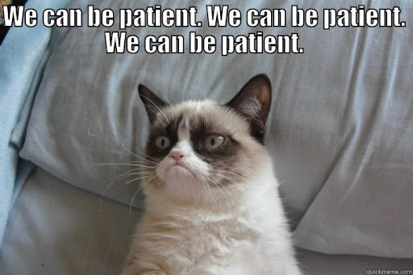
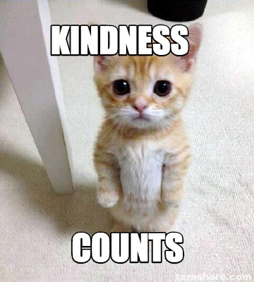
You can make a difference!

Slide 25
how has the pandemic affected you?
Are you having anxiety?
Feelings of uncertainty?
Constant concern about the health of friends or family members?
Concern about your own health, especially coming into work?
Be mindful of how this may be affecting the customer service you provide

Slide 26
Covid Fatigue: When will this be over??
Frustration over moving toward return to normalcy, then going backwards again
We do this work to help people and make a difference
Make a conscious decision about your attitude when facing each work day
Focus on still providing that high level of customer service

Slide 27
Take care of yourself!
Practice Self-Care
Being aware of your own physical and mental health will allow you to provide better customer service, not only to our clients, but with other team members
Use resources available to you:
*Employee Assistance Program (EAP) in partnership with FEI
800-236-7905 http://www.feieap.com/
*EAP available for Dane Co. employees who have disability insurance
https://admin.countyofdane.com/documents/PDFs/Insurance/Disability/EmployeeAssistance-Flyer.pdf
*Consortium Partner Resources
*Contact your healthcare provider

Slide 28
Customer Service
“I’ve learned that people will forget what you said, people will forget what you did, but people will never forget how you made them feel”
~~ Maya Angelou

Slide 29
Questions or Comments?

