Slide 1
Error Prone Profile
Presented by Paul Unger, Lead Worker
June 2021

Slide 2
POTENTIAL ERROR Listing and Error prone profiles
Operations Memo 14-38 was issued On September 15, 2014
An automated process was added to CARES to help identify potential benefit errors to help reduce fraud, client and non-client error.

Slide 3
Counties will continue to be required to maintain error-prone profiles.
These documents are intended to identify areas in which the individual counties feel that there is the potential for incorrect issuance of benefits
All workers should be informed of their county’s error prone profile during their training process. If you are not familiar with your local error prone profile, talk to your supervisor or fraud department.

Slide 4
Error Prone Profile from Capital Fraud/OP Referral form

Slide 5
The goals of the Error Prone Profile
Profiles should:
Catch the most egregious and frequent errors
Utilize information available in CWW Profiles that may prevent intentional (fraud) or unintentional errors by customers or workers
Be meaningful to IM workers and not result in a large number of false positives

Slide 6
*See Process Help Manual 70.1.1.
Potential errors in CARES will display when running eligibility. The Eligibility Run Results screen will have this header at the top of the screen:

Slide 7
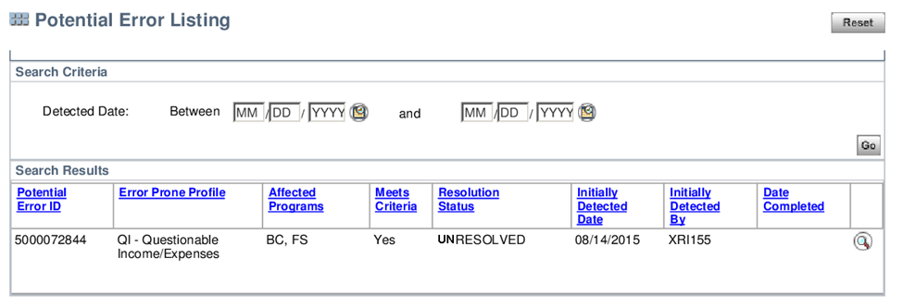
Clicking on the magnifying glass on the right of the screen will take you to the Potential Errors Detail screen. One may also access that screen from the Potential Error Listing screen in the same way:
Once you click on the magnifying glass you will see:

Slide 8
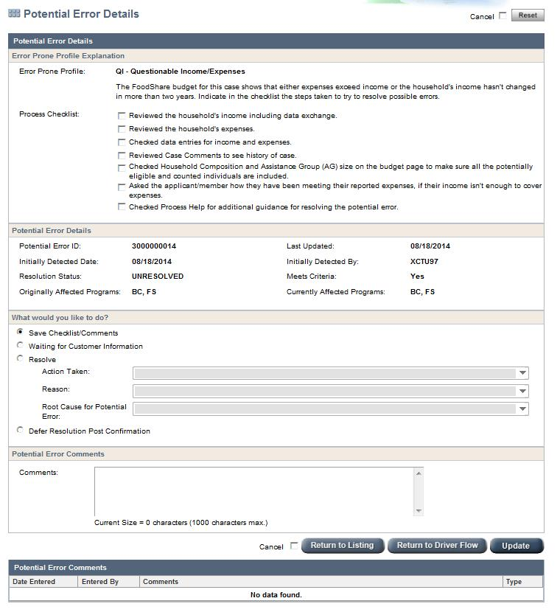

Slide 9
Under Error Prone Profile Explanation, the worker can check the items that correspond to the actions taken in resolving the profile.

Slide 10
“What would you like to do?” section. Click one of the options.

Slide 11
If the worker clicks resolve, you will then need to go to the drop downs for Action Taken, Reason, and Root Cause for Potential Error and select the appropriate responses. Add case comments and you will be done. Normally, you would want to talk to the client and sometimes obtain verification before you complete those.

Slide 12
IPV/Overpayment
The Potential Error screen is similar. Select the items in the checklist to show what you did
Go to the dropdown menus under What Would You Like To Do to complete the page.

Slide 14
Resolve or Defer Resolution
If the worker comes across these screens before having an opportunity to interview the client, s/he may select either the Resolve or Defer Resolution Post Confirmation buttons.
Be sure to add comments, either on the above screen, or the general case comments screen with any pertinent information regarding the potential error.

Slide 15
Potential Error Details
UNDER NO CIRCUMSTANCES SHOULD THIS SCREEN BE SKIPPED OVER WITHOUT SOME TYPE OF ACTION, ESPECIALLY IF YOU HAVE SPOKEN WITH THE CLIENT. REMEMBER THAT OTHER WORKERS MAY TAKE ACTION ON YOUR CASE AND MAY NOT BE ABLE TO CONFIRM A CASE IF THIS INFORMATION IS NOT COMPLETE.

Slide 16
Deferring Potential Errors
It is possible to defer processing of a potential error so that one can confirm a case. Please do not do this routinely. All errors should be processed. Even if it is deferred, it will need to be completed later.

Slide 17
Deferring Potential Errors

Slide 18
Example 1:

Slide 19
Example 1:
18 year old was part of an overpayment on a parent’s case. The parent failed to report income. Because the 18 year old is an adult, s/he was included on the overpayment. This potential error occurred because of that error. She was not directly responsible for the error. For this error, we would mark it as no change and not questionable, making sure to add comments.

Slide 22
Unresolved Discrepancies is the last type of Potential Error screens.
It is generated when there are two or more incomplete discrepancies on a case that are more than 45 days old.
Complete the discrepancies and update the Potential Error screen.

Slide 23
In Summation
Always process these when the client is on the phone. Obtain the necessary information and complete the screen.
If you are unable to complete it, leave detailed comments regarding the situation identified in the error.

