Slide 1
FSOD Training
Updated 04/20/2023

Slide 2
Where When How

Slide 3
Where
FS apps are located on the FSOD tool. You can find the applications assigned to you by searching with your X ID. (see screen shot)
You will also see FS renewals assigned to you on the FSOD tool. (These should be processed on your protected time)

Slide 4
When
FSOD apps are assigned out by the workload manager. You may be pulled from phones and assigned to work on them during your Team time, during part of your scheduled CC shift, or in place of a unit meeting that was canceled.
If you are assigned FSOD apps, you will be emailed about your assignment. You will need to email back the FSOD team with any apps you did not have time to complete.

Slide 6
How
There are 5 types of apps you will see on the FSOD tool.
1) ACCESS applications
2) ACCESS program adds
3) ACCESS Automated Case processing (ACP)
4) RFA created from a paper Application
5) RFA created from a Telephonic Signature

Slide 7
ACCESS apps
These are the most common apps you will get.
Assign the application to yourself so it goes into your caseload, and initiate the app to convert it to an RFA.
If the primary person had a case in the past, the RFA will merge with that case. If there is no past case, then processing the RFA will create a new case.
Tip- You can change primary person on the app if it is the wrong person (for example: if a minor child is listed as primary, instead of the parent)

Slide 8
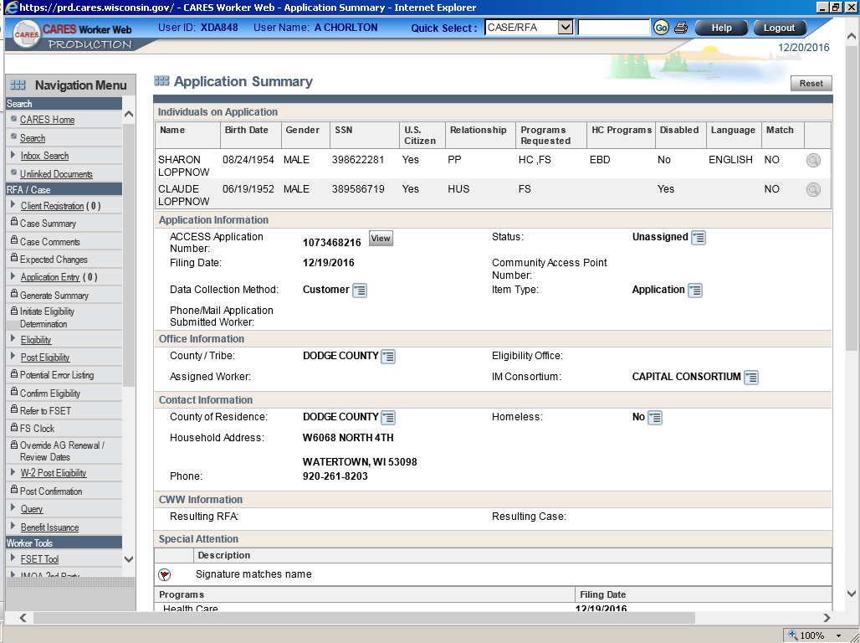

Slide 9
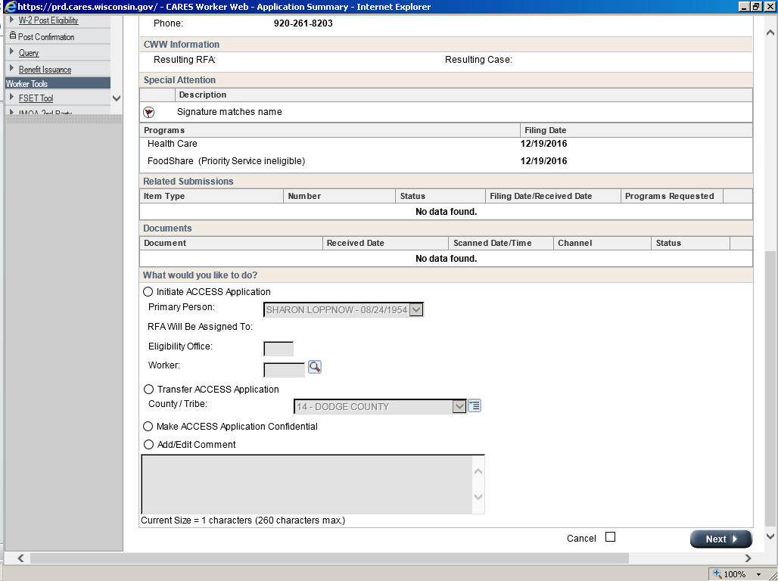

Slide 10
Program Adds
Program adds are requests for a new program on a case that is already open for other programs. The open case will show on the access app.
When you hit “Start/continue processing inbox item” the program add will be merged to the existing case.
Then you need to initiate the program add by selecting “Process linked ACCESS application” in the workflow options.

Slide 11
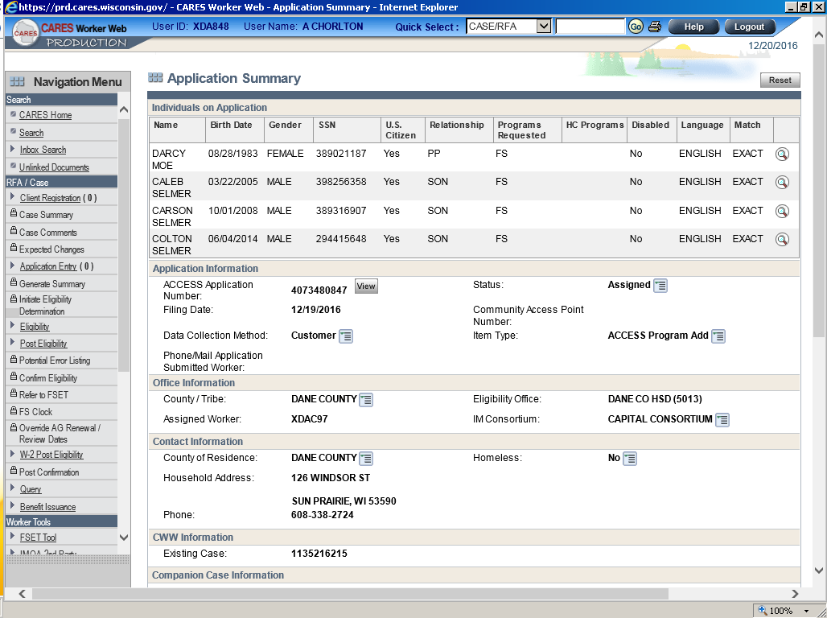

Slide 12
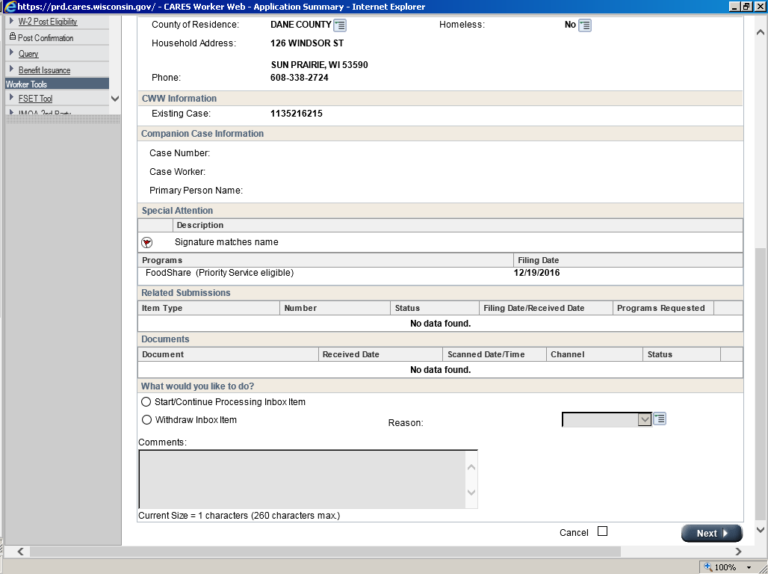

Slide 13
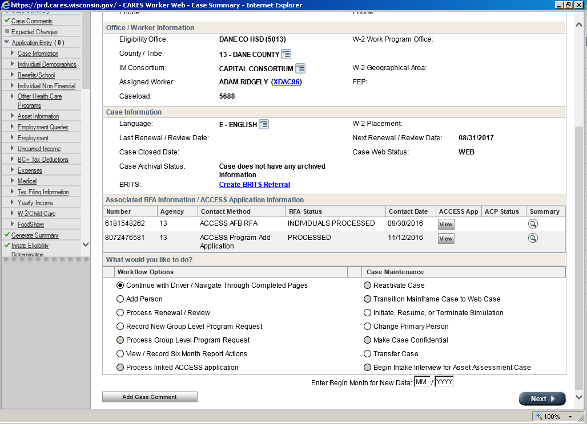

Slide 14
ACP
ACPs are apps that have already been partially processed through the automated case processing system. They already have an RFA/case created, but need additional follow up. The RFA and case will show on the application page
These will look like they have already been processed. You need to notice the Item Type: ACP, which means you need to navigate to the case and do the ACP follow up actions.

Slide 15
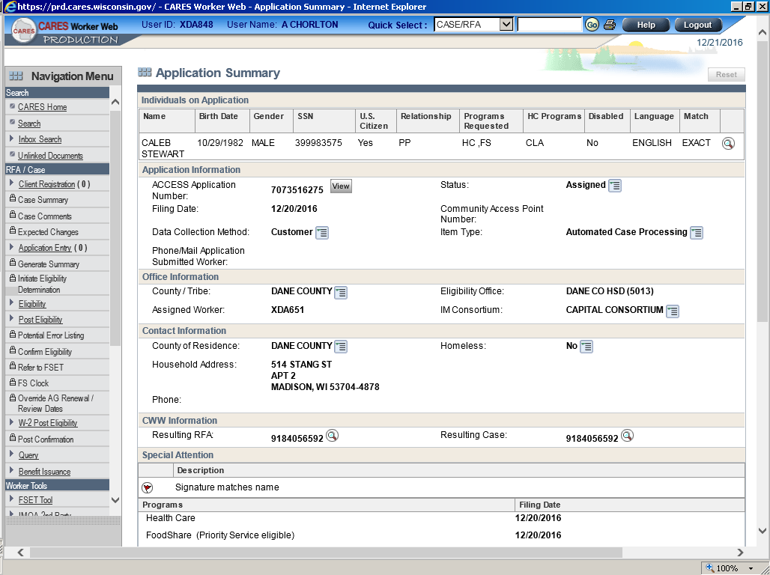

Slide 16
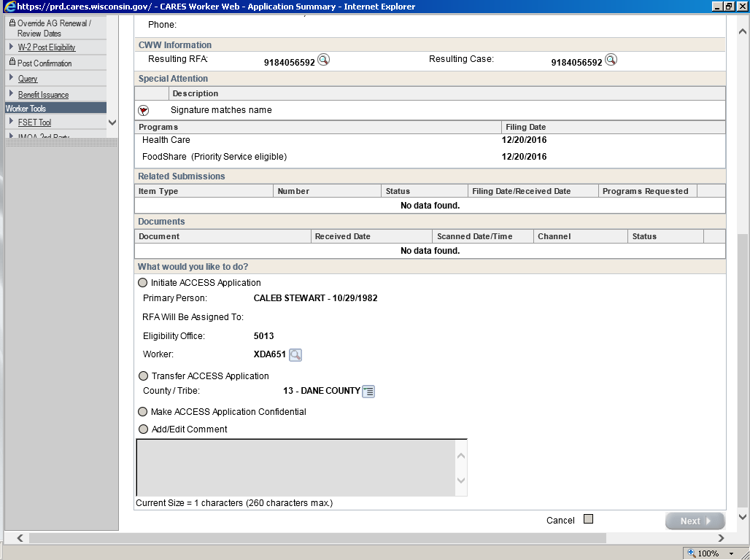

Slide 17
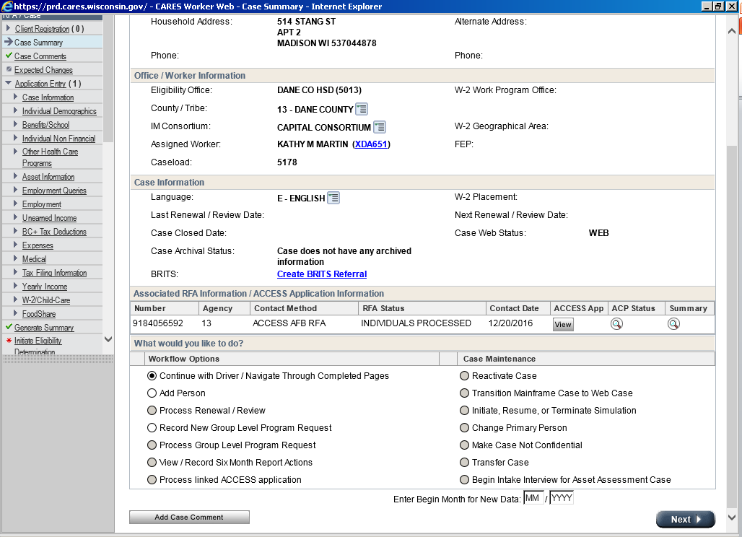

Slide 18
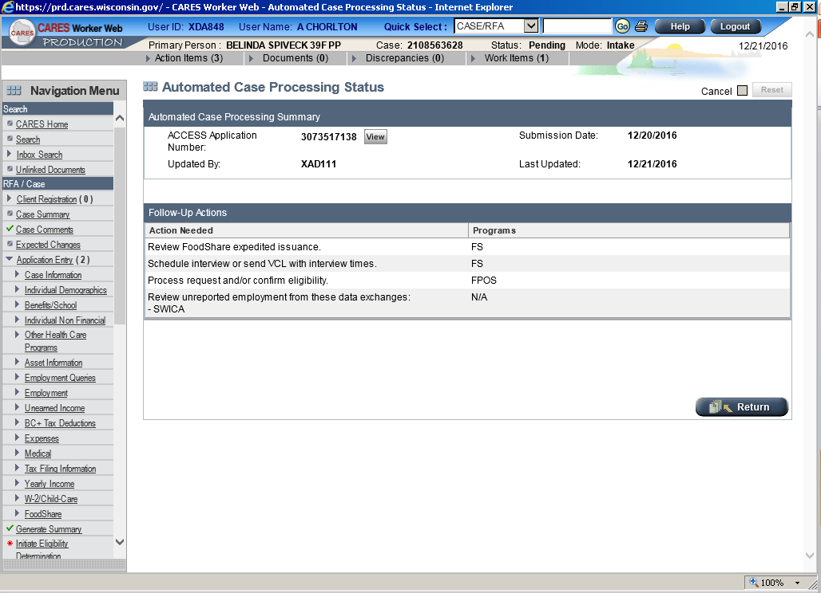

Slide 19
Paper Application
Paper applications will have an RFA created, either by the clerical staff or CDPU.
The paper application will be in the document viewer for the RFA, along with any other documents for the app.
Process the RFA into a new case, or merge it to an existing case for the primary person.
Tip-Sometimes the RFA will be created but the scanned app has not been linked to the RFA yet. You can still call the person 2x and if you reach them just get the information from them over the phone. If you don’t reach them document the 2 calls on the RFA comments, but don’t process the RFA. The app will be processed after the app can be viewed.

Slide 20
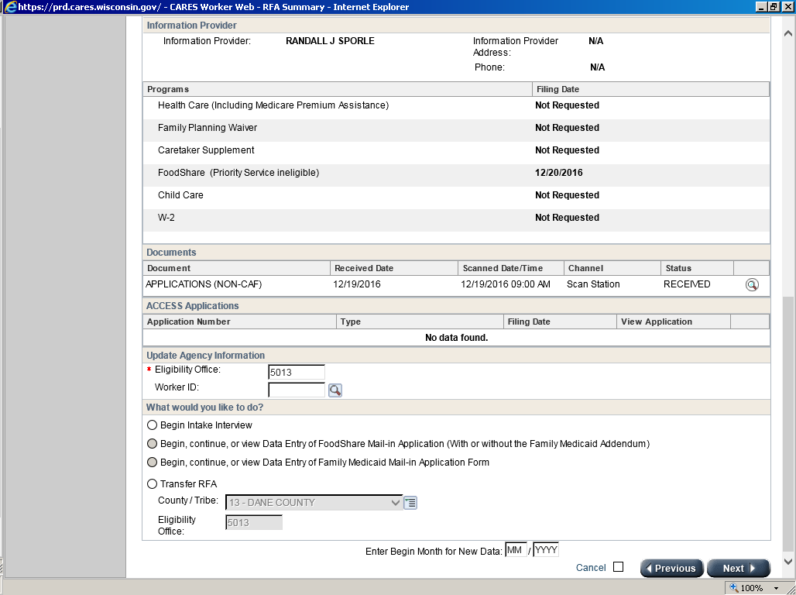

Slide 21
RFA from telephonic signature
If someone calls into CCA and does not have time to do the interview, but wants to set a filing date for FS, they can apply for FS by providing name, address, and telephonic signature to set their filing date.
An RFA will need to be created by the worker for this application. You will need to treat this application like a page 1. (more on this soon)

Slide 22
What to look for
Look at the application before processing it, and look up the person by SSN or name in CWW to see if they are known to CARES.
If the application also has a CC request for another county, or it is an EBD application, send it in to CCA monitoring team to be reassigned.
Most applications you will call 2 times and complete the interview when you reach them. The second call should be 15 minutes after the first. After your 2nd attempt (if you don’t reach them) you should leave them a message to call back the call center to complete the interview. If you don’t reach them, process the application and either pend the case for the interview, or issue expedited benefits for a postponed interview.

Slide 23
Duplicates
If the person already has a case and is open for FS, you should update any changes that are on the application to the case, and withdraw it.
If the person has already applied for FS and this is a duplicate application you should update any changes and withdraw it.
If the case is due for a renewal this month, the application can be run as a renewal.
Be sure to comment on the case and RFA the access/case number and why it was withdrawn.

Slide 24
Exceptions to processing the application
Incomplete applications, FS Page 1 app, or expedited applications ineligible for a postponed interview, such as cases that previously closed FS due to having 3 TLBs and they don’t claim any exemptions.
If you call and reach the person, just collect any missing information during the interview and run the application. If you call 2x and are unable to reach them you will need to schedule an appointment.

Slide 25
Why won’t this application come off the FSOD tool?
Remember to confirm your cases (if HC is pending and FS is failing, please confirm the FS fail)
Run cases all the way through to the confirmation page. If you stop early, and don’t go past the verification checklist, the case will be stuck on the tool.
If the app is withdrawn, it will come off overnight
Apps will come off the tool in real time when an appointment is scheduled in CWW Client Scheduling
In some cases we may need to delete a work item
Still there? Send it to the FSOD Team inbox so we can look at it. There are several system glitches with FSOD

Slide 26
FSOD Renewals
If an ACCESS FS Renewal is submitted on a case in your caseload, it will show on your FSOD tool.
It will also show on your dashboard.
FS renewals should be completed during your protected time.

Slide 27
FoodShare Tips/Scripts
Most of the information in this PowerPoint, as well as sample scripts to use when leaving a message, and sample case comments are available on the Capital Consortium website under:
Procedures
Scripts

Slide 28
Questions?

