Slide 1
BadgerCare under Gap Filling Rules
BC Handbook 16.9 and Process Help 14.1
Updated 9/14/23

Slide 2
WHAT is Gap Filling?
Due to differences between the eligibility rules when counting income used by the Federally Facilitated Marketplace (FFM) and the BadgerCare Plus rules, the Marketplace may determine an individual to be below 100% of the FPL based on their annual income, while BadgerCare Plus determines the income above 100% of the FPL based on their current monthly income.
Because of this difference, the person is not eligible for BadgerCare Plus nor advanced premium tax credits (APTCs). If left in this eligibility "gap," then the only option available is to pay for the full cost of private health insurance through the Marketplace.
To prevent this from happening, these people must have eligibility for BadgerCare Plus determined based on their expected annual income.

Slide 3
Who to test for gap filling?
Individual who fails the monthly income test, and is a Parent, Caretaker Relative, or Childless Adult
100% FPL income limit
CWW Categories
MAGA
MAGS
MAGN

Slide 4
Determining annual income
Use two pages in CWW
Individual Reported Annual Income
Self-reported by client
Expected Annual Income
Verified received and/or expected income
Use the current calendar year’s total income
Combine actual earnings plus expected earnings

Slide 5
Individual reported annual income page
Use this page to enter the client’s self-attested income
Is the individual’s self-attested income over the annual income limit?
If yes, BC+ fails, no EAI page is scheduled, and no gap determination is required.
If no, BC+ pends, the EAI page is scheduled, and the worker validates the annual income.

Slide 7
Expected annual income (EAI) page
If client’s self-attested yearly income is below 100% FPL or is unknown, this page will be required
Detailed wage information is captured here
Earned Income
Self-Employment
Unearned Income
Deductions
If client is under 100% after “validation,” client will be “Gap Eligible”

Slide 8
EAI Page continued…
Workers must “validate” the gap fill by completing the necessary entries on the EAI page(s)
“Rolled up” totals provided are a starting point, not an end point
Review data exchanges, EI/UI entries, and/or use customer reports to build proper totals on the EAI page(s).
The goal? Arrive at the best estimate for the household’s annual income for the year.

Slide 9
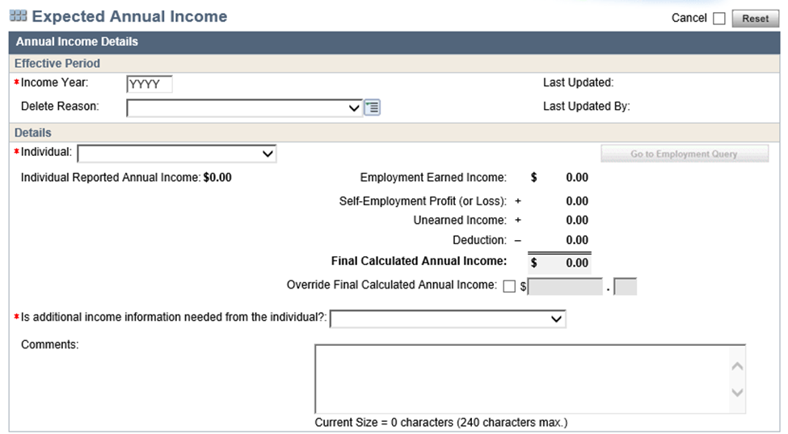

Slide 10
alerts
Work these alerts daily
Indicator that EAI pages have generated and may need completion

Slide 11
VCL and correspondence
Do not leave “Waiting Worker Validation”
This will result in the FYI letter going out overnight
Attempt to verify all GAP Fills immediately, once over monthly income

Slide 12
VCL and correspondence
“? – Pending Information”
Use if verification will be needed
Add text to VCL to detail the verification we are looking for (YTD earnings plus projected)

Slide 13
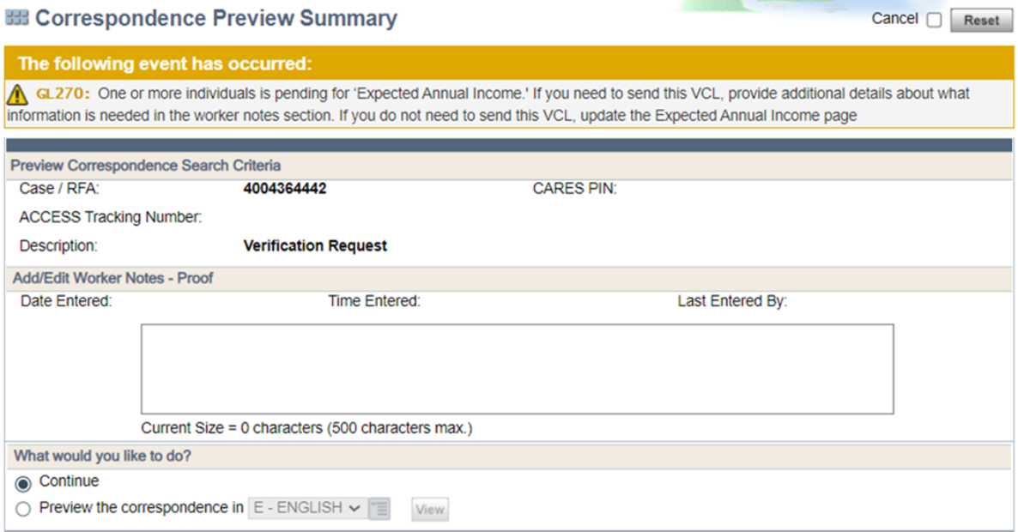
VCL and correspondence

Slide 14
CORRECT or INCORRECT ??

Slide 15
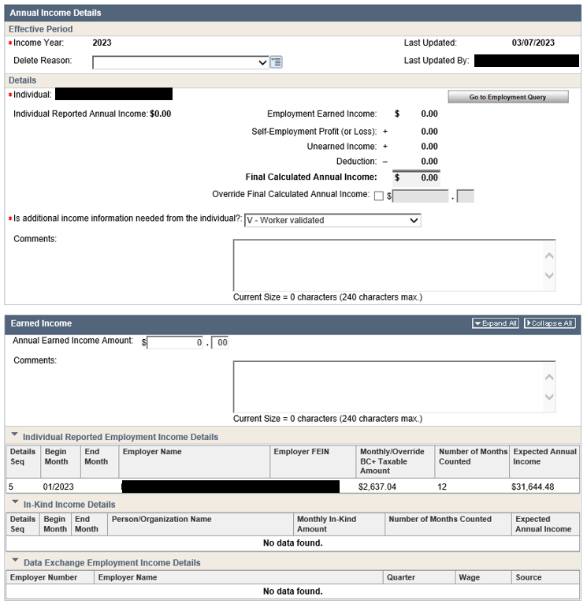

Slide 16
THIS IS INCORRECT – NO TOTALS ENTERED ON THE EARNED INCOME SECTION. ERROR- ASSUMING THE “ROLLED UP” DATA WILL AUTOMATICALLY PULL INTO AN ANNUAL BUDGET.

Slide 17
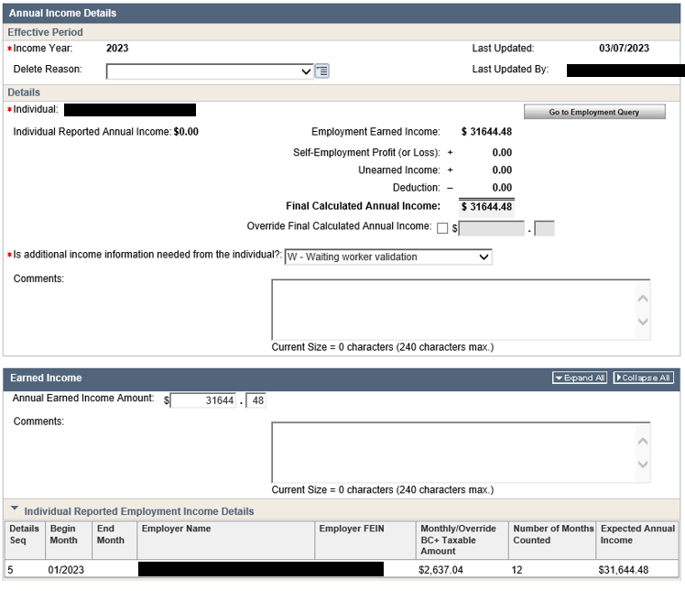

Slide 18
INCORRECT – THE WORKER ENTERED A VALIDATED AMOUNT, BUT FORGOT TO CHANGE THE “ADDITIONAL INCOME NEEDED” FIELD TO “V- WORKER VALIDATED”

Slide 19
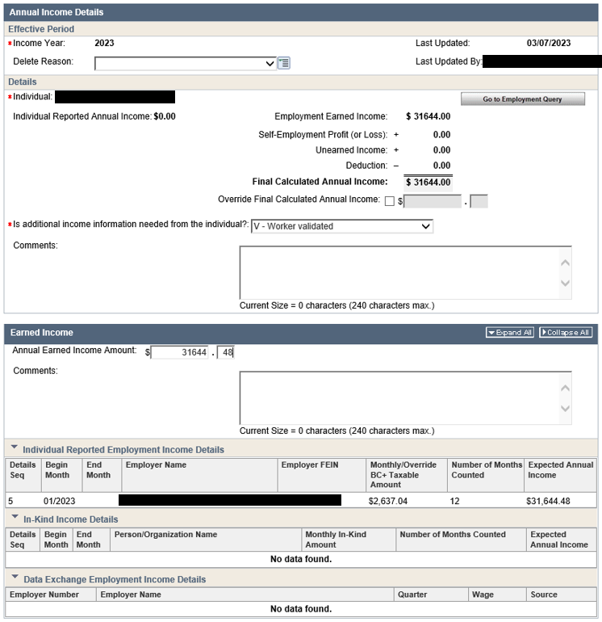

Slide 20
CORRECT – WORKER ENTERED A VALIDATED INCOME VALUE ON THE EARNED INCOME PAGE AND CORRECTLY SELECTED “V-WORKER VALIDATED.”

Slide 21
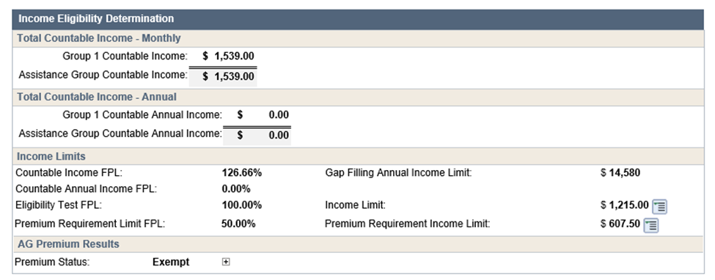
USING the budget
Monthly income at 126.66% but Annual at 0.00%
Impossible to have to have monthly income and not at least some total for annual income

Slide 22
“Rolled up” totals
Do not assume rolled up totals are accurate. Review the EI/UI entries to make sure a true 12 month EAI
Notice only 11 months pulling into the EAI page, however EI page indicates job started earlier

Slide 23
Continued….
Annual earned income must be manually totaled based on the rolled up data combined with FDSH data (adding prospective income with actual income)
Workers must “validate” entries, not assume the EAI page is accurate

Slide 24
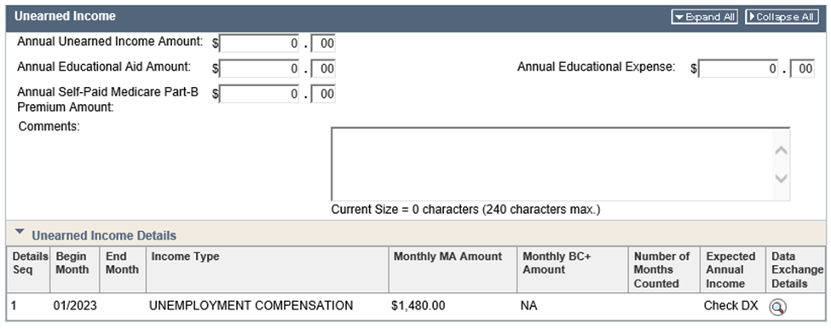
UIB Totals
UIB must be manually calculated as there will not be rolled up data to start from

Slide 25
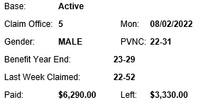
UIB Query

Slide 26
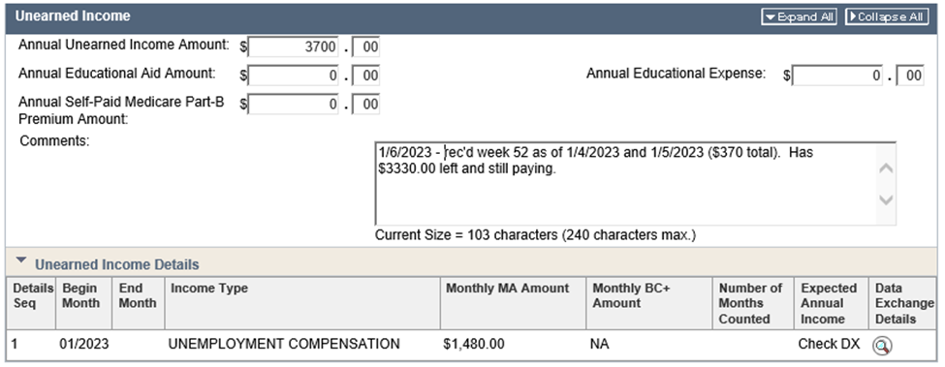
UIB continued….

Slide 27
General Information
Members are still subject to change reporting requirements while enrolled under gap filling rules
A member can lose eligibility if no longer meeting all non-financial requirements
A member can lose eligibility if there is an increase in income that puts the annual income over 100% FPL
Beginning the first Saturday of January (and the first Saturday in January of each following year) a notice will be sent asking gap members to validate their EAI for the new calendar year
EAI information is due January 31, if not provided, the system will terminate eligibility as of March and ongoing

Slide 28
Resources
BadgerCare Handbook 16.9
Process Help 14.1 EAI for Gap Fill
Ops Memo 23-03
Cornerstone: IM Refresher Training: Gap Filling_DMS_BEOT

Slide 29
Questions?

