Slide 1
Person Add
Presenters: Cindi and Melissa

Slide 2
Objective
Answer these questions:
When should I add a person?
What information is needed?
What steps are taken in CWW?
Other considerations?

Slide 3
Introduction
3 common ways a person add begins:
Change report via ACCESS
Verbal change via CCC or Lobby
Written change via documents, applications, or email from another agency.

Slide 4
Question 1
When should I add a person?

Slide 5
Are they relevant to this case?
Does this person live in the home?
Yes
Are they the child under 22, spouse, parent/caretaker, claimed parent , or minor being cared for by a case member?
No
Are they a tax co-filer or tax dependent of someone on a case with a Health care request?
No
Yes
Add as an OTX
Not relevant. Do not add.
No
Yes
Are they sharing food with a case member in the food unit?
No
Yes
Not relevant. Do not add.
Add to case
Add to case
Note: If you feel you have an exception to these rules, please double check with a lead or supervisor

Slide 6
Question 2
What information is needed?

Slide 7
Information needed
Cannot add without
Avoid adding without
Can add without and request verification if needed
Full Name (First and Last)
Date of Birth
SSN
Claimed placement information for a minor child
Relationship to all case members
School status
Disability status
Employment or Income information
Expense information
If a client does not have the information in column 1, they need to call back or we need to follow up to obtain this information. Household Composition can be pended.
If a client is missing an item in column 2 we should do our best to locate the information in our systems BEFORE adding (Check for other cases/PINs in CWW, check KIDS, etc.) but if we cannot find this information, we should still add the person and request the item(s) needed.

Slide 8
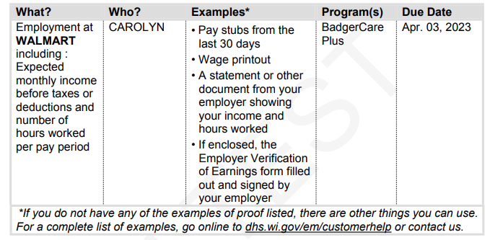
Getting additional information
Information or Documentation
Verification
If we don’t have enough info to request the correct verification OR we don’t require verification we should first attempt to reach the client to clarify. If we cannot or they don’t have the information available we should try to pend the gatepost whenever possible. This will send a questionnaire style notice to the client asking them for more information. Example for employment:
If we have information, but it needs to be verified, pend the page/field that needs verification. This will send a notice asking for specific verification. Example for employment:
This does mean you may have to request verification once the information is received.

Slide 9
Question 3
What steps are taken in CWW?

Slide 10
Person Add Demo

Slide 11
Scenario
Today is May 10th
Ms. Stake has an open FS and HC case and is calling to report as of April 17th her son Jeremy has moved back into her home. He was previously living with his father who lives nearby and does not have any open benefits in CWW. He attends the local high school and does not have any source of income. Ms. Stake now has primary placement of Jeremy and claims him as a tax dependent every other year. This is her year to claim him. Ms. Stake provides Jeremy’s full name, date of birth, and SSN.
Should Jeremy be added?
YES
YES
Do we have enough information?

Slide 12
Case Summary and Household Members Pages
Click “Add Person” (Optionally, enter begin month) and click next
Enter Relevant Details

Slide 13
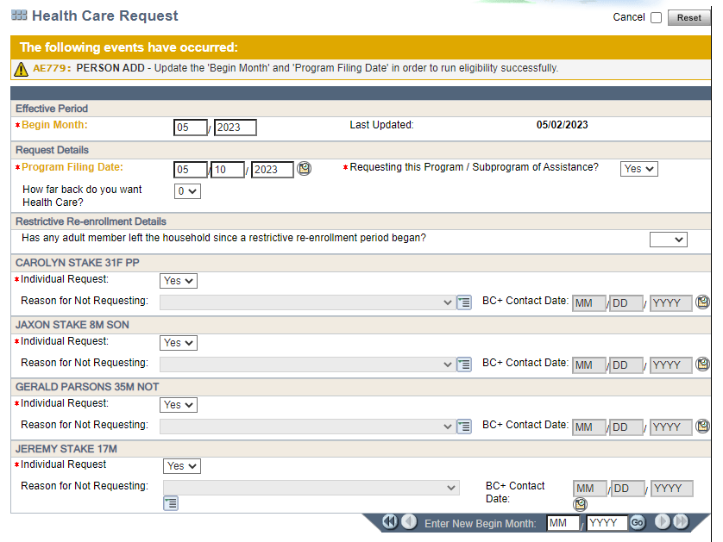
Request pages
Update ALL Begin Months and Program Filing Dates to the day the change was reported (or date of birth for a newborn add). This includes programs that are not being requested.

Slide 14
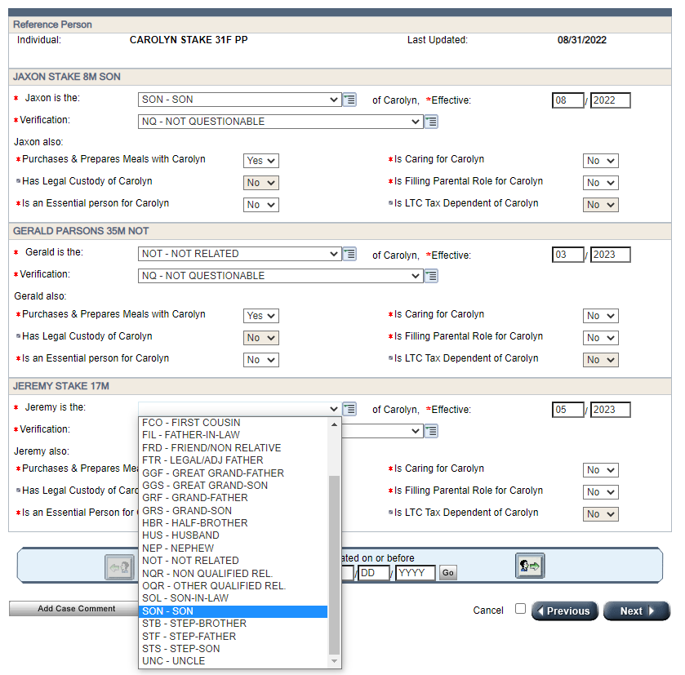
Household Relationship pages
Choose the correct relationship for each household member. Begin month should be the month the change is reported (or birth month for a newborn).
For Minors, remember to list their primary caretaker as “caring for” them

Slide 15
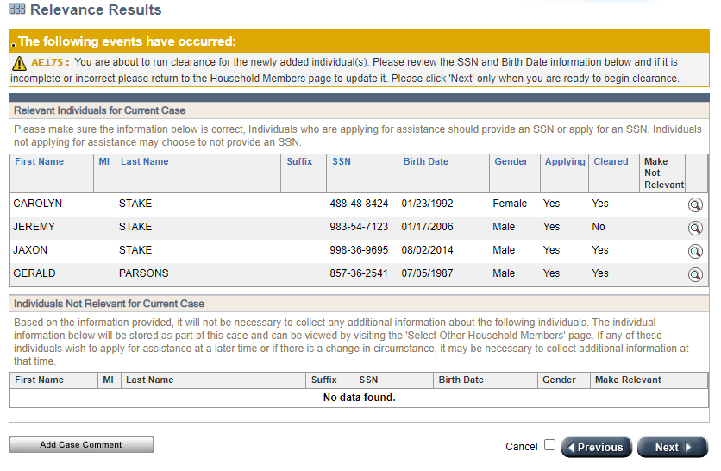
Relevance Page
Anyone marked as No will be run through clearance when you click Next. “Clearance” is CWW checking to see if this person has an existing PIN in the system. Duplicate PINs can cause issues, so it is best to use existing PINs whenever possible.
If the person you are attempting to add appears in the bottom section, CWW has determined they are not relevant to this case. Double check that they should be added and that all Household relationships are correctly entered. If you move past this page with them listed in this section CWW will delete them from the case. If you need to override this and add them anyway, Click the arrow that will appear under “Make Relevant”

Slide 16
Clearance
Choose the correct matching person from the list. If there is no match, click next.
Please note, if a match has at least 92% you will not be able to move past this page without choosing this match. If more than one match is listed at 92% or more you will need to change some information to lower the match %. Best practice would be to remove 2-3 letters from the last name.

Slide 17
Complete Driver Flow
Finish Driver Flow. Pay close attention to the following pages:
Permanent Demographics: Ensure Citizenship/Immigration status is entered correctly. Request SSN if we don’t have one.
Current Demographics: Update the Living arrangement and OTX indicator
School Enrollment: Update/Add school info and request verification if needed
Benefits Received: If a person recently received FS in another state, request verification of the closure date. If there is a Foster care or Kinship care relationship, update those fields.
Absent Parent Page: Make sure all legal parents NOT in the home are referred to Child Support. Advise the client of any new referrals when possible.
Employment Queries/Employment: Check for any new/changed employment and request verification if not available in FDSH and agreed upon.
Unearned Income: Check for new/changed CS income, run SOLQ/UIB queries or request verification if needed.
Expenses: Changes to CS or CC expenses?
Tax Filing Details: Update tax filing information and request further clarification if needed.
FS WR/ABAWD Info: Make sure all adults have a page and the info is current.

Slide 18
Running Eligibility
For FS, POSITIVE changes should be affective the calendar month following the change report
NEGATIVE changes should follow Adverse Action rules. If you run with dates due to a positive change, make sure you check the “Determine Potential FoodShare Supplement” box or no additional benefit will be issued.
For Non-Newborn adds, POSITIVE HC changes should be affective the same month the change was reported. NEGATIVE changes should follow Adverse Action rules. You will most likely need to run with the date of the change report and possibly additional months depending on Adverse Action
For Newborns, HC should be determined from the date of birth.
Best practice is to start with the oldest month that needs to be run and work your way forward. You should try to confirm one category at a time (FS or HC, etc.). There is no limit to the number of times you can run with dates so it is better to be cautious. Once you are done running with dates you should always run without dates (“open”) to ensure ongoing eligibility is correct.

Slide 19
Running Eligibility
Using our scenario, let’s run eligibility. We will start with Health Care:
In this case, the date reported will be used to run with dates.

Slide 20
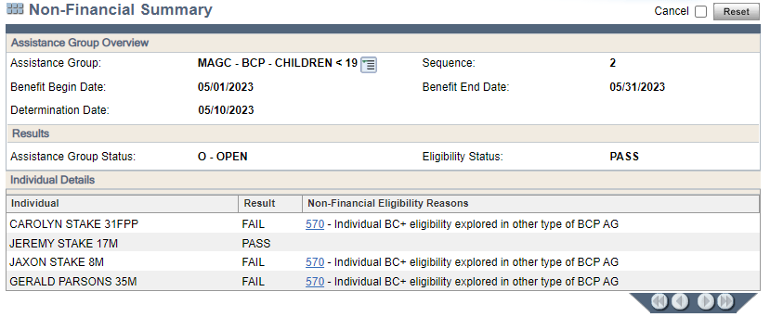
Running Eligibility
The existing HC programs are open, and a new sequence is being added for Jeremy. This is what we anticipated so we will confirm HC. To see who is included in each sequence, review the “Non-Financial Summary” pages for each sequence:

Slide 21
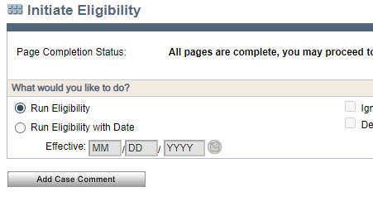
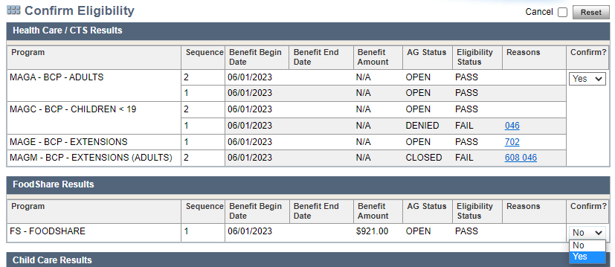
Running Eligibility
In this scenario we do NOT need to run with dates for FS as today is May 10th, and June is both the effective month for our FS change AND the month CWW is currently running. We will now run without dates and confirm:

Slide 22
Tips and Work-arounds

Slide 23
Question 4
Other considerations?

Slide 24
Other things you may need to check at Person Add
Other cases
Make sure you check if the person you are adding is included on another case. Update and case comment on ALL cases.
KIDS
Check to see if the new person pays or receives child support, or if there have been changes to an existing member’s child support.
ECF
If the case is pending or needs more information, check if current verification is available in ECF.
Other state agencies
If the new person recently moved to WI you may need to contact their previous state to verify they are no longer receiving benefits in another state. Email your request, including the case number, person(s) you are requesting info for, and state you are requesting info from to: fevbenefit@countyofdane.com OR use the national directory listed under desk aids on the capital consortium website to contact the previous state yourself. Either way, make sure to case comment and follow up to update the case once information is received.

Slide 25
Questions?

