Slide 1
QC Training
The Importance of the non-financial Summary and foodshare budget pages
10/2020

Slide 2
Eligibility Summary- Make sure both Non-Financial Result and Income Result boxes are checked (CWW automatically checks the Income Result box)

Slide 3
Non-Financial Summary Page- Review the eligibility results for each household member
Example…Passing
Example…Failing/Reason code

Slide 4
Foodshare Budget
Click + sign to view unearned income/deemed income details
Deductions correct?
Click + sign to view all shelter/utility expense details
Is there a recoupment?

Slide 5
Example…”+” sign to expand for Unearned income details

Slide 6
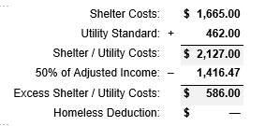
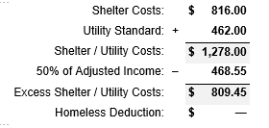
Example…“+” sign to expand for shelter deduction details
Is the correct shelter entered?
Is client receiving the correct utility standard?
Should excess shelter costs be capped? (Anyone age 60 or older or disabled?
Capped
Not Capped

Slide 7
Example…Recoupment

Slide 8
Now to review…. First check income?
Is the gross income what you expected?
Review EVFE (Pay frequency, pay rate, any OT, commissions, bonuses? )
Review paystubs, quick tip for double checking your math, add up the gross wages from the 2 paystubs, does that match the figure listed in this CWW field on the employment page?
Is there Self Employment income?
Is income being deemed to the food assistance group?

Slide 9
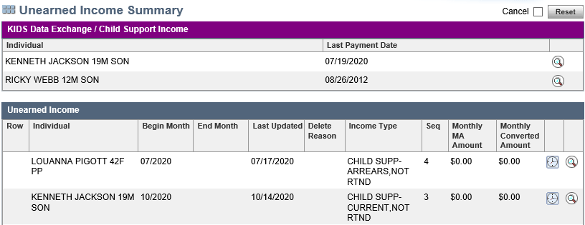
Use your summary screens… (click on the clock icon to review previous month’s income)
Employment Summary Page
Unearned Income Summary Page

Slide 10
Next…household size?
Is the assistance group size what you thought it should be?
Living arrangement status-Out of home, Incarcerated?
Student?
Anyone OTX and should be or shouldn’t be?
Drug Felon?
Immigrant?

Slide 11
Deductions …. There are so many!
Medical Expenses (Mandatory verification item to receive the deduction)
Is there anyone disabled or age 60 or older in the household?
Did you ask if there are any medical expenses being paid out of pocket?
Dependent Care (Verify only if questionable)
Has this page been updated? Does household still have this expense?
Does the client receive any credits/other subsidy payments?
Support Payments (Mandatory verification item to receive the deduction)
Is the parent and children in this household?
Has the expense been updated with last 3 months average?

Slide 12
…….. And more
Shelter and Utilities --- this is not a dollar for dollar deduction (Verify only if questionable)
Do they get a rent subsidy?
Does mortgage include property taxes and/or homeowners insurance?
Does rent have a pet, garage or air conditioner charge included?
Did household get energy assistance in the last year?
If client states billed for electric, is that for heat or just lights?
If anyone is disabled in the household, are they coded correctly on the disability page?

Slide 13
QC errors- Your responsibility!
Always review the Non-Financial Summary and the FoodShare Budget prior to confirmation.
Once you confirm the case, any QC errors could be attributed to you!

Slide 14
Questions….

