Slide 1
SNAP FoodShare
Jamie O’Dea, Updated 9.2023
Current as of FS Handbook Release 23-02
& PH Release 23-04

Slide 2
What is SNAP?
Note: processing instructions start on slide #20.
SNAP stands for the federal Supplemental Nutrition Assistance Program.
Wisconsin’s FoodShare is funded by SNAP, but is run with certain waivers to the federal SNAP rules.
A SNAP case occurs when a food unit with at least one EBD member is over the FoodShare gross income limit of 200% FPL. SNAP rules mandate that, if an EBD case fails under the waivered program, we must test them with the federal rules.
These special “SNAP rules” are what we are going to review today, along with the manual process used to apply them.
https://www.fns.usda.gov/snap/waivers/rules
https://www.fns.usda.gov/snap/eligibility/elderly-disabled-special-rules

Slide 3
Why Do We Need This Training?
We are federally mandated to apply SNAP rules if an EBD case fails because of gross income, however
1. Some SNAP cases are being missed or incorrectly processed
and
2. Some SNAP allotments are being incorrectly calculated.
FSHB 4.4.1 Assets
Assets PH 17.1
https://www.fns.usda.gov/snap/eligibility/elderly-disabled-special-rules
Notes:
Some individual may not need additional training, but, consortium-wide, knowledge of policy and processes for SNAP cases for both leads and workers needs development.

Slide 4
What We Will Cover Today
Brief EBD reminders
Identifying SNAP cases and eligibility
Importance of expenses
Assets and divestment for SNAP
Reason codes and approval/denial processes
Sample FoodShare worksheet for a SNAP case

Slide 5
What is an EBD FoodShare Case?
An EBD FoodShare case includes at least one member
in the FoodShare unit
who is elderly, blind, or disabled (EBD).
FSHB 4.2.1.5 Elderly, Blind, or Disabled Food Units
USDA/FNS (2021, October 1). SNAP special rules for the elderly or disabled.
https://www.fns.usda.gov/snap/eligibility/elderly-disabled-special-rules
Notes:
Quick reminders. Everyone knows this, but you might see something confusing in the handbook.

Slide 6
Who is Elderly, Blind, or Disabled for FoodShare?
Food unit members are considered elderly at age 60 or older.
Food unit members are considered disabled as determined by the Disability Determination Bureau, but could also be considered disabled for FoodShare if they fit certain other criteria (see FSHB 3.8.1)
Being unable to work for ABAWD/Work Registration purposes
is not the same as EBD for FoodShare.
FSHB 3.8.1.1 EBD Introduction , FSHB 3.8.1.2 Disabled Veterans
FSHB 4.2.1.5 Elderly, Blind, or Disabled Food Units

Slide 7
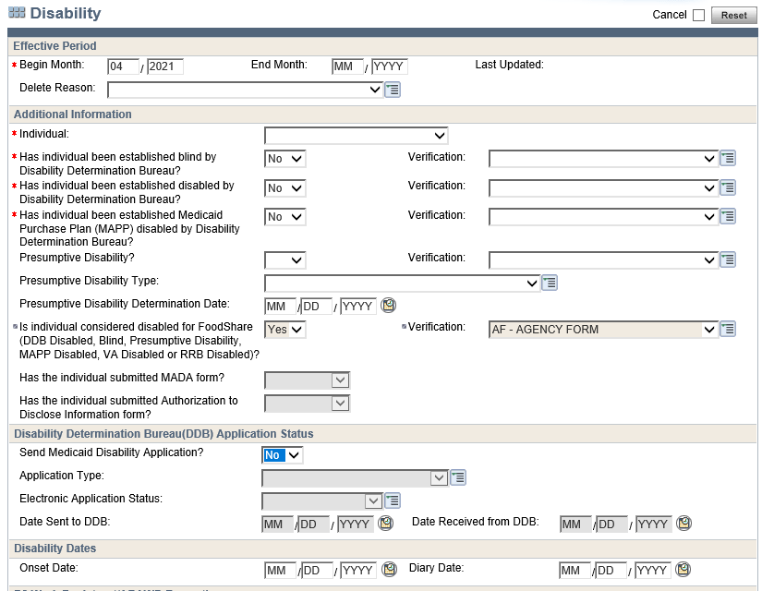
Complete this section of the Disability page if the applicant has not been determined disabled by the DDB (Disability Determination Bureau) but fits another disability criteria for FoodShare purposes.
FSHB 3.8.1 Elderly, Blind, or Disabled (EBD) Individuals
Notes:
It does say DDB Disabled as a choice in this area. If disabled by the DDB is checked yes, even if you choose no for this field, the system will change it to yes when you click off the page. So, this field is primarily important if there is NOT a DDB determination.

Slide 8
A FoodShare Case Becomes a SNAP Case When
1. There is at least one EBD member in the food unit
and
2. The gross household income for the food unit is over the gross income limit of 200% FPL. Once gross income is over 200%, we shift our focus to net income
FSHB 4.2.1.5 Elderly, Blind, or Disabled Food Units

Slide 9
A SNAP Case Becomes Eligible When
1. The food unit is under the net income limit of
100% FPL for FoodShare
and
2. The household’s assets that count for FoodShare*
do not exceed $4250**
*FS countable assets will be defined later
**$4250 is the countable asset limit for the entire food unit
FSHB 4.2.1.5 Elderly, Blind, or Disabled Food Units
FSHB 4.4.1.1 Introduction to Assets: EBD Households
Notes:
Important: many assets that count for Medicaid do not count for FoodShare FSHB 4.4.1 Assets

Slide 10
Process Applications That May Be Eligible Under SNAP Rules
If requested, continue to provide applicants with light prescreening in the interest of customer service, but lean toward taking potential SNAP eligible applications. In other words, the call should not end just because an EBD caller has income over 200% FPL. This would be an error.
Notes:
While clients often ask for a prescreening, it’s a balance.

Slide 11
Eligible SNAP Cases Have High Expenses
Ask all appropriate expense questions, paying special attention to medical expenses for EBD members
Current and past unpaid medical bills and expenses, no matter how old, no matter whether the member intends to pay it, including
Items in collections
Items contributing to credit card balances
(not to include interest)
Collections R Us Medical Bill
John “Fancy Footwork” Doe
Date of Service 3.1.1970
Disco Accident $10,000
Still owed today
FSHB 4.6.4 Medical Expenses
PH 18.2 Medical Expenses
Notes:
You may be surprised by how many people have bills in collections. Many individuals who are disabled due to sudden onset have significant unpaid bills.

Slide 12
Eligible SNAP Cases Have High Expenses
Health insurance premiums (including vision and dental)
Monthly prescription and doctor-recommended OTC expenses
Remember, shelter expenses also have no cap for EBD
Child support expenses can be high for higher incomes
Rent Due
$2000 (for example)
Child Support Expense
$150 bi-weekly (for example)
FSHB 4.6.4 Medical Expenses
PH 18.2 Medical Expenses

Slide 13
Please Slow Down in the Expense Section
Guide participants through each countable expense.
Most applicants have no idea what expenses are approved under FoodShare policy that may make them eligible under SNAP rules.

Slide 14
Rusty on Medical Expenses?
IM Refresher Training: Medical Expenses for FoodShare
-DHS Learning Center, Cornerstone
Medical Expense Training
-Presented periodically by Dane County Lead, Jeremiah Cook
You may reference the PowerPoint used for this training on the Capital
Consortium website under Trainings/QC > Past Trainings >
General/Multiple Programs > Medical Expenses
https://widoa.csod.com/login/render.aspx?id=defaultclp
https://capital-im.com/trainings/past-trainings

Slide 15
Countable Assets for FoodShare
Significantly fewer types of assets are countable for FoodShare
than for Medicaid.
Although medical expenses can only be counted for EBD members, the entire unit’s assets count toward the SNAP asset limit of $4250
Rule of Thumb: review the asset section of the FoodShare Handbook (4.4.1) for whether an asset is countable or not and how it should be treated (for example, mixed and joint assets).
FSHB 4.4.1 Assets
Notes:
First, let’s look at a list of some of the disregarded assets for FoodShare. It looks very different than the list for Medicaid.

Slide 16
Examples of Disregarded Assets for FoodShare
Highlighted items may be particularly surprising to some workers. Please review the comprehensive list in FSHB 4.4.1.4.
Unavailable Assets: countable assets that the owner cannot make immediate use of.
Self-Employment or Business Assets
Real Property: disregard all real property, regardless of whether it is homestead property or not
Vehicles: disregard all vehicles
Personal Goods and Property: disregard household goods and personal effects, such as home appliances, furniture, and clothes
Burial Plots: disregard one for each food unit member. Burial plots held for people outside the food unit are countable (differing from EBD Medicaid policy that allows plots for children).
Pre-Paid Funeral Agreements/Burial Trusts: disregard one per food unit member.
Retirement Accounts: many types of accounts are excluded/disregarded (e.g., 401, 403, 408, SEP, 457, 501, Federal Employee Thrift Saving Plan)
Cash Surrender Values of life insurance policies
Payments to Indigenous peoples, referred to as Tribal/Native American Payments
Payments as a result of certain settlements (see handbook)
Student Financial Aid
Value of outstanding checks on checking accounts
Trust Funds: disregarded under certain conditions
Income Tax, Refund, Rebate, or Credit for 12 months
FSHB 4.4.1 Assets
Notes:
This is a just partial list of assets that don’t count for FoodShare. Four types that stood out have been highlighted to bring attention to how they are treated for FS compared to Medicaid. All real property is disregarded, all vehicles, most types of retirement accounts (even if they could be cashed in) and cash surrender values of life insurance policies. Basically, while Medicaid counts a lot of assets, you’ll find that FS disregards quite a few.

Slide 17
Common Countable Assets for FoodShare
Checking Accounts*
*Disregard outstanding (un-cleared) checks
Savings Accounts
Stocks, Bonds, and Other Investments
Nonrecurring Lump Sums (e.g., retroactive Social Security payments)
FSHB 4.4.1 Assets
FSHB 4.5.5.2 Nonrecurring Lump Sum Payment
Notes:
The assets we see most often that are countable for FoodShare are bank accounts and investment accounts. Remember, investment accounts that are coded for retirement are not countable. Back pay, like retroactive Social Security payments, are counted as an asset, starting the month they are received.

Slide 18
FoodShare Divestment Policy for SNAP
YES. It’s true, there is divestment policy associated with
FoodShare eligibility under
SNAP rules.
BUT…
Notes:
Let’s transition now to divestment rules for SNAP. These rules exist and applicants do have to be asked whether they divested when you start to go down the SNAP eligibility path.

Slide 19
Divestment for FoodShare Based on SNAP Rules
It is unlikely that divestment policy will apply to a FoodShare case due to the circumstances under which it would have to occur:
1. Divestment occurred within three months before the date of application or while receiving FoodShare,
and
2. The reason for the asset transfer was to become or remain eligible for FoodShare.
FSHB 4.4.1.6 Divestment

Slide 20
Policy Overview Complete-Let’s Process
Just like every FoodShare application:
Follow the driver flow
Complete a thorough review of income and expenses
Review the budget and reason codes

Slide 21
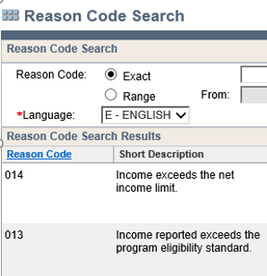
Reason Code 013 for an EBD Case Means SNAP
Code 013 If the case is EBD and only fails the gross income test (013) but not the net income test, you have a SNAP FS case that may be eligible for an allotment. At this point, you’re going to screen for FS countable assets.
If an EBD case fails both the gross income test and the net income test (013/014), it must be manually denied.
PH 17.1 Assets: FoodShare
Notes:
Now that we’ve handled policy, let’s talk about the process you’ll follow when you encounter a SNAP case. The easiest way to spot a SNAP FS case is to look for the 013 failure code.

Slide 22
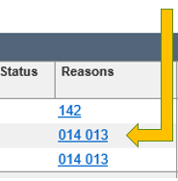
If an EBD Case Has Gross Income Over 200% FPL and Net Income Over 100% FPL
Manually Process the SNAP Denial for Income
Process Help 17.1
Suppress system notices
Mail a manual Notice of Decision (Form F-16001) with a completed FoodShare worksheet (Form F-16033)
The NOD must cite the reason from the Code of Federal Regulations (CFR) for the denial:
INCOME: The income we counted for your household is over the program limit. To learn more, please see the enclosed worksheet. (7 CFR 273.9)
PH 17.1

Slide 23
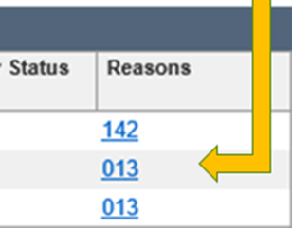
If the Case is Under the 100% FPL Net Income Limit, Screen for Assets
If the case is passing the Net Income limit of 100% FPL (reason code 013), the next step is to screen for assets.
In case you forgot, the countable asset limit for the FoodShare unit is $4250.
Notes:
Please note, there is an Assets Determination Summary page for FoodShare under Eligibility Results in the Navigation Menu. While it has been updated to show the correct asset limit of $4250, CWW has not yet been updated to process SNAP FS cases.

Slide 24
Screen for FoodShare (SNAP) Countable Assets
1. Complete your asset screening (failure code 013). Update/add assets to CWW. Remember to only screen for and record/update assets that are countable for FoodShare(FSHB 4.4.1.1).
2. If the system pends for an asset-dependent program, add a note to the automated VCL explaining that it is pending due to a reported change during the FoodShare application. Extend the due date for the other program out to 30 days to match the FoodShare application.
Notes:
Sample CNFL for assets.

Slide 25
AVS Requests and FoodShare
Please do not initiate AVS requests for FoodShare.
The AVS system is for EBD Medicaid.
However, per DMS Ops Memo 18-14, we may “consider AVS data as information known to the agency. The worker will need to request verification of assets if AVS data indicates that FoodShare countable assets are over $4250 for the household.”
Initiating
AVS Requests
Available
AVS Data
DMS Ops Memo 18-14

Slide 26
Verify FoodShare (SNAP) Countable Assets
3. Send a Free Format Letter requesting the assets for the FoodShare application.*
Sample text for creating a manual asset VCL for SNAP can found on the Capital Consortium website under Trainings/QC > Past Trainings > FoodShare Trainings
4. Set an expected change to track receipt of verifications and
check correct case processing.
*Please do not use the DCF manual Request for Verification form DWSP-2303

Slide 27
If an EBD Case is Over 200% FPL, Under 100% FPL, but Over $4250 in FoodShare Countable Assets
Manually Process the SNAP Denial for Assets
Process Help 17.1
Suppress system notices
Mail a manual Notice of Decision (F-16001) with a completed FoodShare worksheet (F-16033)
The NOD must cite the reason from the Code of Federal Regulations (CFR) for the denial:
ASSETS: The assets we counted for your household are over the program limit (7 CFR 273.8).
PH 17.1

Slide 28
If the Applicant Has Divested per FSHB 4.4.1.6
Manually Process the SNAP Denial for Assets
Process Help 17.1
Suppress system notices
Mail a manual Notice of Decision (F-16001) with a completed FoodShare worksheet (F-16033)
The NOD must cite the reason from the Code of Federal Regulations (CFR) for the denial:
ASSETS: It has been determined that you have divested assets. You will be ineligible for FoodShare based on federal rules until [add first date of potential eligibility based on calculated divestment period]. (7 CFR 273.8).
PH 17.1
Notes:
In the rare circumstance that you believe someone has divested in order to gain or retain eligibility for FoodShare, see FSHB 4.4.1.6 Divestment for how to calculate and apply a divestment penalty. For example: someone applied on April 1st. They have $10,000 in a checking account (their only asset). On May 1st, they apply and only have $4250 in their checking account. You should ask for proof of what happened to the money and determine whether they have divested.

Slide 29
To Calculate the Divestment Period
Follow the process outlined in FSHB 4.4.1.6.1 to calculate and track the period of ineligibility (divestment period). Start the allotment when that period is over.
Add the value of the divested assets to other countable asset values
Determine how much this total exceeds the assistance group’s asset limit
Use the chart in FSHB 8.1.4 Disqualification for Divestment to determine the divestment period
Example 7 in the FSHB under 4.4.1.6.1 provides a
step-by-step divestment period calculation.
FSHB 4.4.1.6 Divestment
FSHB 8.1.4 Disqualification for Divestment
Notes:
In the rare circumstance that you believe someone has divested in order to gain or retain eligibility for FoodShare, see FSHB 4.4.1.6 Divestment for how to calculate and apply a divestment penalty. For example: someone applied on April 1st. They have $10,000 in a checking account (their only asset). On May 1st, they apply and only have $4250 in their checking account. You should ask for proof of what happened to the money and determine whether they have divested.

Slide 30
If an EBD Case is Over 200% Gross FPL, Under 100% Net FPL, and Under $4250 in FoodShare Countable Assets: Issue an Allotment
Manually Process the SNAP Approval
Suppress system notices
Mail a positive manual NOD with a completed FoodShare worksheet
Adjust income in CWW to issue the correct allotments. Make thorough page-level and case level comments to track how you have adjusted the case.
A suggested best practice is to start all SNAP-related comments with ***SNAP FS Case*** to provide a heads-up to other workers so they don’t start “fixing” the case.
PH 17.1

Slide 31
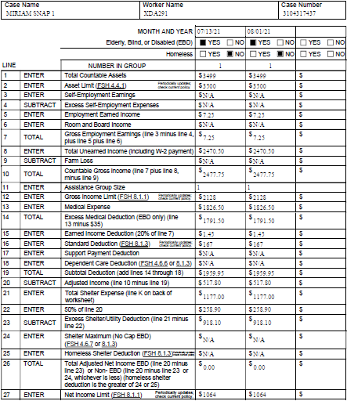
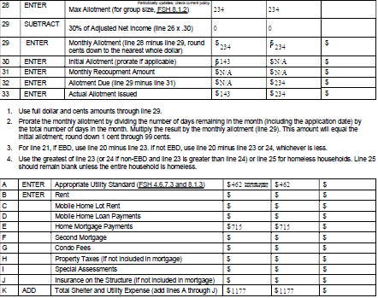
Completed FoodShare Worksheet, Form F-16033, for sample case #3104317437 in the CWW training environment. Most information can be transferred from the FS budget in CWW!
Zoom in to
see better!
NOTE: Income and asset limits and deductions change periodically. This
worksheet and the associated case in the CWW Training environment reflect information effective in the 3rd quarter of 2021.
Notes:
Most of this information can be transferred from the FoodShare budget in CWW. If you do it this way, make sure you transfer the information from the budget BEFORE you adjust the case to force an allotment issuance.

Slide 32
Wrap Up
A SNAP FoodShare case is
EBD (at least one elderly, blind, or disabled member in the food unit)
Over the gross income limit of 200% FPL for FoodShare (reason code 013).
To be eligible, a SNAP FoodShare case must
Be under the net income limit of 100% FPL for FoodShare after all countable expenses have been considered
Have less than $4250 in FoodShare countable assets

Slide 33
Agency Process
All workers will screen cases for potential SNAP eligibility (EBD and over 200% gross FPL)
Family workers will transfer potential SNAP applications to the EBD queue and comment
EBD workers will process the SNAP case
Applications should always be offered if there is a chance that the applicant may be
under the net income limit of 100% FPL for FoodShare and
under the countable asset limit of $4250 for FoodShare
Reach out the to PRT for help while you get up to speed on this process
SNAP Case Tracking: once the EBD worker has processed a SNAP application, please send an email to the PRT with the case number and whether SNAP was approved or denied. For example:
Subject: SNAP Case-approved
Body: MIRIAM SNAP 1 69F PP Case: 3104317437

Slide 34
References
Questions, clarifications, constructive feedback?
If you have questions, please send them to Alex Premo at premo@countyofdane.com with the subject “SNAP FS Training.”
Have a suggestion or see an error? Trainings are only effective if they fit your needs as a worker. Please email Jamie O’Dea at odea.jamie@countyofdane.com with suggestions/corrections.
State of Wisconsin/Department of Health Services. Process Help Handbook, Release 23-03. Retrieved August 3, 2023 from https://prd.cares.wisconsin.gov/help/ph/ph.htm?
State of Wisconsin/Department of Health Services. (2021, January 19). FoodShare Wisconsin handbook, Release 23-01. Retrieved August 3,2023 from http://www.emhandbooks.wisconsin.gov/fsh/fsh.htm#t=home.htm
United States Department of Agriculture/Food and Nutrition Services (2021, October 1). SNAP special rules for the elderly or disabled. https://www.fns.usda.gov/snap/eligibility/elderly-disabled-special-rules
United States Department of Agriculture/Food and Nutrition Services (2021, April 6). Waivers of Rules. https://www.fns.usda.gov/snap/waivers/rules

Slide 35
Thank you!

