Slide 1
Simulation Overpayments 101
Simple Steps for Processing a Basic Overpayment

Slide 2
Typical OP Types for Simulation
Agency Error due to Incorrect Entry of
Rent Expense, Child Support Payments, Dependent Care, Pay Frequency etc.
Duplicate Issuance
TLB

Slide 3
Getting Started
BRITS Referral
Has one been made?
If yes, move on to step
If not MAKE a BRITS referral ! ☺
Keep the BRITS referral handy because you’ll need it later

Slide 4
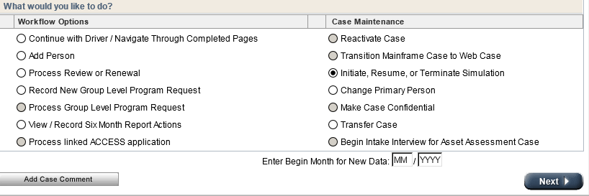
CWW Step 1
Choose Bullet to Initiate, Resume, or Terminate Simulation on the Case Summary Page

Slide 5
CWW Step 2
Initiate Simulation

Slide 6
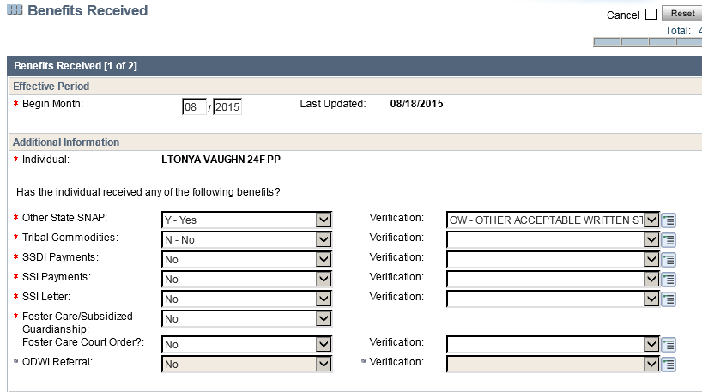
CWW Step 3
Make the Appropriate Changes to the Case
Change Dates as Necessary
Don’t forget to make changes for each household member

Slide 7
CWW Step 4
Run with Dates

Slide 8
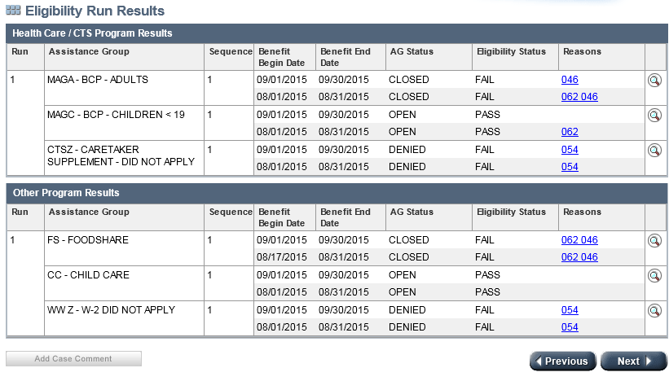
CWW Step 5
Check Results for Accuracy

Slide 9
CWW Step 6
Click Through Until All Pages Are Complete (do not click the “Next” button)

Slide 10
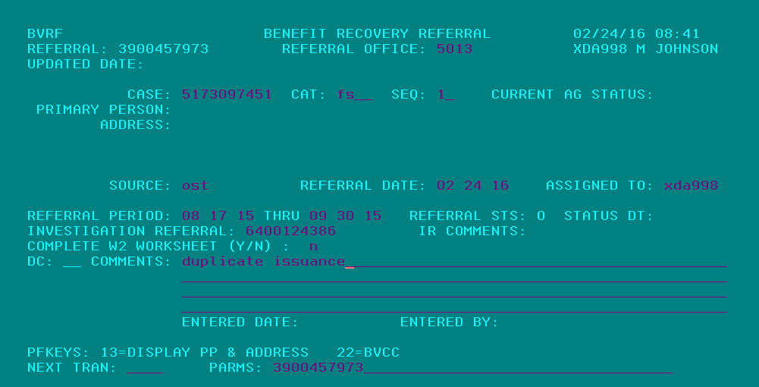
CARES Step 7 (the dark side)
Complete the BVRF Screen (all fields are required)
This is where you’re BRITS referral number is needed
Hit Enter for Your Claim Number

Slide 11
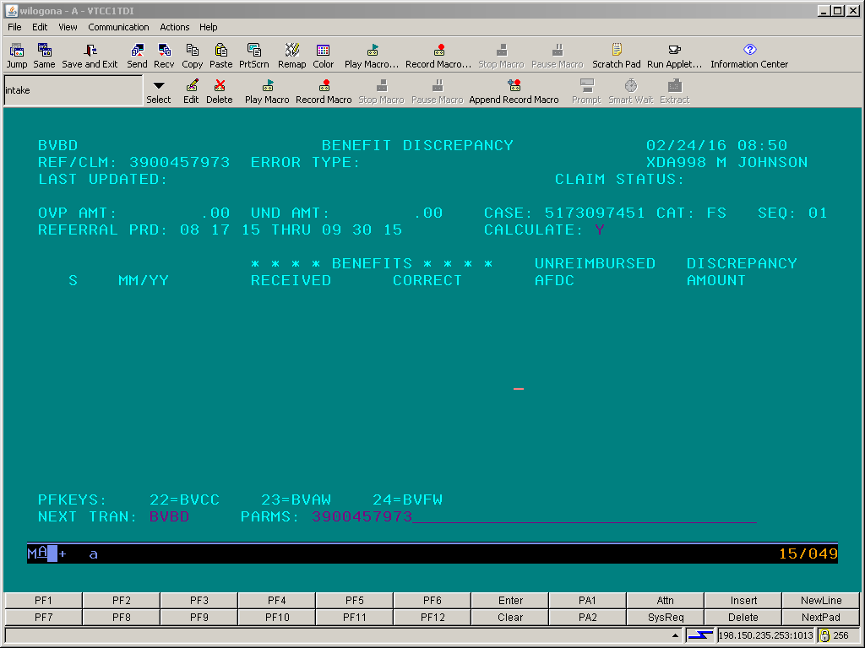
CARES Step 8
Go to BVBD with the Claim Number in Parms
Enter “Y” to Calculate Overpaid Benefits and Enter
Pro Tip: if you lost your claim number go to BVRA using the case number to recover it

Slide 12
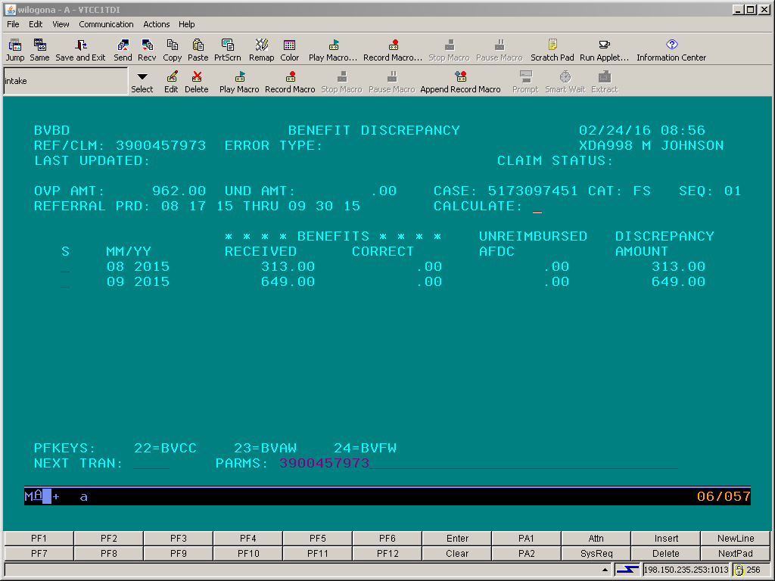
CARES Step 8
BVBD Screen After Overpaid Benefits Have Been Calculated:

Slide 13
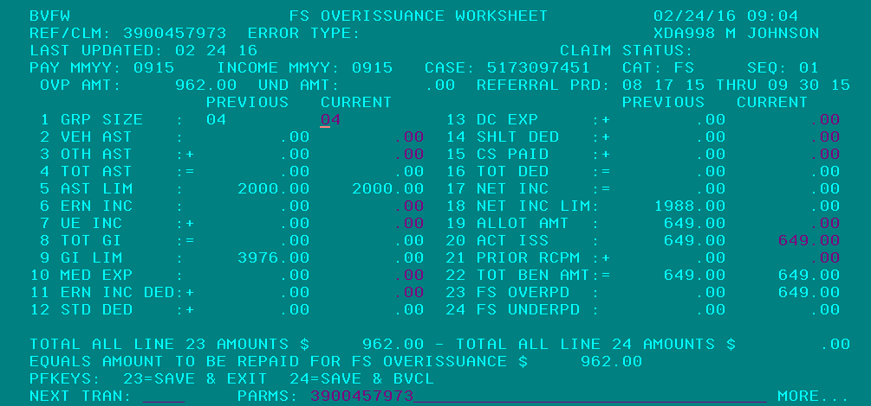
CARES Step 9
Make sure the FS OVERISSUANCE is correct according to BVBD
Shift F12 again for Save and BVCL Screen

Slide 14
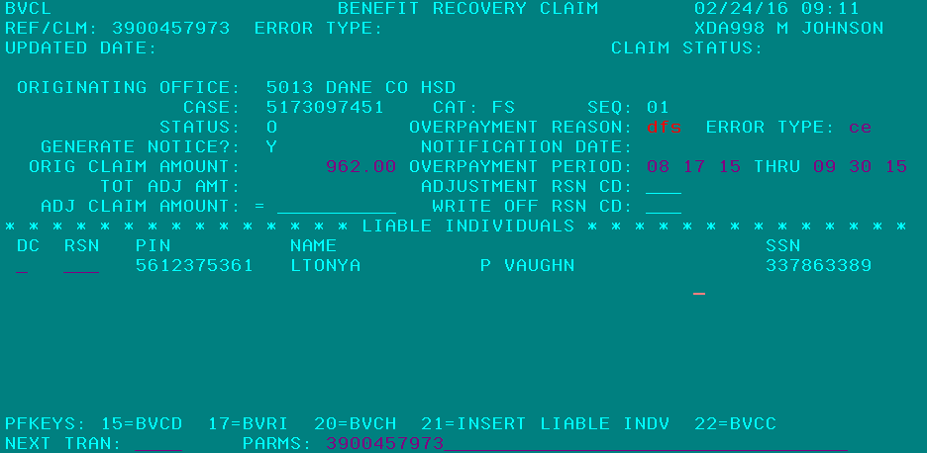
CARES Step 10
Complete BVCL Screen and Enter
Use # and enter if you’re unsure of codes for OVERPAYMENT REASON or ERROR TYPE

Slide 15
You’re Done!
Don’t forget to put case back into production!
Don’t forget to case comment claim details (claim #, $ amt, OP period, and reason for OP) in CWW and BRITS!
CARES will generate an OP Notice and Provide the Customer with the OP Worksheet created on BVFW
You can view BVRA for OP information (use case # in PARMS)

