Slide 1
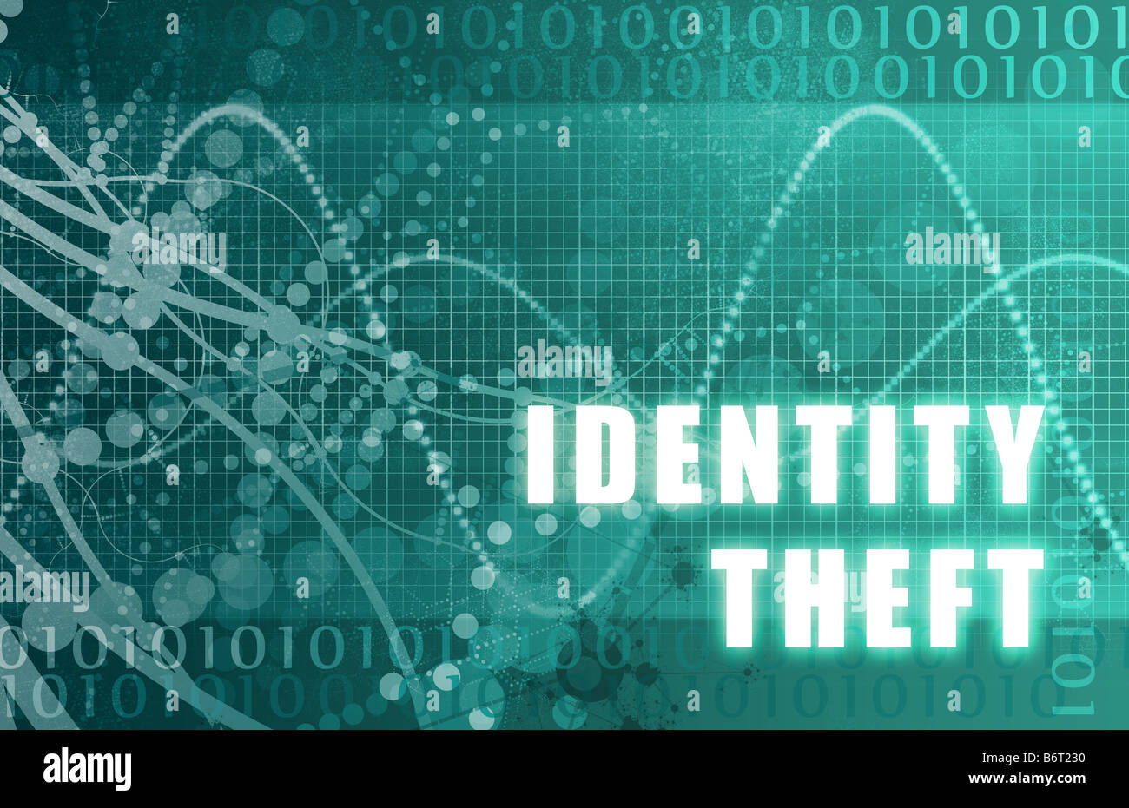
IDENTITY THEFT

Slide 2
WHAT ARE WE SEEING?
Multiple cases at a single address
Cases using out of state mailing addresses
ACCESS Fraud (Applications/Change reports)
Phone application fraud (same phone number opening multiple cases)
False identities presented in lobby to obtain Vault cards/mail fraudulently
Fake ID’s
Fake Passports
Fake SS Cards
Most of the stolen ID’s are from individuals residing out of state.

Slide 3
WHAT ARE WE SEEING (CON’T)
Cases with multiple adults (as many as 10 adults on one case)
Minors ID’s stolen
Cases reporting children that don’t exist
ID’s showing as “verified” with SSA even though names don’t match
Stolen ID’s listed on applications across several consortia.

Slide 4
WHAT WE ARE SEEING (CON’T)
ID thieves accessing FIS accounts and placing passwords on the accounts.
ID thieves accessing DMV website, changing addresses/other info, requesting new ID’s be sent to updated addresses.
FDSH matches from out of state employers
SSI/SSDI matches appearing despite no income being reported.
Benefits applied for deceased individuals
Most (not all) are applying for FS only, no MA.

Slide 5
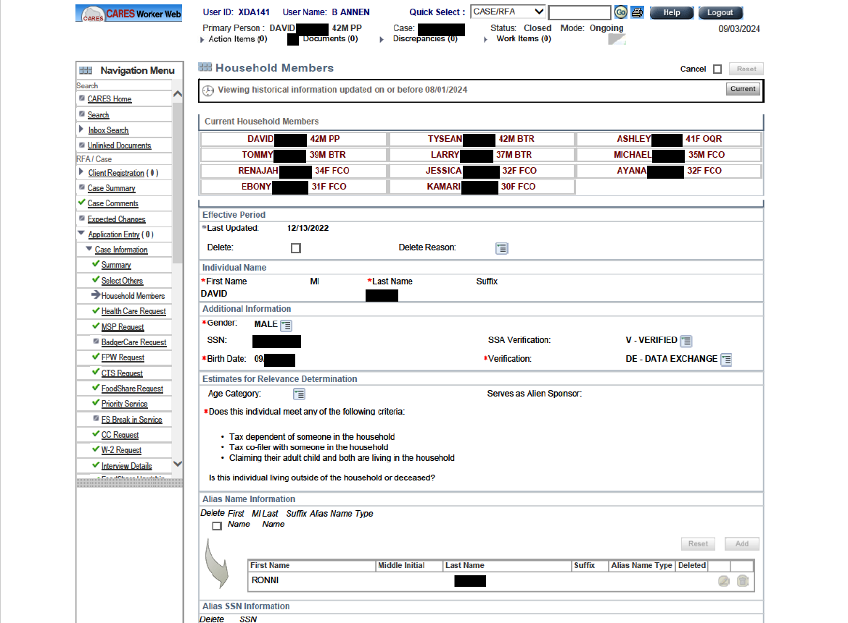

Slide 6
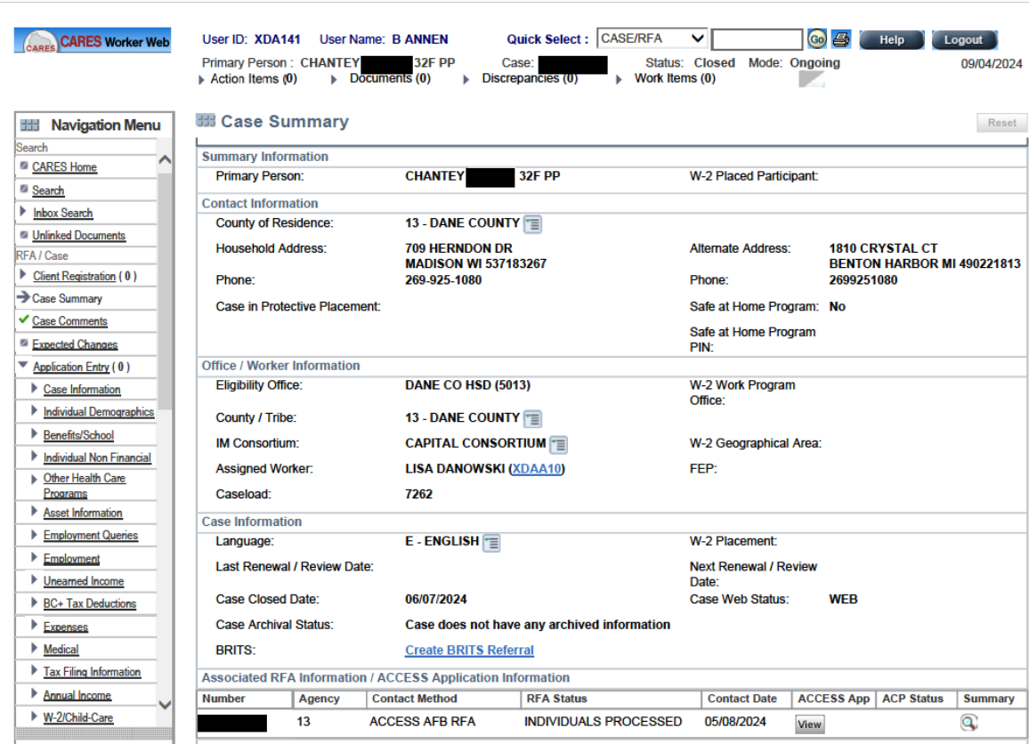

Slide 7
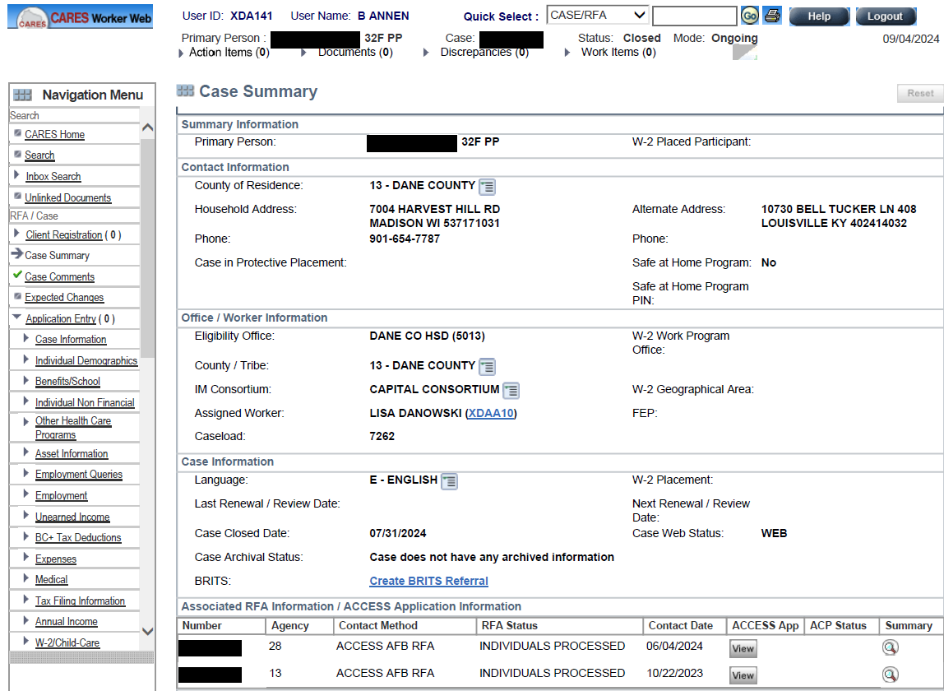

Slide 8
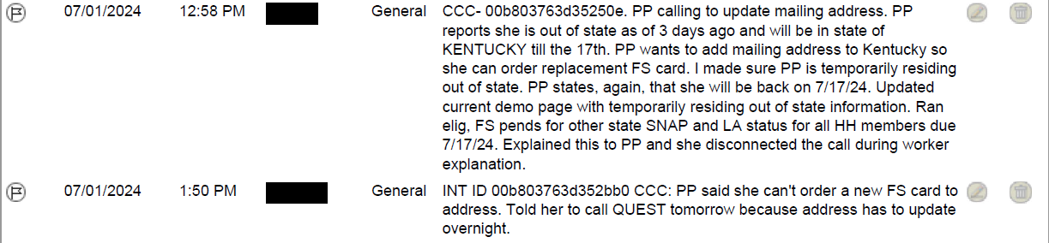
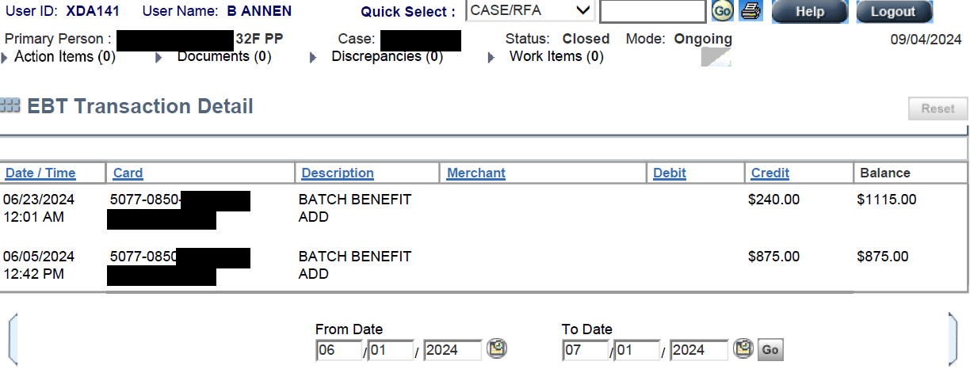

Slide 9
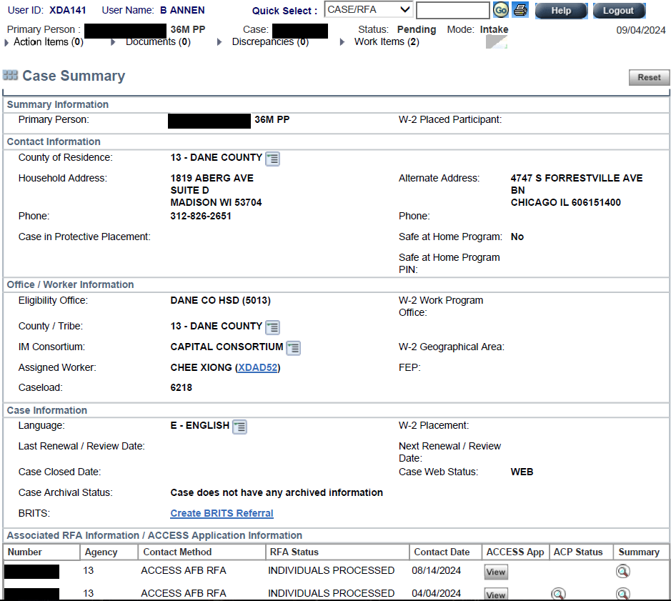

Slide 10
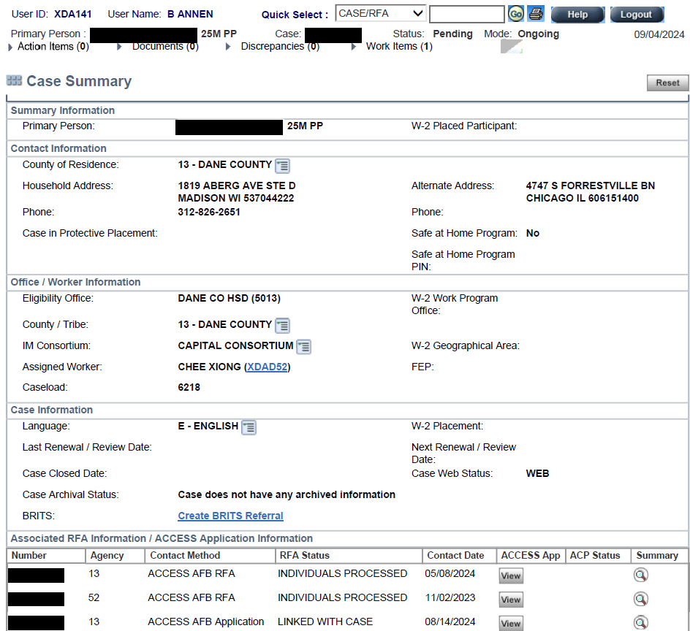

Slide 11
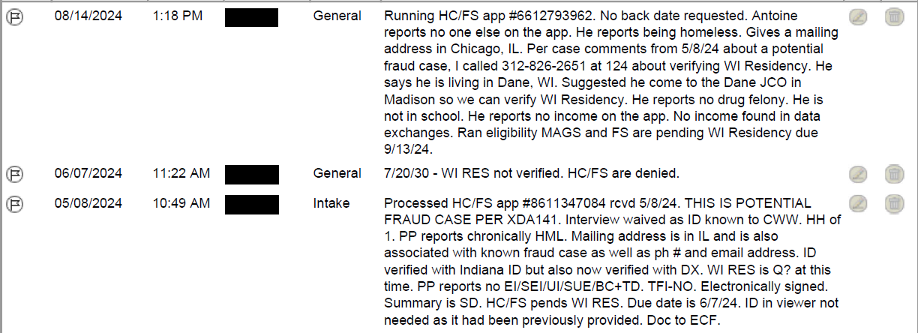

Slide 12
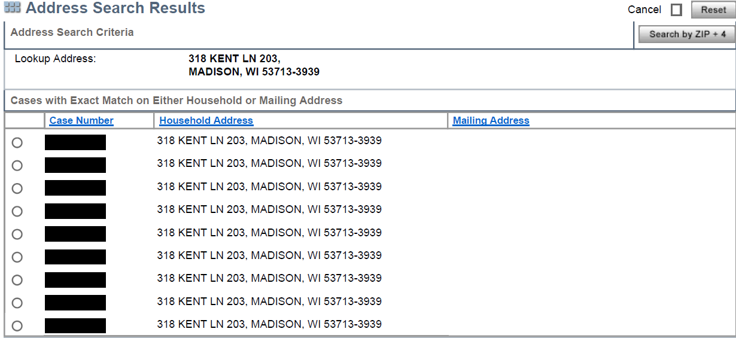

Slide 13
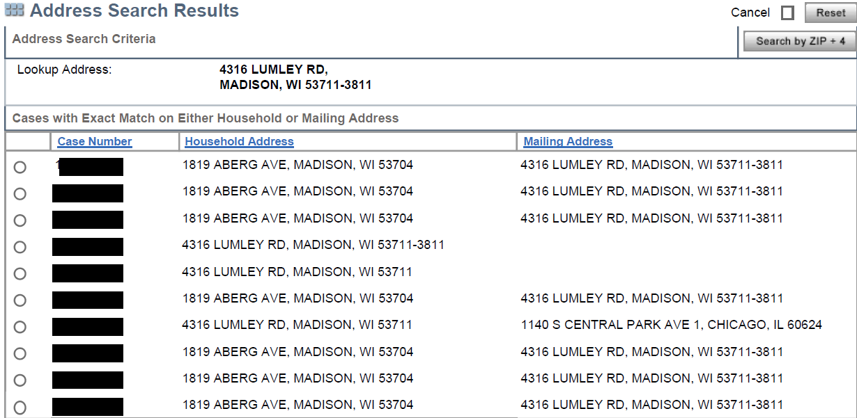

Slide 14
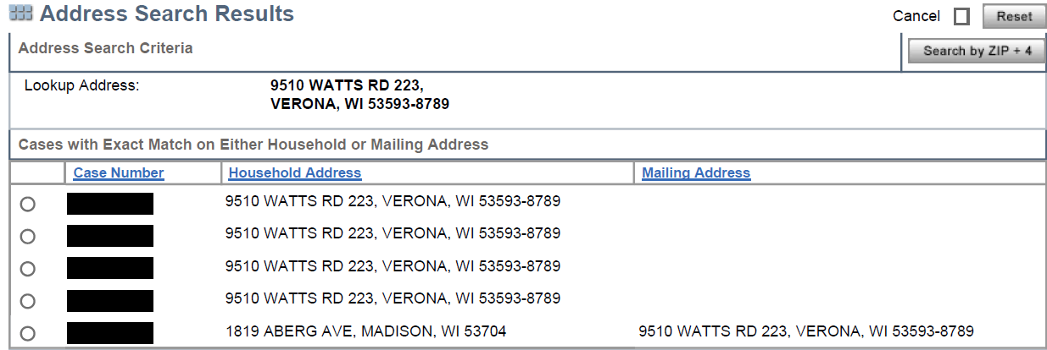

Slide 15
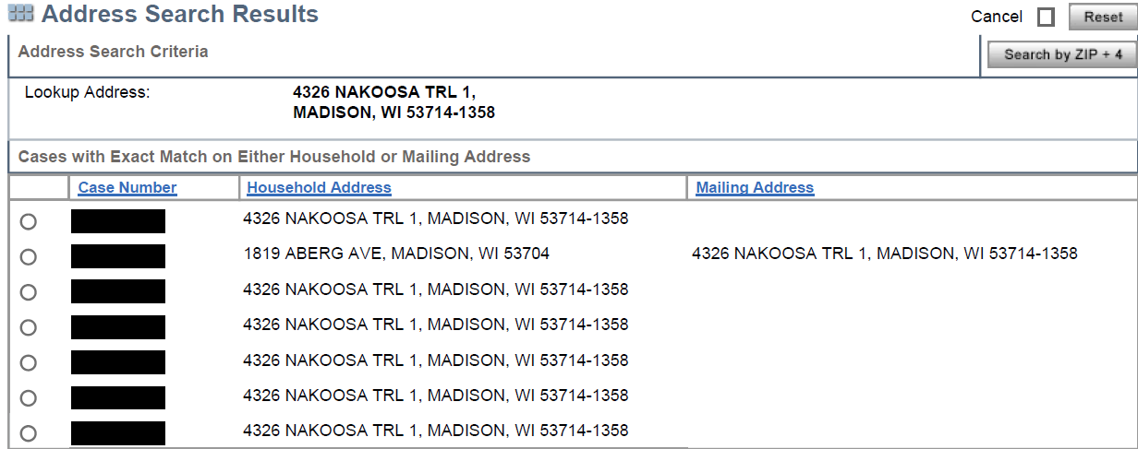

Slide 16
WHAT IS THE PROGRAM INTEGRITY UNIT DOING?
Hundreds of ID theft cases identified so far
Numerous cases identified as suspicious, but not confirmed as ID theft yet.
All identified ID theft cases have been made confidential and assigned to a lead worker (Lisa/Chee/Paul)
Screening all PS ACCESS Applications Daily
Monitoring of known phone numbers used to open ID theft cases (Genesys).

Slide 17
WHAT IS THE PROGRAM INTEGRITY UNIT DOING? (Con’t)
Reviewing FIS (EBTEdge) for all identified ID theft & possible ID theft cases to check phone numbers checking the balances on EBT cards, and direct delivery addresses to attempt to identify more ID theft cases.
Reviewing FIS phone daily report. This report shows phone numbers that call in multiple times in a single day on multiple cases.
Reviewing FIS daily user report. This report shows a single ACCESS ID linked to multiple accounts.

Slide 18
WHAT IS THE PROGRAM INTEGRITY UNIT DOING? (Con’t)
Working with DCSO detective(s) on all ID theft rings.
Securing subpoenas for IP addresses
Securing evidence, following leads.
Suspects in some of these ID theft rings have been identified.
Some arrests made, still pursing known suspects.
Working with FNS, USDA OIG, other consortia fraud investigators/Sheriff’s Departments as we continue to pursue suspects.

Slide 19
WHAT SHOULD YOU DO?
Be diligent!
If it seems suspicious it probably is.
Check EBT usage, mailing addresses, case comments.
If you deem something suspicious contact me immediately so it can be screened. E-mail me & “CC” Kara with the case number and a brief description of what is happening.
Annen.Robert@danecounty.gov
Ponti.Kara@danecounty.gov

Slide 20
BRITS REMINDERS
We are seeing an influx of the Gatekeeper office being incorrectly entered.
The Gatekeeper office should always match the County of Residence, not “Case Office”.
It is important to enter the correct Gatekeeper office, as the Gatekeeper office entered dictates where the referral goes.
Sheboygan, Dodge, Columbia do their own investigations.
Dane covers the rest of Capital Consortium.

Slide 21
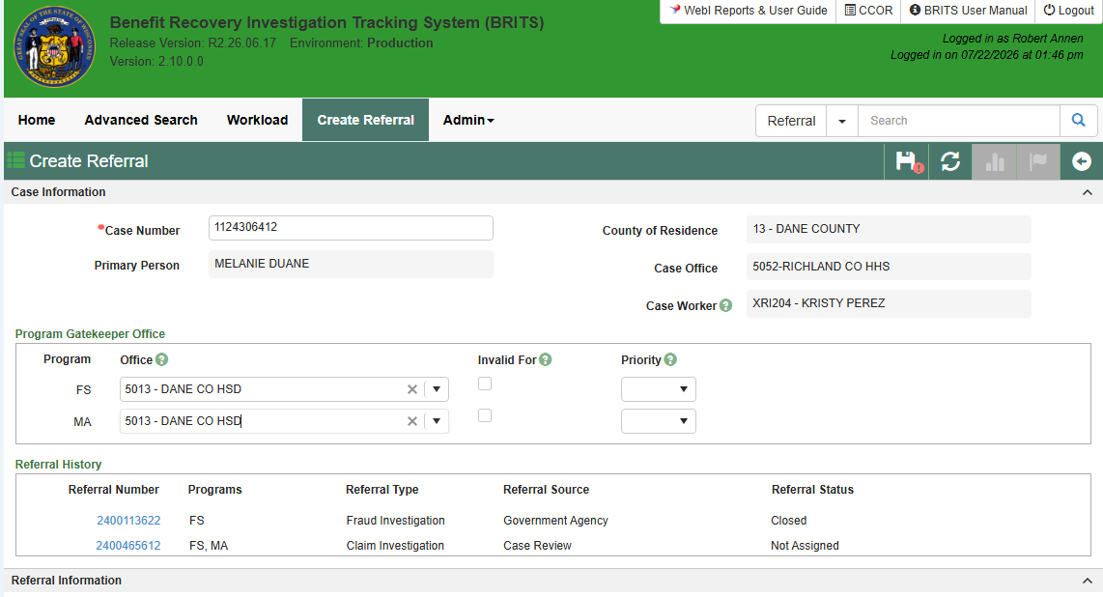

Slide 22
QUESTIONS?

