Slide 1
“Eligibility workers must not simply restate the application information but must address and resolve with the household unclear and incomplete information.”
-State SNAP Interview Toolkit

Slide 2
foodshare interviewing
Capital Consortium QC Team - July 2026

Slide 3
Why this topic?
COVID (‘20 – ’24) 28 months of waived interviews
Leading and Closed questions
Active Error Rate
  Interviewing contributed to $1309 of $1786 (73.2%)
Transcripts will be part of PCR effective 7/13
Notes:
Waived interviews – 2+ plus years between 4/2020 and 7/2024 (approximately 28 total months)
PCR and other QC processes involve periodic review of interviews – thru these we’ve found leading/closed questions as a dominant method of interviewing.

Slide 4
Why do we interview?
EXPLORE
  clarify/identify
SCREEN
  expedited service, work requirements, etc.
PROVIDE
  Rights and Responsibilities, Change Reporting, card usage rules, etc.
Notes:
Conducting the Interview
SNAP interviews serve three primary purposes:
1.
Explore and clarify the household’s circumstances and identify information that needs to be verified.
2.
Screen the household for circumstances that pertain to special SNAP rules, such as expedited
service, work requirement exemptions, student requirements, and non-citizen requirements,
including for sponsored non-citizens.
3.
Provide information to the applicant household regarding its rights and responsibilities under the
SNAP regulations and explain SNAP program requirements.

Slide 5
ACTIVE LISTENING
Focusing/Understanding/Reflecting/Proving
Remove distractions (cell phone)
Avoid interrupting the applicant
Verbal Nods - “I see,” “Got it,” “Makes sense”
Paraphrase – “To make sure I got this right….”
Take notes - minimize repeating and help recall
Notes:
Active listening is the practice of giving a speaker your full, undivided attention. It means focusing completely on understanding their message. You process both the words and the emotions. Finally, you provide thoughtful feedback to prove you understood them.
Key Steps to Actively Listen
Give full attention: Put away distractions like your phone. Face the speaker with an open posture.
Show you are listening: Nod your head. Make eye contact and use short phrases like "I see" or "That makes sense".
Do not judge: Wait for the speaker to finish before you form an opinion or share advice.
Paraphrase: Repeat back what you heard using your own words. For example, say, "So what you are saying is...".
Ask questions: Ask open-ended questions to learn more. This shows you are engaged and curious.

Slide 6
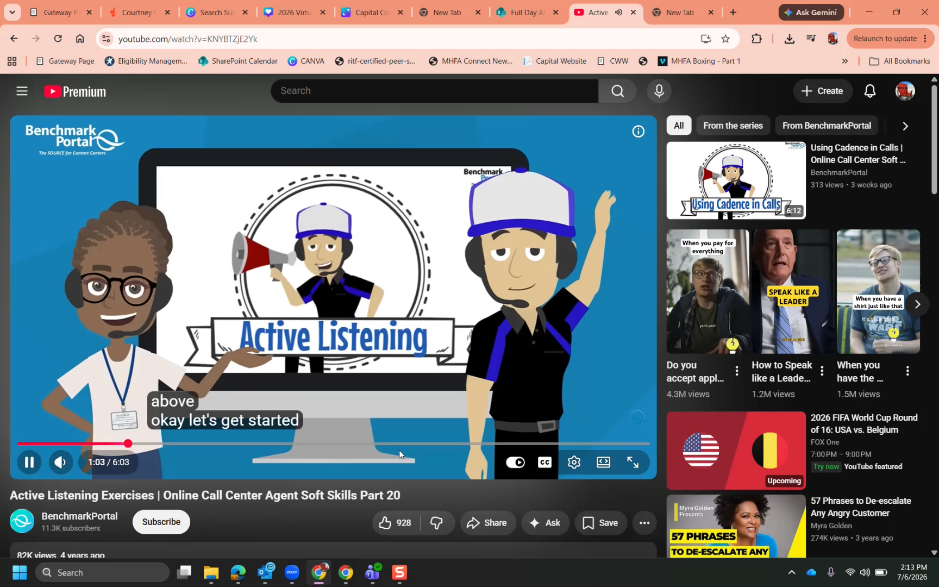
Notes:
Priority Service screening – you already gathered some info (income/shelter/utilities). Be ready to recall this when discussing income/expenses.
Irrelevant/Relevant Questions – EI page; do hire dates matter or is pay dates more important?
Receiver Bias – “Over Income,” but are we failing 013/014 or 557? It’s not always about double-checking income but expenses too!

Slide 7
Open-ended questions
  Let the applicant describe/explain
  Cannot be answered with Yes/No
  In their own words
  Having a conversation
  “80/20 Rule” - Applicant to Worker talk ratio
Notes:
An open-ended question is a query that cannot be answered with a simple "yes" or "no". It requires a longer, more detailed response, allowing the person to express their own knowledge, feelings, or experiences in their own words. [1, 2, 3, 4, 5, 6]
Key Characteristics
Word Choice: They typically begin with words like "what," "how," or "why," or start with phrases like "tell me about".
Depth: They encourage deeper thought, elaboration, and explanation rather than a quick, static fact.
No Single Answer: There is no finite list of choices; the respondent leads the direction of the answer. [1, 2, 3, 4, 5, 6, 7]

Slide 8
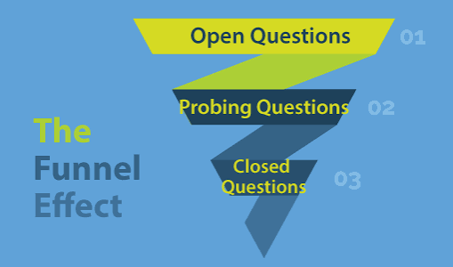
Funnel technique

Slide 9
HH Composition Funnel
Worker X opened the interview by stating to the client, “I see you, Sarah, John, and Evan on the application, is this correct?” No further discussion was had regarding household composition. How can we use the funnel technique to improve this interaction?

Slide 10
HH Composition funnel
“Who is living with you?” (Open)
“What is your relationship to this person?” (Probe)
“Are you purchase/preparing food with this person?” (Probe)
“To confirm….is this correct? (Closed)

Slide 11
Earned Income Funnel
Worker X inquires with the applicant if anyone in the household is working. The client states, “no,” and the worker moves on to expenses. The case was later found to have multiple new hires, including a new hire match within the last 90 days. How can we use the funnel technique to improve this interaction?

Slide 12
EARNED INCOME FUNNEL
“Our records suggest employment existed with X, can you share more about this job?” (Open)
“So, the job ended, but can you confirm the date of your final paycheck please? (Probe)
“To make sure I got this right…is that correct?” (Closed)

Slide 13
Expenses Funnel
Worker X has concluded the interview and runs eligibility. Foodshare fails for reason code 557 (net income too high to issue an allotment). Worker X informs the applicant they are over income and ends the call. Worker X discussed only shelter and utility expenses during the interview. The client has employment and utilizes the Wisconsin Shares program for two children. How can we use the funnel technique to improve this interaction?

Slide 14
Expenses Funnel (557)
“I see you’re on the child care program. Can you tell me about your personal costs for this?” (Open)
“Can you break down the cost per child?” (Probe)
“To make sure I got this….correct?” (Close)

Slide 15
Bonus material

Slide 16
Starting the interview
Normalize the Process
"Before we begin, I want to let you know that I am going to ask a lot of standard questions about your household and finances. We ask these exact same questions of everyone who applies to make sure you get every dollar you are eligible for.“
“There will be periods of silence as we make updates to your file.”

Slide 17
Hold is your friend
Use to control the call
Eliminate background noise
Time to absorb/reflect
Remember to check in (2 minutes)
We control and set the flow
Client has no time? Set filing date!

