Slide 1
QC presentation

Slide 2
agenda
Issuance Numbers
PCR Tool
Best Practices

Slide 3

Foodshare issuance numbers

Slide 4
Average monthly Foodshare numbers
**
*Source: IMMR IM FoodShare Benefit Issuance County of Residence Report
**2025 YTD average, total is a projection

Slide 5

Child Care Issuance Numbers

Slide 6
Average monthly Child Care numbers
*Source: WEBI report: Benefits Utilized and Children and Families
**2025 YTD average, total is a projection

Slide 7
BadgerCare Plus and Medicaid Numbers

Slide 8
2024 numbers
 | People enrolled | Medicaid cost | Cost per person
Adams | 4,307 | $46,308,864 | 10,752
Columbia | 5,537 | $59,533,824
Dane | 91,160 | $980,152,320
Dodge | 11,233 | $120,777,216
Juneau | 4,007 | $43,083,264
Richland | 12,829 | $137,937,408
Sauk | 10,815 | $116,282,880
Sheboygan | 16,542 | $177,859,584
 | 156,430 | $1,681,935,360
*Sources: badgerinstitute.org, usafacts.org, DHS Badger care enrollment data report

Slide 9

ESS impact
Capital Consortium in 2024:
Average 134 FT Caseloads
1.89 Billion dollars in benefits
13.98 million dollars per caseload
Active Error Rate – Absolute Value!

Slide 10
PCR TOOL
A new way to review cases

Slide 11
What is PCR and why are we moving to it?
Pre-Certification Review
Capital Consortium initially opted out of this tool
FoodShare confirmation delayed until case can be reviewed for accuracy
DHS requesting consortium integrate and use
Driven by changes established by H.R. 1 (“Big Beautiful Bill”)
Viable replacement for EI QC project

Slide 12
When will PCR begin and who will conduct reviews?
Monday, October 13th
QC Team will conduct reviews (PCR replaces previous EI QC Project)
Dane Reviewers
Lisa Danowski, Jeremiah Cook, Jesus Sanchez, Megan Thurston, Mary Pat Dilley
Partner Reviewers
Brad Schwartz (Sauk), Mandy Oman (Richland), April Lee (Juneau)
Supervisors
Alex Premo (Dane), Amber Taylor (Adams), Darin Steinmetz (Richland), Antonio Esterrich (Dane)

Slide 13
What Cases will be pulled in for PCR?
Sample Criteria
Non-expedited FoodShare -and-
$580 or more in Earned Income -and-
Intake or Program Add ready for confirmation
Minimum of 20 cases pulled per week
Anticipate a continuous run, with breaks planned for holiday weeks
ex. weeks of Spring Break, Thanksgiving, Christmas, New Years

Slide 14
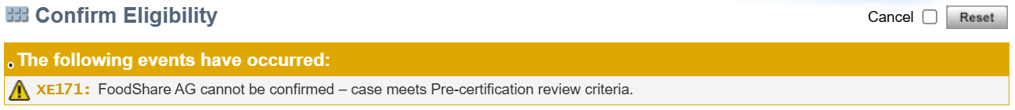
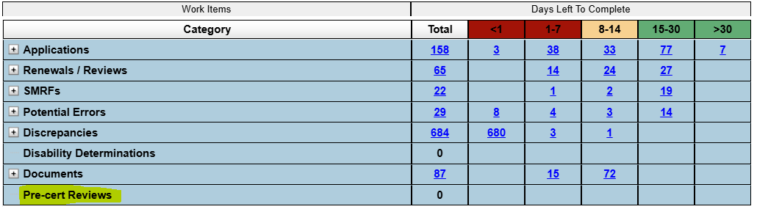
How will I know if a case is pulled for PCR?

Slide 15
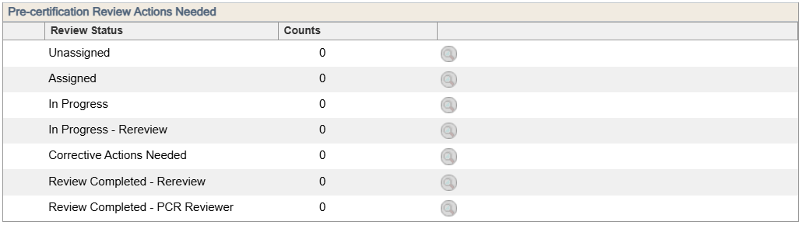
How will I know if a case is pulled for PCR?

Slide 16
What do I tell clients if I see the PCR banner?
Nothing, no need to inform clients that case is pulled for PCR
Confirm other benefits, only FS will be held for PCR
QC Team will have a process to identify cases needing same day confirmation
Same day review/confirmation will occur when:
Benefits are scheduled to open -and-
Benefit availability is expected same day/next day -and-
The client interacted with staff by phone or in person

Slide 17
What pages are reviewed through PCR?
Case Comments
Current Demographics
School Enrollment
Employment
Self-Employment
Unearned Income
Expense Gatepost (WHEAP)
Dependent Care Obligations/Payments
Support Obligations/Payments
Medical Expenses
Shelter Costs
Utility Costs
Non-financial Summary
FoodShare Budget
Notes:
EXPLAIN OLD PROCESS WAS EI TARGETED AND USUALLY ONE EI PAGE, NOW WE ARE REVIEWING MORE SCREENS. HC/CC ARE SECONDARY AS THIS IS A FS TOOL.

Slide 18
Will PCR results/findings be shared with staff?
Yes, QC Team will notify staff of results/findings via email
Workers will review findings directly in CWW
Errors found will be corrected by the QC Team
Can send back to workers
PCRs will hang on the dashboards until PCR finalized and case is confirmed

Slide 19
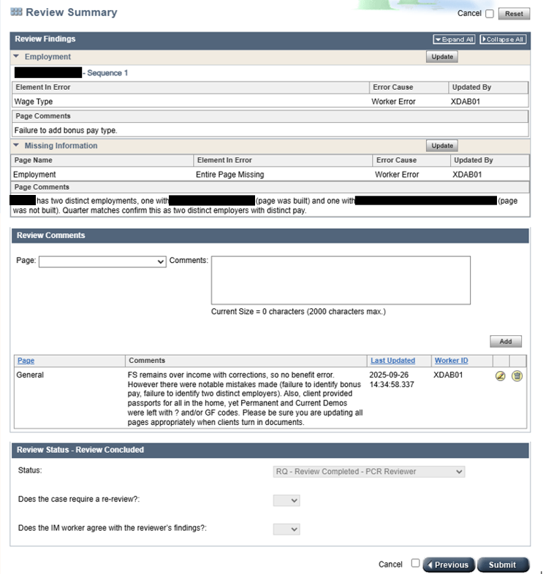

Slide 20
Best Practices
Case Comments
Current Demo
School Enrollment
EI Page
Dependent Care
SUE

Slide 21
Case comments
Make sure case comments reflect what is entered in the case
i.e. Drug felony screen
Don’t rely solely on case comment – check the case!

Slide 22
Current demo
Begin Month, please update first before making changes to the page
ID is one-time verification (FSHB 1.2.3.1)
Remember, if SSN is verified, ID is verified
Living Arrangements
Consistent for all household members
i.e. PP coded 10-Homeless, while others 01-Independent
WI Residency
NQ on FS only cases (FSHB 1.2.3.5)

Slide 23
School enrollment:
Work Study – must be awarded AND using it
'Meets caring for dependent children’
Missing this when there is a child in the home under age 6 and/or for single parents
Pending Student Eligibility
Already meeting employment exemption? May not need to pend.
Please update enrollment for school aged children
especially teenagers when dependent 18 year old rules may be affected
Q?’ing Enrollment Status
Not Questionable, typically need FS Student Eligibility Reason
Comments - Please use!
Full-time? Part-time? Degree program? Exemption met or not met?

Slide 24
EI Page
Overrides are a last resort – use Detailed Wage information (Dynalist)
NO FEIN? Check SWICA/FDSH/New Hire exchanges to find it
FEINs on EVFEs should be cross-referenced with the exchanges
FEIN search on EI page is unreliable – use FEIN from DE or EVFE
Final Month’s Pay
Expedited FS does not need verification of final pay
Add detailed comments as to why you are requiring final pay
Job Ends
Use end dates if no return anticipated (i.e. Fired)
Leave open-ended if client will return (i.e. Seasonal)
Get details from the client while completing your FS interviews!
Deleting pages for ended jobs that are recent. Keep any EI screens that are less than 12 months old

Slide 25
FDSH
PCR reviews will include cases with FDSH used
Processing FDSH, PH 16.4.3.1

Slide 26
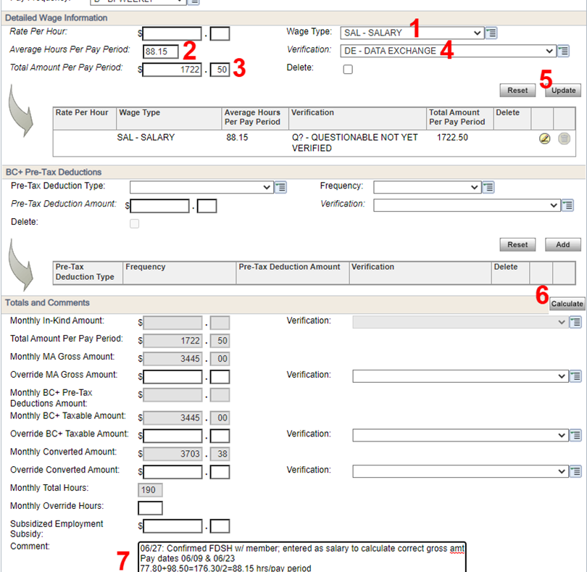
Required FDSH entry format
Enter “Salary” for wage type
Enter average hours
Enter average gross earning for pay period
Enter DE for verification
Update
Calculate
Enter the date, that you confirmed FDSH with the client, pay dates and calculations use

Slide 27
FDSH Continued
Reminder – FDSH does not show pre-tax deductions, please ask the client about this and pend as appropriate (BC+ cases)
Only commenting “per FDSH” is not acceptable, the comment must include:
Clear indication client agreed,
Pay dates used to establish the budget,
Salary is being used,
Show calculations

Slide 28
Dependent care
Self-declared unless questionable or unreasonable 1.2.4.6
Add/remove as needed – expense may continue to hold spot
Ex. 1 – client no longer working at renewal interview, but expense is left budgeted
Ex. 2 – client is working and has daycare costs, but no questions asked or amount budgeted

Slide 29
SUE
Count base rent - no garage fees, pet fees, etc.
FSHB 4.6.7.2 Do not count surcharges such as pet expenses or extra garage rentals as shelter or utility expenses. The monthly amount of rent the individual is obligated to pay should be taken into consideration each month when the shelter deduction is determined without regard to when the rent is actually paid. Only allow current monthly expenses. Do not include arrearages, late charges, or discounts for early payment.
Count only their portion of rent (households with roommates)
Does SUE exceed income?
Enter estimated and/or actual utility amounts, avoid $0 or $1 place holders

Slide 30
Thank you

