Slide 1
Adding and Deleting Individuals
Updated 5/2021
Notes:
Ed Sheskey
Last updated 1/2018

Slide 2
Newborn Adds
Process Help 3.1.1 Pregnancy End and Extension
End the pregnancy on the Pregnancy page by entering the newborn’s birth date into the Pregnancy End Date field.
Take the case through the mini driver flow to the Initiate Eligibility page.
Run eligibility and confirm pregnancy extension for the mother -OR- proceed to Adding a Newborn instructions.

Slide 3
Newborn Adds con’t
Process Help 3.1.2 Adding a Newborn to a Case
*STEPS COMPLETED BY FISCAL AGENT (Forward Health)*
Report of baby’s birth received centrally and newborn added to CWW and run through clearance to obtain MCI ID.
Newborn added to Household Members page and Household Relationships are updated.
Worker receives an alert to run eligibility and the alert CHANGE PROCESSED.

Slide 4
Newborn Adds con’t
STEPS COMPLETED BY WORKER
Check Birth Query
End pregnancy on Pregnancy page.
Build a newborn screen.
Update Absent Parent page.
Check Household Relationship screens.
Update all program request dates with date of baby’s birth (except W-2 if program request is yes).
Continue through mini driver flow and initiate eligibility (run with dates back to birth month, confirm HC only).
Check eligibility results (MAGB for CEN open).
Make case comments.
Notes:
***mention about migrant workers – pay attention! Sometimes workers just get into the habit of answering those questions without reading them. Some of our counties have more migrant workers than others.

Slide 5
When Adding a Newborn
Check Birth Query
Check for errors and paternity, then copy state file #
If found in BQ, use BQ for Permanent Demographics page for Citizenship
Use NB on Identity Verification AND Identity MA Verification lines on the Current Demographics page.
If not found on BQ, and mother was receiving full benefit HC at the time of birth, use NB for verifications (both lines) of the US Citizenship verification on the Permanent Demographics page and Identity Verifications (both lines) on the Current Demographics page.
**Note: GF verification code will NOT work if there is not a SSN for that individual

Slide 6
Hints for using the BQ
Always select “Starts With”
Exact DOB not needed – just search by the year of birth
First name not needed – try searching by just last name
Try using multiple last names – check AP’s last name, other siblings’ last names, etc

Slide 7
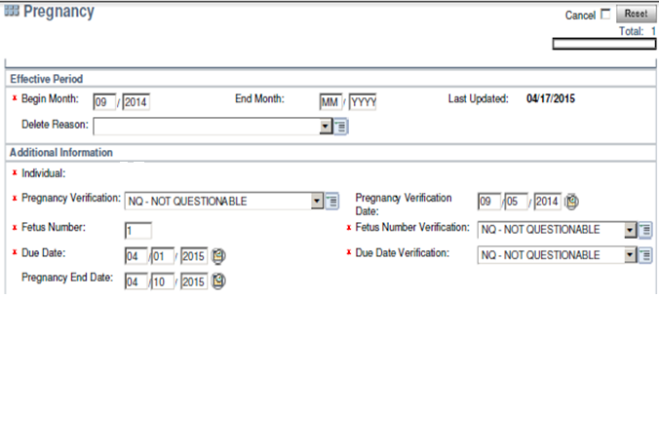
Pregnancy End Date
*Do not end date the pregnancy page.
But…End Date Pregnancy

Slide 8
Absent Parent Page
Add the newborn to the AP dynalist,
AND
Delete the row for the mother with the “M” indicator

Slide 9
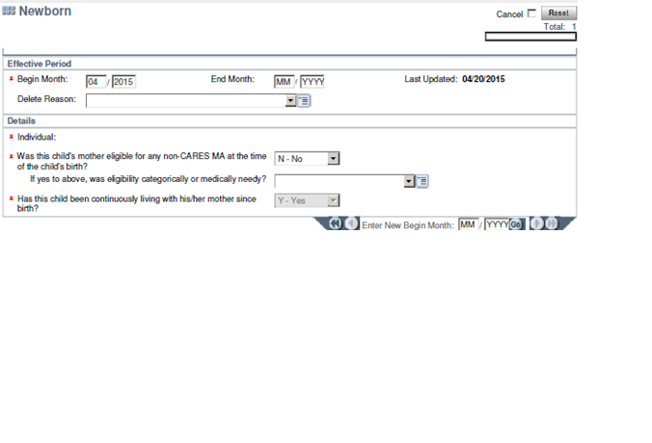
Newborn Screen
Enter birth month

Slide 10
The mother may have Non-CARES MA (Prenatal for immigrants, or EMA) due to immigration status or because the mother receives SSI-MA. If the mother has Non-CARES MA at the time of the child’s birth then the newborn screen needs to be completed with “yes” and “categorically needy”. This is necessary in order to correctly open MAGB (CEN) for the newborn.

Slide 11
Continuously Eligible Newborns
Newborns are automatically eligible for BadgerCare Plus from the date of birth through the end of the month in which they turn 1 year old if:
The mother was determined eligible for one of the following programs:
BadgerCare Plus
Other full-benefit Medicaid
Emergency Services BadgerCare Plus
Emergency Services Medicaid
BadgerCare Plus Prenatal Program (as a non-qualifying immigrant)

Slide 12
Continuously Eligible Newborns
There is no income test for these children while they are eligible under this status. The CEN will not have to pay premiums and is not subject to the health insurance access/coverage requirements.
Anyone who has ever been eligible as a CEN under Medicaid or BCP is exempt from the citizenship and identity documentation requirements.
This means that we do not request verification of citizenship or ID for that baby.

Slide 13
Continuously Eligible Newborns
A newborn is not required to reside with his or her mother to be eligible as a CEN. This is true even if the newborn is being placed in foster care, adoption, or is residing with a caretaker relative.
The newborn child does not receive this automatic eligibility as a CEN if the mother's BCP enrollment is a temporary enrollment through the Express Enrollment program.
Children born to incarcerated mothers will not be eligible as CEN Continuously Eligible Newborns.

Slide 14
SSN Requirements for Newborns
Do not require SSN for CEN(s) for BadgerCare Plus coverage (SSN due after child turns 13 months old)
SSN due before child turns 6 months old for CTS
SSN due at recertification or by 6 months of age for FOODSHARE.
SSN or proof that client has applied for SSN for child is NECESSARY for CC/W-2 (30 days)
If multiple programs are open, go with the rules of the most strict program.

Slide 15
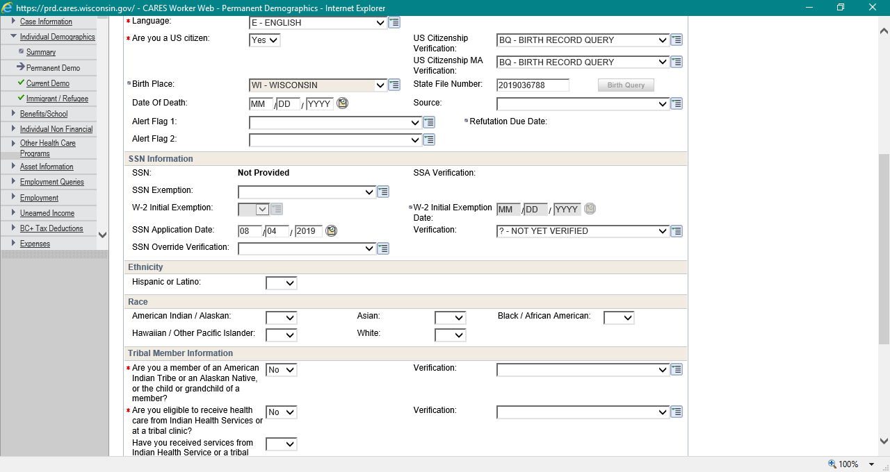
SSN Application Date for CC/W-2
*Once we enter BQ here and we run eligibility, the code will update from “BQ” to “NX” ☺

Slide 16
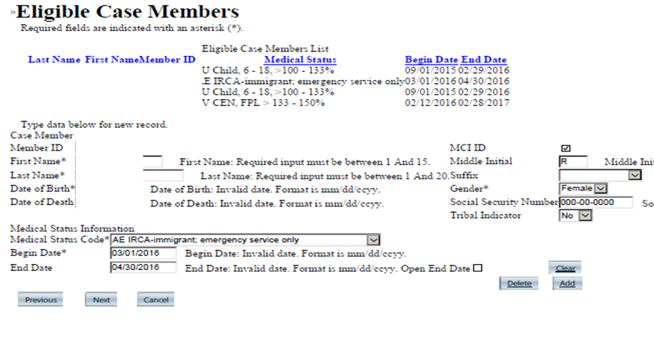
60 day extension for Immigrants (3070 manual certification for AEMA)

Slide 17
Child Support Referrals
Refer to Child Support
Pregnant woman who is unmarried or not living with husband (not required to cooperate for 60 days following birth)
Non-marital co-parents when paternity not established
One or both parents are not living in the household
Don’t Refer to Child Support
Cooperation with Child Support Enforcement is not an eligibility requirement for:
FFCY (Former Foster Care Youths)
Foster Care parents, court ordered Kinshipcare
BCPP (BCP Prenatal Program)
Children receiving SSI

Slide 18
Child Support Referrals
Check birth query and update AP screen as appropriate when paternity has been established.
Update Household Relationships as appropriate. It is not necessary to pend HH relationships while waiting for Child Support to establish paternity.
Enter “claimed” father as not questionable.
Refer to Child Support when the non-marital father is in the home (father could be responsible for birthing costs).
If both parents are in the home and married, there is no referral to Child Support.

Slide 19
Child Support Notices
The Good Cause Notice and Notice of Assignment must be mailed when programs (not FS) are requested for a child who does not have both legal parents in the home:
At intake
Case already open for programs, now requesting HC
Adding a child to an open case
Parent leaves the home

Slide 20
Child Support Notices
Notices are provided automatically through ACCESS when people apply or complete renewals online, so the requirement for IM workers to furnish the notice directly to them does not apply in these situations.
We must continue to mail Child Support forms to clients who apply or complete renewals (not FS) by mail or by phone. To send these notices:
Under Client Correspondence on the CWW Navigation Menu:
Click on Manual Letter Selection
Check Generate a Manual Letter
Program Code = All Programs (for CC/W2) or Healthcare
Letter Code = CC GOOD CAUSE CLAIM-NGCC and CC GOOD CAUSE NTC-NGNC (For W2/CC) or IM GOOD CAUSE CLAIM-NGCI and IM GOOD CAUSE NTC-NGNI (For Healthcare)

Slide 21
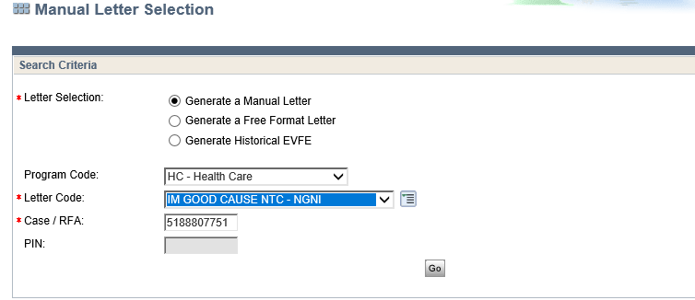
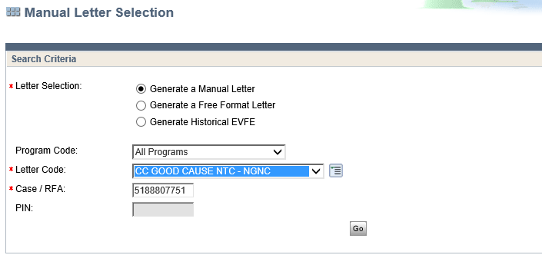

Slide 22
Special Considerations
Issue FS supplements (auxiliaries) for month following report of birth
When running with dates confirm only HC for back dated months.

Slide 23
Adding Non-Newborns
Process Help 3.2.1 Process At A Glance:
Navigate to Case Summary page, and Select Add Person.
Add the new person to case on the Household Member page.
Program Request Page - Update begin month and request date to the effective date of the person add.
Continue through the Person Add driver flow.
Update Absent Parent, Employment, Unearned Income page as appropriate.
Initiate eligibility, running with dates as needed for correct eligibility.
Check eligibility determination pages.
Supplement benefits if appropriate.
Check review date on Confirmed Assistance Group Summary.
Enter Case Comments.

Slide 24
Add a Person
Where there is a button, there is a driver flow.

Slide 25
Adding Non-Newborns
*Special Considerations*
Always make one change at a time. NEVER delete one individual and add another in the same step.
FS supplement for month following report of person add
Run with dates to cover month when change was reported for HC (Run backwards, confirm HC only)

Slide 26
Deleting Individuals
Process Help 3.3
Navigate to the Household Members page
Select the person to be deleted
Check the delete box and enter delete reason
If the difference in the program filing date and the current date is more than 3 months, you need to update the program filing dates. CWW will prompt.
Run eligibility
Review budget screens
Confirm if correct
Issue auxiliary benefits if appropriate
Make case comments

Slide 27
Deleting Individuals
*Special Considerations*
May need to add AP page if person deleted is parent of a minor child in HH and refer absent parent to Child Support.
Best practice is to delete BEFORE running a renewal or intake, or making a change to avoid negative impact on other cases.
Person delete is complete only after case is fully confirmed and individual is no longer showing on ANID (in the Mainframe)
Banner when individual is open on another case—courtesy email to other worker to update from 15 to 01 and re-run.

Slide 28
15 versus Delete
Enter a “15” on the current demographics for an individual when the person is expected to return to the home.
Delete when there is no anticipated return to home and no tax filing relationship.
Deleting an individual automatically 15’s that person on any other case that person is listed on.
So there’s no need to 15 and then delete.

Slide 29
Deceased Individuals
When we receive a report of a death, make sure to enter correct Date of Death from data exchange or Death Certificate (wrong date can affect Burial Funds)
DO NOT change primary person on case Example: If wife is primary person on case, and husband calls to report his wife’s death, the husband must do a new application as the primary person.

Slide 30
Adding adult to CC Case
Non-financial verification—Not verified:
Enter verification codes and CWW will correctly close the entire AG. Running with dates is not needed
Financial verification—Not verified:
Enter verification codes, run eligibility with dates (CC PH 1.8.4.1) If this is an ongoing case, CWW will continue to pass the entire AG, which is WRONG. The worker must do manual overrides in CARES mainframe (PH 41.3) to correctly fail the AG with the correct failure code of 769 (earned income) or 760 (unearned income)

Slide 31
Adding adult to CC case

Slide 32
Troubleshooting
Getting that “Can’t Run 9 Months Live” error?
Update all the request dates to the DOB of the newborn

