Slide 1
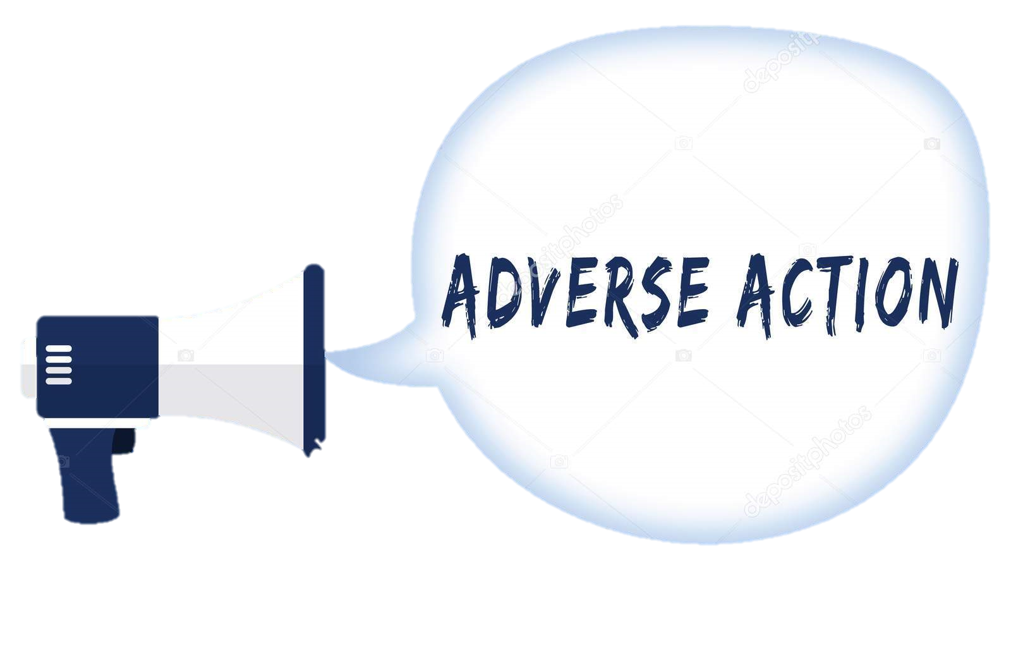
Tips Regarding (AA)

Slide 2
Objectives
What is Adverse Action
The impact of change reporting on:
FoodShare (FS)
HealthCare (HC)
Caretaker Supplement (CTS)
Reminders

Slide 3
What is it?
Adverse Action
Referred to as cutoff
A batch run done approximately 13 calendar days prior to the end of the month
Allows 10 days for negative notices regarding benefit reduction, denial, or closure

Slide 4
Pulldown
Occurs 1-2 working days after AA
Cannot run with dates during this period

Slide 5
Why is it important?
Last day to impact next month’s benefits to ensure proper
notices to client
Process SMRFs and renewals before cutoff to avoid negative notices
Timeliness = less work (running w/dates, issuing auxiliaries, phone calls)

Slide 6
Reduce CAPER (Case and Procedural Error Rates)
monitored by the state
Reduce client anxiety and stress
Impacts QC timeliness report

Slide 7
FoodShare

Slide 8
FoodShare
All reported changes that cause an increase in the FoodShare benefit will be effective the first of the month following the report month
person adds
increase in expenses
decreased income
If case is pending for verification over AA, benefits will be issued at the last confirmed amount

Slide 9
FoodShare
Examples:
1) Sarah reports on April 2nd that her rent increased. If not questionable, FS will increase effective May 1st.
2) Nancy reports on April 10th that her income decreased, verification is due April 30th. AA is the 17th, May FS benefits will be issued at the last confirmed amount.
-If verification is received April 15th (before AA), FS will increase effective May 1st.
-If verification is received April 20th (after AA), since May benefits have already been determined, worker will need to issue auxiliary for May.

Slide 10
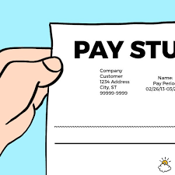
FoodShare
Examples:
1) Barbara reports on April 20th that she gave birth on April 5th. The baby add is effective May 1st. The worker will need to run with dates for May and issue a FS auxiliary for May.
2) Ryan calls on April 20th to report a new job, verification is due May 10th. The new income, once verified, will be used to determine June benefits.

Slide 11
3) Luke calls on January 29th to report a job loss, verification of February income is due February 18th. Verification is received February 21st. Since verification was not provided timely, Luke is not eligible for a February auxiliary. The change will effect March benefits.
January
February
March
No verification

Slide 12
You will not be able to run with dates during pull down.
You must go back to the case and run with dates and issue aux, if needed, after pull down.
Make yourself a reminder:
Use outlook
Write it down
Set an alert

Slide 13
HealthCare

Slide 14
HealthCare
Reasons for running with dates
To make a correction to healthcare benefits
To add an individual to healthcare

Slide 15
HealthCare
TIPS for running with dates:
Make sure that begin months are accurate
Check the non-financial and financial results before confirming
Confirm only the HealthCare AGs
Check renewals dates (do not extend or shorten certification periods)

Slide 16
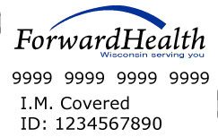
*** Confirming eligibility for healthcare while running with dates will certify the eligibility within ForwardHealth ***

Slide 17
Baby Add
**Prior to AA** Client reports on 6/5 that she gave birth on 6/2. The worker will need to certify the baby effective June:
run with June dates (6/2), and
run without dates to certify the baby
**After AA** Client reports on 6/20 that she gave birth on 6/2. The worker will need to certify the baby effective June:
run with June dates (6/2),
run with July dates (7/1), and
run without dates to certify the baby

Slide 18
Changes to income/premium
Decreased Income/Premium:
If the change is reported within 10 days of when the change occurred, the lower or $0 premium amount is effective during the month in which the change occurred. If the change is not reported within 10 days of when the change occurred, the lower or $0 premium amount is effective during the month in which it was reported.
Example: Brian reports on April 10th that his job ended April 5th (timely reporting), the lower premium or $0 premium is effective April
Example: Brian reports on May 2nd that his job ended April 5th (untimely reporting), the change is effective May

Slide 19
Increased Income/Premium:
Client must be given a 10-day notice when the group is required to pay a premium for the first time or is required to pay a higher premium
The increase is effective the following month if eligibility is confirmed before AA
If the change is confirmed after AA, the increase is not effective until the month after the following month

Slide 20
Example: Jessica has BadgerCare with a premium for her children. She reports a change in income on April 23rd that results in a higher premium amount. Jessica’s premium amount will increase effective June 1st. She will receive the coupon for the new premium amount at the end of May.

Slide 21
Premium Increase (Person Add)
If the person was added to the case before AA, the increase is effective the next month
If the person was added to the case after AA, the increase is not effective until the second month
Example: Rachel’s husband Mike moved back into the home on June 1. She reported the change on June 6 (before adverse action), Mike’s income resulted in a premium increase. The increase is effective July 1.
July
$$$

Slide 22
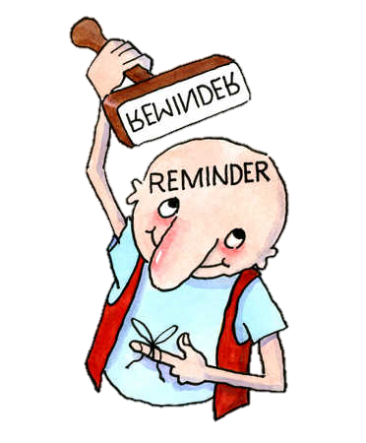
REMINDERS:
You will not be able to run with dates for the following month during pull down.
Example: It is 3/19/18 (pull down) and you need to run with dates for March and April. You can run with dates for March, but will not be able run with dates for April until after pull down.
You must go back to the case and run with dates after pull down.
Make yourself a reminder:
Use outlook
Write it down
Set an alert

Slide 23
CTS

Slide 24
CTS Interface
Is the transmission of CTS eligibility from CWW to Wisconsin SSI program
Interface completed at AA and pull down dates contains majority of CTS benefits for the following month and coincides with the SSI payment cycle
CTS eligibility can be confirmed anytime, however will only transmit to SSI program twice a month

Slide 25
CTS Interface
Data interface occurs twice per month
Initial interface occurs on adverse action
2nd interface occurs one week after AA (last date possible in order to have CTS benefits included in the first of the month)

Slide 26
CTS Payment Schedule
Generally CTS payments are
made on the 1st of the
month for that month
CTS payments can be made separately from the SSI payment, such as retroactive payments or late renewals
For instance, a retro payment can be paid out by the 3rd week of the month instead of the 1st of the following month
Case MUST have received both Federal and State SSI in that month to receive CTS

Slide 27
CTS Payment Schedule
If CTS payment is confirmed after the 2nd CTS run, payment will be added to next possible payment month’s SSI check for that parent
Example:
If CTS is confirmed on 3/30/18 (after the 2nd CTS run for March and April), the next possible payment month is May.

Slide 28
CTS Payments (HOD)
Query CPRG- to see which payments have interface and have been issued
Query CPRB- to see which payments are in retro status and waiting to be processed/paid

Slide 29
Running with Dates
Once running with dates has been completed, it cannot be undone
Running with dates should only be completed on certain circumstances:
When determining eligibility for an individual member being added to CTS AG (newborn / child added to the home)
SSI parent already receiving CTS is found eligible for SSI for a previous time period

Slide 30
Retro Form
Newborn / child added to the home
SSI parent already receiving CTS is found eligible for SSI for a previous time period
Manual payments are issued within 2-3 weeks of the fiscal agent receiving completed payment request
Complete F-22564 and fax
(fax number is listed on the form)
Code F-22564 as MAEF and scan to ECF
Complete mainframe screen ACMP
(F16 to start a new screen)
Case comment

Slide 31
Example:
On 2/6/2018 Anna calls to report that her son, James moved back in to the household in January. James is eligible for February CTS benefits.
The worker must:
1) Run with dates for February
2) Complete and fax the retro form
3) Code and send retro form to scanning
4) Complete ACMP in HOD
5) Case comment
February CTS for James will be issued by the 3rd week or last week of February.
On March 1stAnna will receive March’s CTS benefits.

Slide 32
Late Renewals
One grace month of eligibility before CTS will close to lack renewal
Can delay CTS payment
Do not update CTS begin date in CWW
Terminated
Examples:
Jennifer’s CTS renewal is due 12/31/2017. Jennifer fails to complete renewal by 12/31/2017. Jennifer will receive benefits for month of January, the CTS AG will close at January adverse action. CTS benefits will end 1/31/2018.

Slide 33
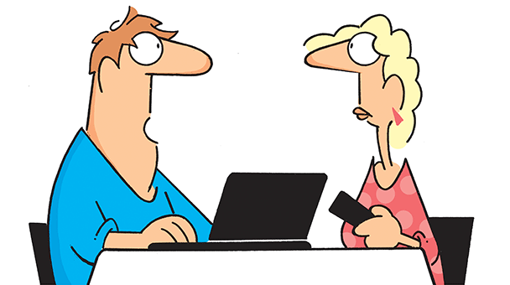
Late Renewals
If Jennifer completes her CTS renewal on 1/10/18 (before January AA)
CWW will automatically run eligibility for February (no need to run with dates for January)
January payment already scheduled out January 1st
Feb payment will be received by Feb 1st

Slide 34
Late Renewals
If Jennifer completes her CTS renewal on 1/23/18 (after January AA)
CWW will automatically run eligibility for February (no need to run with dates for January)
January already scheduled out January 1st
Feb payment will be delayed
Received 3rd week of Feb, no later than March 1st

Slide 35
Late Renewals
If Jennifer completes her CTS renewal on 2/7/2018 (before AA)
January will already be paid out on January 1st
Feb payment will be delayed
Will be paid with March CTS
March CTS will be paid on time, March 1st

Slide 36
Late Renewals
If Jennifer completes her CTS renewal on 2/20/2018 (after AA)
January will already be paid out on January 1st
Feb payment will be delayed
Will be paid with March CTS check
March payment will be delayed
Will be paid the first week in March
April payment will be paid on time, April 1st

Slide 37
Renewal Not Completed
If Jennifer calls in March regarding her December CTS renewal and still meets all of the requirements
Consider it a new CTS application
Update CTS begin date in CWW
Written signature is needed
They are not eligible for CTS for February

Slide 38
Change Reporting Reminders
A child must be residing with at least one
biological parent to be eligible for CTS
No other person (non-biological parent) labeled as guardian can receive CTS for the child even the person is receiving SSI
Exception applies only if the child is officially adopted and the adoptive parent is also receiving SSI

Slide 39
Change Reporting Reminders
If the CTS child is reported out of the home for any reason
Check to see if the parent has been receiving CTS for the period of time the child was out of the home
Overpayment will be collected for both client and non-client errors

Slide 40
Change Reporting Reminders
Non-SSI biological parent moves into the home
If parent is not receiving Wisconsin SSI, check if paternity is established
If established, no CTS for the child
If not established,
child can continue to
get CTS payment

Slide 41
Change Reporting Reminders
Placement of school age children must be verified if the child was living with other relatives or taken away by social services
Parent must be shown as the guardian of the child to regain eligibility for CTS payments
Request verification of guardianship and residency
from the child’s school, if possible, (schools may not be aware of the child’s placement status)OR the social worker

Slide 42
Change Reporting Reminders
Dependent 18-year-olds
CWW will ask for anticipated date of graduation for 17 year
old.
Request verification that the 18 year old is expected to graduate prior to attaining age 19.
If 18 year old graduates before his/her 19th birthday, eligible for CTS until the graduation date.
If 18 year old will NOT graduate by their 19th birthday CTS ends.

Slide 44
When processing a change, ask:
Is a FS aux needed?
Email your lead or supervisor if aux
approval is needed.
Is it appropriate to run with dates?
Are the HealthCare AG review dates correct?
Are HealthCare benefits correct for all eligible members?
As a best practice, do not wait until day 10 to process changes, documents, renewals, etc.
Request verification following a report of change to prevent “failure to act” agency QC errors.

Slide 45
Where are the AA dates?
Can be found on Capital Consortium website
https://capital-im.com
Under Desk Aids
Then Multiple Programs
Mainframe: RTDT in trans and TBIC in parms.

Slide 47
Questions

