Slide 1
Non Swica Discrepancies
Jeremiah Cook
Dane County Human Services
Updated 02/05/20

Slide 2
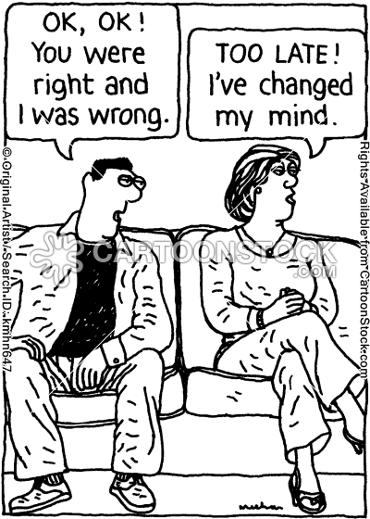
What is it?
Discrepancies are action items that alert us that an inconsistency exists between CWW info and info from the data source.

Slide 3
Where to find discrepancies
On the CWW home page on your dashboard.

Slide 4
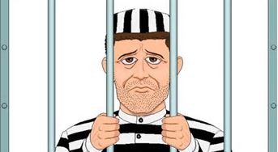
Four Types
Unemployment Insurance (UIB)
SOLQ-I
SWICA
Prisoner

Slide 5
Unemployment Insurance (UIB)
Three common discrepancies:
Working part time
Query the UIB page to verify income, and update the UI page manually. Also check Employment Page.
Child Support intercepted
TIP: enter the CS expense deduction on all cases, even those that don’t allow CS payment expenses as a deduction. You’ll avoid a discrepancy every month.
More than one payment missing
Query the UIB page to verify income, and update the UI page manually.

Slide 6
Example of UIB Discrepancy

Slide 7
SOLQ
SOLQ inquiry is initiated during intake, renewal, person add, program add, and SMRF from the General Case Information page.
SSN ver not found / last name mismatch
New SSN provided check DX and update
New DOB from SSA check DX and update
Dual / Trip entitle update SS and Medicare
Federal SSI-update State SSI (SISS)
Railroad Retirement update Medicare
Gross / net SS discrep enter OT income

Slide 8
SOLQ
SSN ver not found / last name mismatch: SSA cannot verify an SSN because the last name doesn’t match. Follow up with customer to verify name and SSN. CARES will not auto update any CWW pages.
New SSN provided check DX and update: SSA verifies the SSN, but the SSN and/or DOB is off by one digit. Check SOLQ to obtain the correct SSN and update Household Members page.

Slide 9
SOLQ
New DOB from SSA check DX and update: SSA found the person and returned an SSN verification, but the SSA DOB doesn’t match the DOB in CWW. Use SOLQ and other resources to determine the correct DOB.
Dual / Trip entitle update SS and Medicare: The SOLQ process can’t update income for individuals with dual or triple claim numbers. Check SOLQ with the individual’s SSN and manually update the income on the Unearned Income pages.

Slide 10
An Example of a Dual/Trip Entitlement

Slide 11
SOLQ
Federal SSI-update State SSI (SISS): SOLQ can only update federal payment information. Verify the State SSI payment and update the information manually on the Unearned Income page.

Slide 12
An Example of a State SSI Discrepancy

Slide 13
SOLQ
Note that the State SSI does not display on the initial screen. Hit the Previous Source button to view this information.

Slide 14
SOLQ
Here we see the State SSI payment displayed.
In this particular case, the client is deceased, thus generating that alert.

Slide 15
SOLQ
Railroad Retirement update Medicare: The SOLQ process cannot update income or Medicare as some or all benefits may be received through Railroad Retirement. Verify income or Medicare and update the appropriate pages in CWW.

Slide 16
SOLQ-I
Gross/net SS discrep enter OT income: When there is a difference between the gross and net SS amount, we enter the NET on the Unearned Income page, and that amount, plus the Medicare Premium amount should equal the gross amount. If not, Workers must contact SSA or the applicant/member to gather more information on the deduction.

Slide 17
An Example of a Gross/Net Discrepancy

Slide 18
SOLQ Notes
NOTE: Enter the amount that is being deducted on the Unearned Income page as “OT” income. Case comment. If the deduction is for an allowable expense for the program requested, enter the expense on the appropriate page in CWW (Support Obligations / Payments page, the Medical Expense page, or Medical Coverage page).
NOTE: If the individual receives Medicare Premium Assistance, the amount of the discrepancy will be the gross amount, minus the payment displayed on the Unearned Income page. (Since the premium is already counted in the payment.)

Slide 19
Prisoner
CWW sends a monthly request for prisoner match data from SSA for all individuals 18 and older, as long as there is a code of V, C or W for SSN verification.
These matches require further verification of incarceration before taking any negative action.
Agency liaison, phone calls, State of WI Offender Locator or Federal Prisoner Information – links to websites in Process Help.
If customer is incarcerated, make necessary updates, determine ongoing eligibility, and determine whether there may be an overpayment.

Slide 20
Example of Prisoner Discrepancy

Slide 21
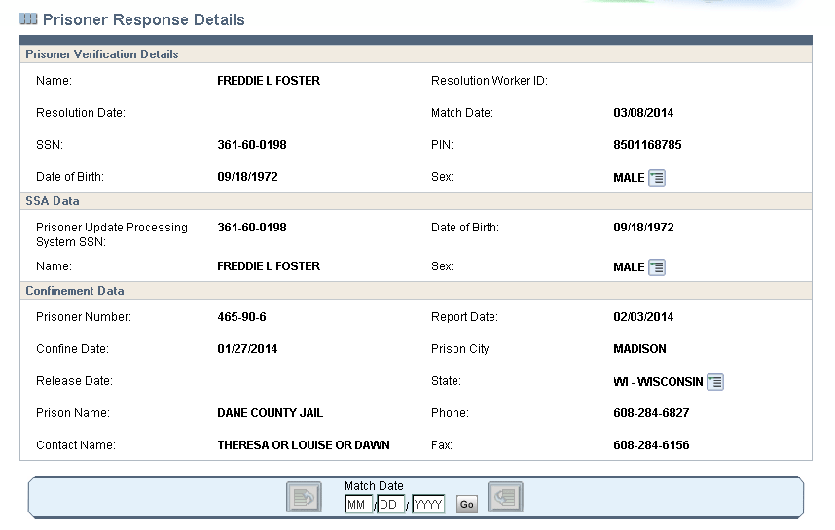
Prisoner Response Details

