Slide 1
Immigrants, Refugees and SAVE
Updated 1/20

Slide 2
Table of Contents
Page 3: Immigrants
Page 5: 40 Work Quarters
Page 8: Dreamers/Deferred Action
Page 9: BadgerCare Prenatal
Page 10: Newborn Adds for BadgerCare Prenatal
Page 13: SSN Requirements for Newborns
Page 15: Who qualifies for EMA?
Page 16: Two categories of Eligibility’
Page 17: Non-financial Eligibility
Page 18: Manual Program
Page 19: Deeming Income for FS
Page 20: Refugees
Page 23: Verification
Page 26: Institute Secondary Verification
Page 30: Manual Certification form (3070 or F-10110)
Page 32: Ops Memo 19-J3
Page 33: Reasonable Opportunity Period

Slide 3
Immigrants
5 Year Ban/Waiting Period
  Applies to Adults only with Legal Status as outlined in Program Manuals
  No ban for children, pregnant women, EMA only applicants
  Case head does not have to receive benefits on case

Slide 4
Immigrants (continued)
Special Categories
  Cuban/Haitian Entrants—11 on Alien Page
    Eligible for benefits-even if status later changes
  Iraqis and Afghans with Special Immigration Status
    SI COA code; treated as refugees; 04 code on Alien Page
  Refugees—04 on Alien Page
  Asylees—05 on Alien Page
  Battered Aliens
    See BC 4.3.4 and FS 3.12.1.1 for processing details

Slide 5
40 Work Quarters
Legal permanent resident non-citizens who have worked for 40 qualifying quarters are eligible for FoodShare. There is no time limit on this category of eligibility.
A qualifying quarter includes:
One worked by a parent of a non-citizen before the immigrant reached his or her eighteenth birthday, including those quarters worked before the non-citizen was born;
One worked by a spouse of a non-citizen during their marriage if the non-citizen remains married to the spouse or the spouse is deceased.

Slide 6
Each person in the applying food unit is considered an applicant. Therefore, each spouse can claim the quarters of the other spouse, and the children can claim the quarters worked by their parents. An individual can only earn four quarters per year. If both spouses worked in the same quarter, this would count as one quarter – an individual cannot earn two quarters in the same quarter.
Count both qualifying quarters of work covered by Title II of the Social Security Act, and qualifying quarters of work not covered by Title II. Beginning 1/1/97, a quarter in which the immigrant received federal means-tested assistance is not counted as a qualifying quarter.
Use mainframe screen DXQR to request a history and DXQC to view the request a few days later.

Slide 7
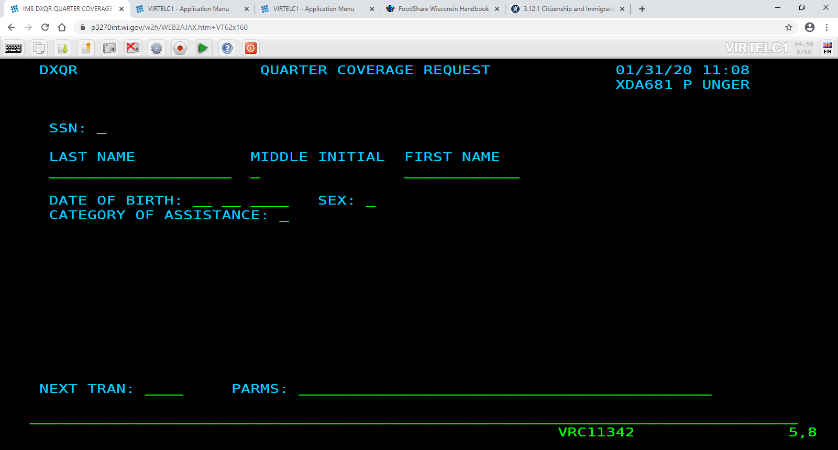

Slide 8
Dreamers/Deferred Action
Individuals under age 31 in 2012 who entered the US without documentation prior to age 16 and meet other immigration rules pertaining to criminal charges, schooling, military
Will receive a work permit, SSN
Eligible only for EMA or BC Prenatal
NO FS ELIGIBILITY
In the process of being phased out.

Slide 9
BadgerCare Plus Prenatal
Pregnancy coverage for immigrants ineligible for regular BC+ based on immigration status.
60 day Emergency BadgerCare extension period beyond end of pregnancy.
Special considerations if immigrant has current coverage under other health insurance.
Eligibility begins in month of pregnancy report; no backdating. EMA can be backdated for those needs.

Slide 10
Newborn Adds for BC+ Prenatal
  End date pregnancy on Pregnancy Page but DO NOT end date page
  Build a newborn page
    Mark Y to Was this child’s mother eligible for any non-CARES MA at the time of the child’s birth?
    Choose Categorically Needy in response to If yes above, was eligibility categorically or medically needy?

Slide 11
Newborn Adds for BC+ Prenatal (continued)
Update AP page, creating referral to CS as appropriate
Continue through the person add driver flow
**Change program request dates to DOB for newborn** Be careful that there is not a pending FoodShare application.
Answer the “non-CARES MA” question as Y
Make sure newborn opens as MAGB
Run with dates backwards to open from DOB forward
Supplement FS as appropriate
Complete AEMA 60 day manual extension in Fwd Health for mother. The interface is supposed to take care of this for you.

Slide 12
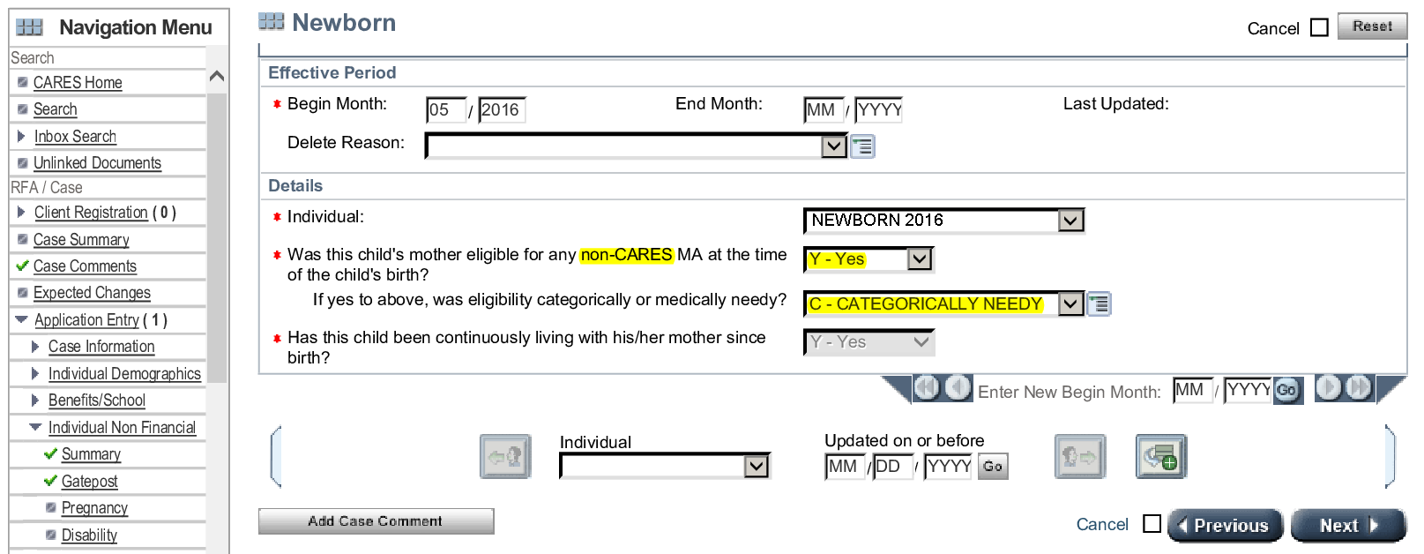

Slide 13
SSN Requirements for Newborns
Do not require SSN for CEN(s) for BadgerCare Plus coverage (SSN due after child turns 13 months old)
SSN due before child turns 6 months old for CTS
All individuals requesting FoodShare must provide an SSN or be willing to apply for one, unless the person refuses to obtain one for religious reasons or the individual is a child younger than 13 months old.
If an application for an SSN has been filed with SSA, the member must provide the SSN to the agency by the time of the next FoodShare renewal, or eligibility will be terminated. In addition, if eligibility for another program pends for provision of an SSN and the SSN application date on file is six months old or older, eligibility for FoodShare will also pend.
SSN or proof that client has applied for SSN for child NECESSARY for CC

Slide 14
EMA
Emergency Medical Assistance for Immigrants

Slide 15
Who Qualifies for EMA?
Documented immigrants who have not been in the US for at least 5 years
Undocumented immigrants
US CITIZENS ARE NOT ELIGIBLE FOR EMA or EMERGENCY ONLY SERVICES

Slide 16
Two Categories of Eligibility
BadgerCare Plus Family
Children
Parents/Caretakers
Pregnant women
YEOHCs
Single Adults are not eligible unless
disabled.
EBD
Must meet EBD requirements of age (65) or disability
Requires MADA if not already determined disabled

Slide 17
Non-Financial Eligibility
The only failure code in CWW will be 039 (immigration status), which will be found in the non-financial category on the Eligibility Summary screen
Client must be elderly, disabled, pregnant, a minor child, or caretaker of a minor child.
Single adults are not eligible unless found disabled.
If they claim disability, an MADA must be filed.
For EBD categorical eligibility, must verify assets.
**It is NOT our job to verify the emergency or the need for coverage.**

Slide 18
Manual Program
All new certifications for EMA/Emergency Services Only coverage are manual certifications (F10100, formerly 3070s).
If a client has a previous record in Forward Health, you can build off that and complete an electronic certification.
AE is certification code used.
If a client has no previous record, fax in the 3070 request using the CARES assigned MA ID number.
Authorize for period of emergency only, 1 year for dialysis or asthma patients.

Slide 19
Deeming Income for FoodShare
When an ineligible immigrant is part of a household, their income is deemed to the household
  Take their income, subtract a 20% earned income deduction, and then divide by the number of total people in group, then multiply by the number of eligible members
  Shows on budget pages/CWW does the math for you

Slide 20
Refugees
Eligible for both FS and MA
Special Considerations
  An immigrant admitted as a Refugee or Asylee may remain eligible for BC+ even if their immigration status later changes.
  Please apply for a Social Security Number online with the client if they are in the office.
  Must use CWW or SAVE to verify immigration status. CWW works only for medical cases.
    NOTE: if client just arrived, SAVE might not be updated yet.
    Alien page code for Refugees is 04.
    Alien page code for Asylees is 05.

Slide 21
Refugees (continued)
Other Considerations (Dane County)
  Client will have an appointment with W2 for Refugee Cash Assistance (RCA).
    RCA payment will need to be manually budgeted on IM case as does not update in system—W2 worker will give you this information.
    Please e-mail unger.paul@danecounty.gov so that he can pull the case into his caseload.

Slide 22
Refugees (continued)
Special considerations
  If multiple individuals from same family (adults) apply, make sure to check if in same HH and PPE together.
    They may receive multiple RCA payments, but be ONE FS group.
    So, individual cases for MA, and all together for FS, if applicable.

Slide 23
VERIFICATION
May use SAVE to verify immigration status for documented non-citizens. Can use CWW to verify if HealthCare is requested.
Client may provide immigration paperwork OR their numbers for use in accessing CWW or SAVE for verification.
Passports, I-94’s, Alien Cards or documents from INS may work.
ALWAYS enter code from SAVE on Alien Page, use SV for verification code. If run in SAVE, print and send the results to scan.
Cuban and Haitian entrant response must go through SAVE. You will need a document to submit.
Documents will be needed for secondary verification.

Slide 24
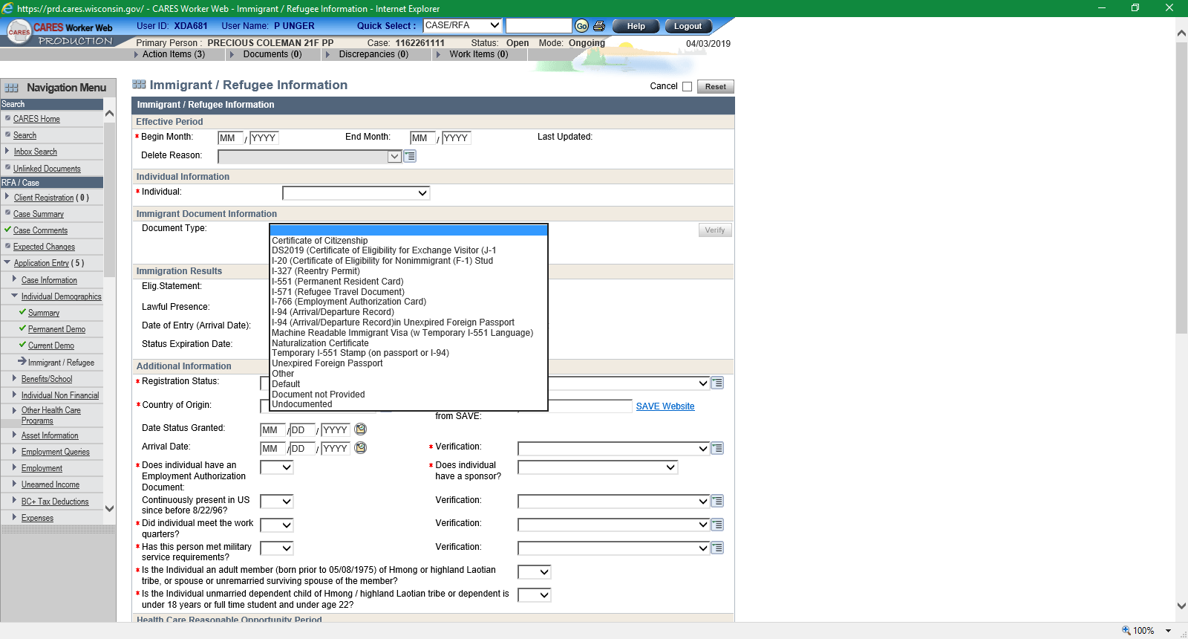
As you can see, there are quite a few different codes. Each code has its own questions to complete. You also need all of the requested information for each code. It will not work without everything requested. So, unless you have the document, front and back, you may want to use SAVE…

Slide 25
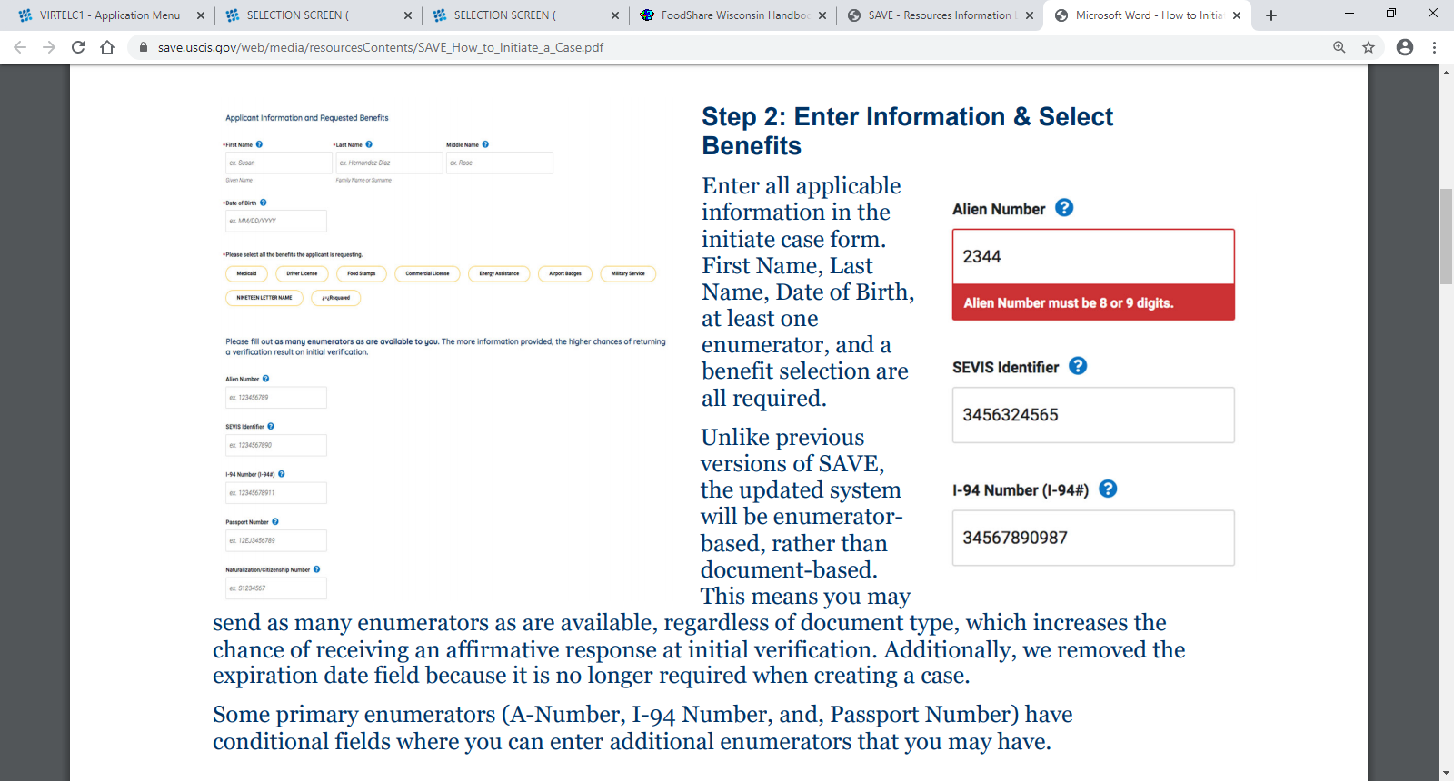

Slide 26
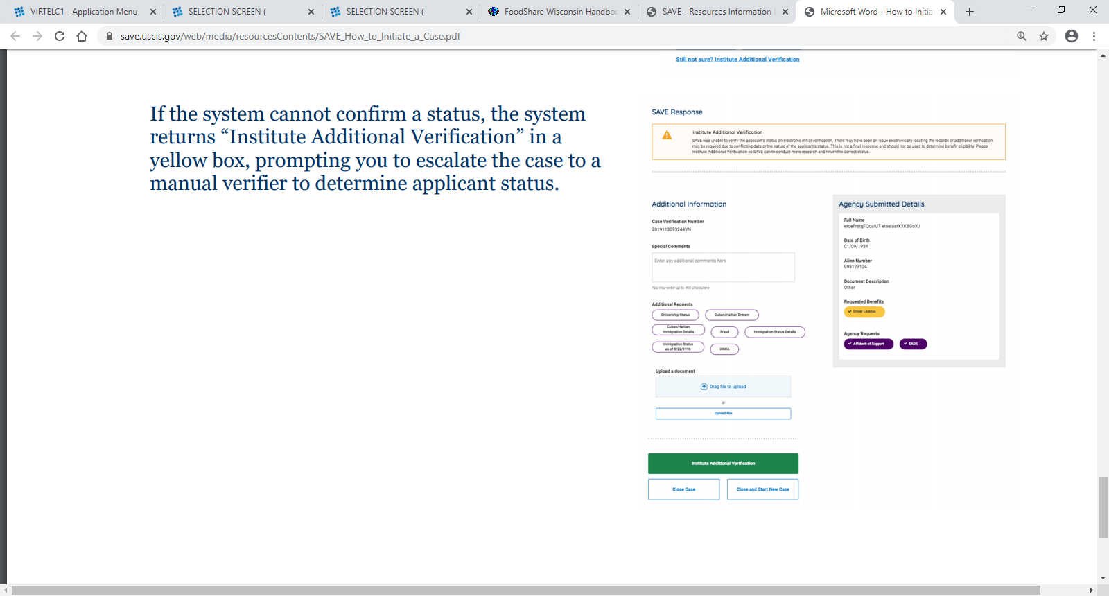

Slide 27
You will see the above message if SAVE can not identify the individual based on the information submitted.
You will need to upload the documents that you have received.
The documents will be examined and the answer will be entered in SAVE.
The worker will need to check SAVE in a few days for the response.

Slide 28
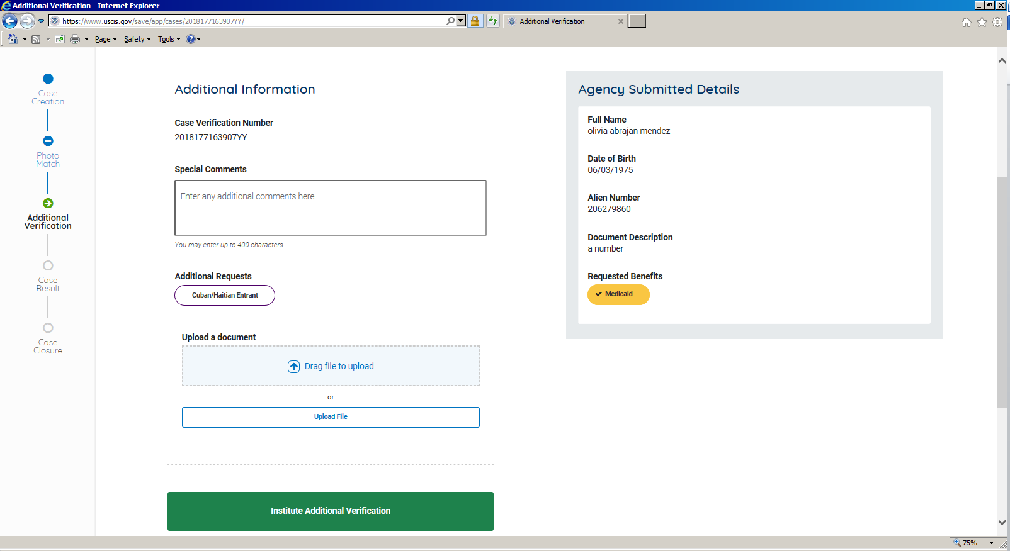

Slide 29
The client’s information will appear in the gray box on the right.
Any comments or concerns can be entered in the box marked “Special Comments.”
Save whatever paperwork that you want to upload to your computer.
Click “Upload File” and it will take you to the documents in your computer.
Click the file and it will appear in the “Drag File to Upload” box.
Hit “Institute Verification.”
Check back a few days later for your result.

Slide 30
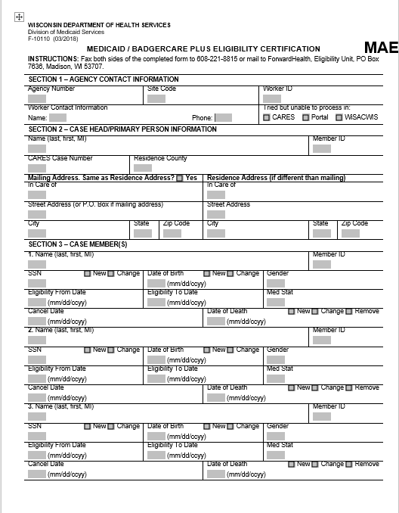

Slide 31
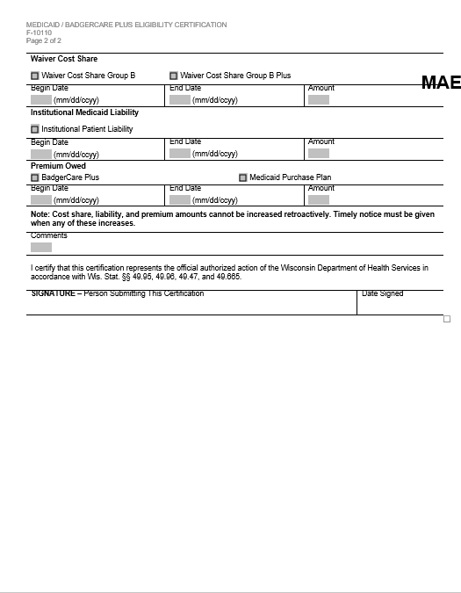

Slide 32
OPERATIONS MEMO 19-J3
The purpose of the Ops Memo was to correct certain errors in the verification of citizenship, identity and immigration status.
Once verified, these three things should not be verified again. Do, however, make sure that we have whatever CARES is coded with.
We will need to reverify immigration status at review for children, youths and pregnant women coded 20 (Lawfully Residing).
We will also need to verify any reported changes in an immigrant’s status.
The reverification should only occur at application, renewal or a report that indicates someone may no longer be lawfully residing.
If an individual has declared a registration status of 09-Undocumented or 10-Illegal Alien, workers should enter a registration status verification code of NV-Not Verified. This verification code will not result in a verification-related failure on the Notice of Decision or the Pending/Not Verified page. NQ has been disabled.

Slide 33
Reasonable Opportunity Period (ROP)
Applicants otherwise eligible for health care and for whom immigration status has not yet been verified will be granted up to 95 days of eligibility to allow a reasonable opportunity period for verification of immigration status.
This includes verification of information needed to determine their eligibility as a qualifying immigrant, such as military service or the date of arrival in the U.S.
The reasonable opportunity period applies to any individual requesting health care benefits at application or renewal, or when adding an individual to a health care case and verification is needed of the person’s immigration status - if that individual has provided a declaration of satisfactory immigration status.

Slide 34
Applicants otherwise eligible for health care and for whom immigration status has not yet been verified will be granted up to 95 days of eligibility to allow a reasonable opportunity period for verification of immigration status.
Please see a lead or contact the Problem Resolution Team if you have questions.

