Slide 1
Health Care Renewal Errors and the override process

Slide 2
Timely Processing of Health Care (HC) Renewals
Have you seen this error?
AE253: Please update the ‘Begin Month’ and the ‘Program Filing Date’ in order to run eligibility successfully

Slide 3
Timely Processing of Health Care (HC) Renewals
What should you do?
When processing a timely HC Renewal,
If HC does not open correctly, do not confirm for the ongoing month. If you confirm the renewal for the ongoing month, any months in between will continue to fail 077 AND there is no way to get HC to pass when running with dates. Overrides would have to be used to pass HC.
DO NOT
update the filing dates since HC is open

Slide 4
Timely Processing of Health Care (HC) Renewals
Example: February renewal processed after AA and before closure (3/1)
Jerry submitted his MAGS renewal on 2/20. When running eligibility, the
worker observes that CWW is only looking at April eligibility. WHAT about
MARCH?
The worker should:
1.
2.
3.
4.
5.
DO NOT confirm ongoing benefits (April)
Run with dates for March prior to confirming April
If March is failing due to 077, complete an override for March
Run without dates for April
Complete manual certification in iC for March

Slide 5
What if...
If the filing date is not updated and the 9 months live edit occurs?
Try updating the filing dates for a non-requested program
FYI: Most of the 9 month live errors are tied to programs that aren’t requested and have old filing dates. This is a documented CARES problem. Research has shown that this issue is usually tied to only 1 non-requested program and primarily one of the following program filing dates: MSP, CTS, CC or W2 filing date (not FS).

Slide 6
Processing Late HC Renewals after closure
When a HC renewal is received or processed after the renewal was due, but within 3 months of closure, workers must update the filing date.
Use the date the late renewal was received or the date late verification was turned in if the renewal was completed timely as the filing date.
Enter the backdated month(s) requested. CARES should open Health Care back to the filing date or backdated month - whichever is earlier.

Slide 7
FPS Processing Reminder
When a renewal is completed and there have been changes in income that will make the member ineligible after the renewal month, you will see reason code 535: “Eligibility based upon your initial FPW eligibility”, and usually another reason code related to a financial impact. At AA of the renewal month, FPS will close.
If the member reports a change after closure that makes them potentially eligible and FPS fails 077, update the filing date.

Slide 8
FPS Processing Reminder
** Reminder, once certified, FPS certifications are for one year - changes in income do not affect eligibility. The 525 code is to ensure FPS stays certified for the original 12 month certification period.***

Slide 9
Multiple HC AGs different renewal dates
If more than one HC AG is open on a case with different renewal dates and one AG is due for renewal, if that renewal is submitted after AA and before closure, CARES skips the next month and only opens as of the recurring month.
This will occur if any other HC (i.e.: EBD MA) is open, with the exception of FPS.

Slide 10
Multiple HC AGs different renewal dates
Example: MAGC renewal due in 2/2019 and MAGB renewal due in 9/2019. MAGC renewal not completed by February AA so MAGC closes for renewal (077).
Member submits a renewal on 2/26. Because MAGB is open, MAGC opens for the recurring month (April). If the worker runs with dates for March, MAGC will fail 077.
There is no workaround for this other than overrides. When overriding make sure to correct the renewal date and manually certify MAGI in Forward Health. For this case, if FPS was the only HC AG open, MAGC would pop open as of March.

Slide 11
EBD Medicaid AGs
If an EBD renewal is failing 077 and if the case has archived data:
Worker should request the archived data to be retrieved and wait overnight (this processing runs at night) for the 077 failure to be resolved.
Do not confirm the 077 renewal failure, when that happens, you will not be able to resolve the 077 problem by running with dates.
For details about the archival process see Ops Memo 16-J3 (Process Help 36.4).
Note: There is NO trigger in CWW to retrieve archived data, this is just a workaround to attempt.

Slide 12
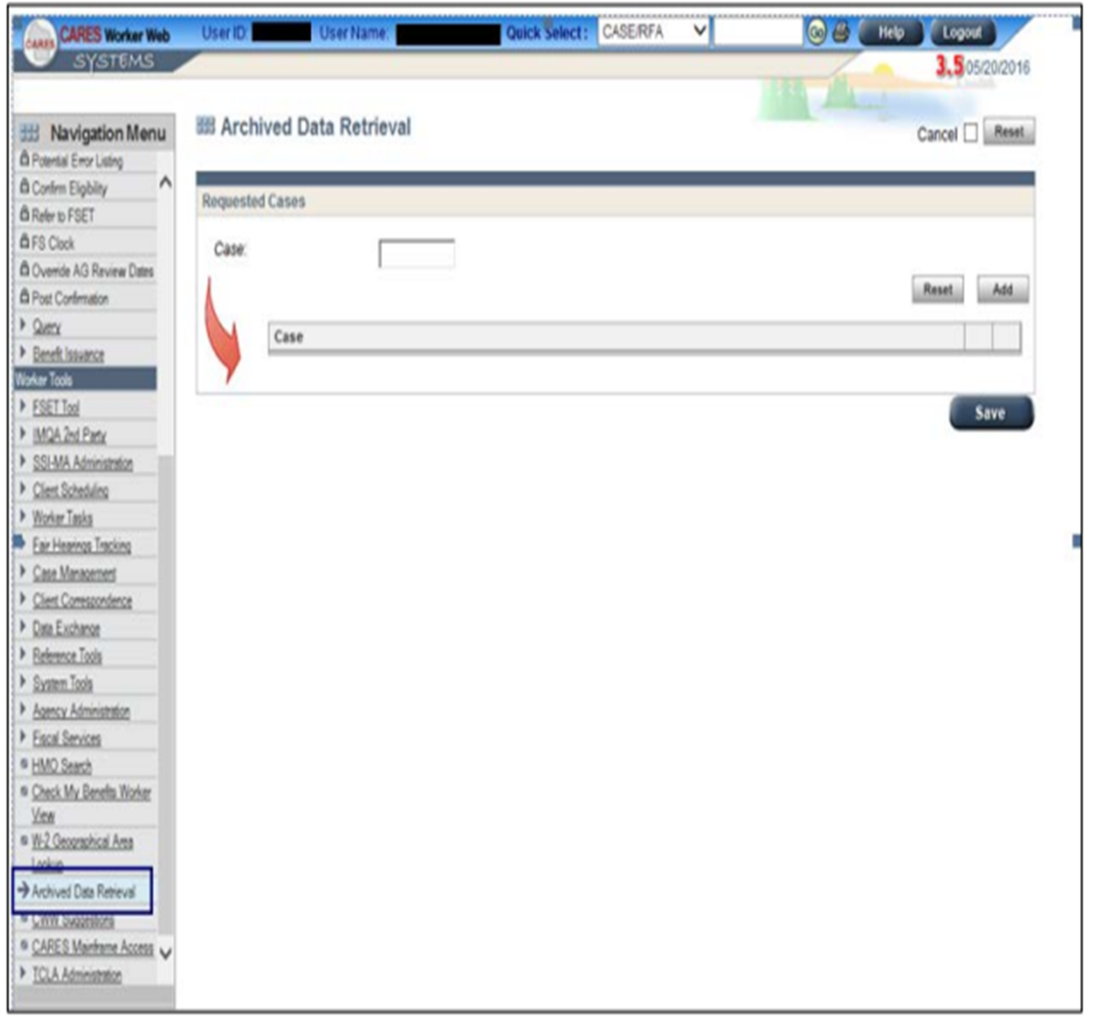
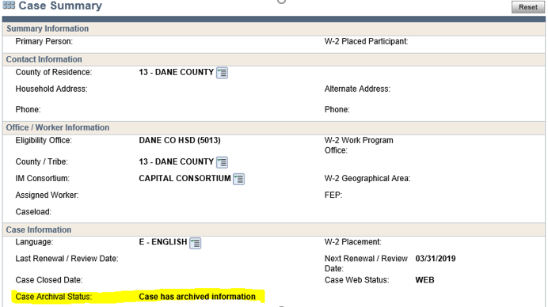
The retrieved data will be available to view in CARES for 90 calendar days and will be archived at the end of the 90 days.
Note: This workaround does not work for MAGI AGs.

Slide 13
When to update filing date:
Application
Person add
Person delete
Program add
Late renewal or renewal related verification is submitted for Health Care
Late verifications are submitted after the 30 day denial notice is sent for a FoodShare application
When CARES shows this message:

Slide 14
What the heck is an override and how do I do it?
Check out Process Help 41.3

Slide 15
Processing overrides in cares

Slide 16
When in the course of human events, it becomes necessary for one worker to dissolve the results which have connected them with errors, and to assume among the powers of the earth, the separate and equal station to which the QC specialists and co-workers entitle them, a decent respect to the opinions of mankind requires that they should override the causes which impel them to the mistake.

Slide 17
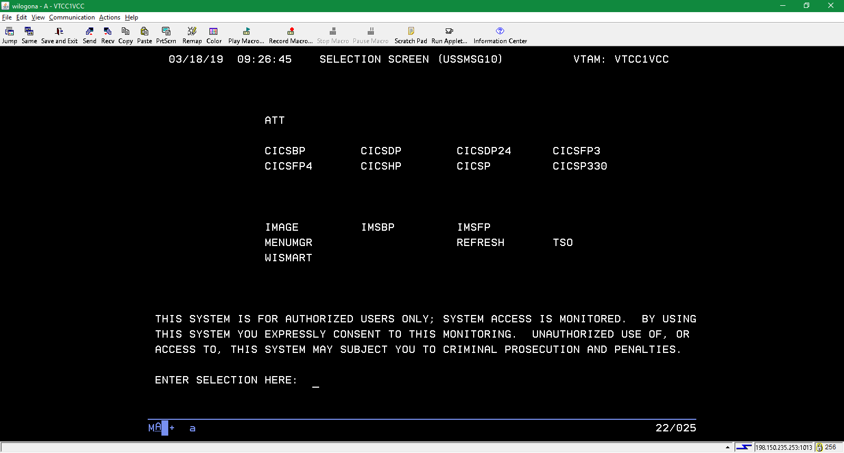
Why override?
CARES normally does a very good job at determining eligibility and benefits. However, there are times when the worker must take extra steps to ensure that a correct determination is made. That process is still the domain of the mainframe (darkside, HOD, , etc).

Slide 18
Soooo…you’re running eligibility and you’re not seeing the results that you want? What do you do? Which screen do you go to in order to fix the case?
FIRST…check your numbers. Be sure that all of the data is correct.
SECOND…make sure that your case is in the correct mode: review, intake, etc.
THIRD…is CARES running the correct months? You may need to make adjustments on the program request pages.
FOURTH…what are you trying to do? If you are attempting to issue a supplement, did you check the “Determine Potential FoodShare Supplement” box?

Slide 19
You may need to do an override…
if you need to make an individual eligible.
to open a program that CARES is denying or closing.
change an allotment.
IT WILL NOT:
send eligibility for past months to ForwardHealth.
change a cost share amount. You will want to update the amount if making a change, but you still need to manually certify it in FowardHealth and send a manual notice.

Slide 20
Starting an override
The worker must run eligibility prior to entering an override. If s/he does not, there will be nothing to change.
If you are attempting to run for a past month, you should run with the corresponding dates in the Worker Web first.
AGAIN…be sure that all of your data and case modes are correct.
Once you see your results, and want to make a change, you will need to go to the mainframe.
Use tran code AIOE and your case number for the parm. You can also add /case type/sequence after the case number to take you directly to the correct screen, i.e. 1234567890/magc/02.
You can only enter lines that are green. If you miss one, it will light up red.

Slide 22
The screenshot on the previous page shows an individual override page for an individual who is passing for MAGS.
Say, for example that you want to deny this person with an individual failure code…you would first enter an “F” in the ELIGIBILITY RESULT OVERRIDE field. The “S” that is currently there means that the client is passing.
If you are failing or denying someone, you will need a reason code. To do so, enter # in the REASONS OVERRIDE line and hit enter.
Please remember to remove the reason code if you are passing someone who was failing.
This will take you to the list of codes that may be entered there. Said codes will be marked for individual or group overrides.

Slide 23
These are the first of over 700 reason codes. The letter under LEVEL indicates if the code is for Individual (I), Assistance Group (A) or Both (B). WKR ENT tells you if it is worker enterable. More details regarding these may be found on REASON CODE SEARCH page in the worker web by entering your code number and hitting the magnifying glass.

Slide 24
The worker will need to enter an OVERRIDE REASON CD. Options are MAD-MA Deductible Choice Provision, POL-Policy Not Auto-mated, QMB-QMB Adversely Affected, SYS-System Error, and WKR-Worker Error.
On the individual screen, all workers with a security clearance of 50 or higher can enter Y do approve their override.
A 25 will need to have their supervisor confirm the individual override before one can move on.
To go to the next screen, hit enter. Please be aware that the CW COST SHARE OVERRIDE will turn red. Simply delete that to move forward.
If you are working a case with a cost share: changing the numbers here will have no effect on the case nor the notices.

Slide 25
The line highlighted in red will turn red when the worker hits enter. Simply delete it and hit enter again.

Slide 26
After all overrides have been entered and approved, you will need to go to mainframe screen AGOE.

Slide 27
Once you’ve added the individual overrides, you will need to enter group overrides.

Slide 28
You do not need to enter a Reasons Override code if you are passing someone. You may add one if you want. One example would be if a case is now eligible for a program due to a decrease in income. Failing a case will require a code.
If you are passing a case that was failing, please remember to remove the failure code.
The worker will need to enter an OVERRIDE REASON CD. Options are MAD-MA Deductible Choice Provision, POL-Policy Not Auto-mated, QMB-QMB Adversely Affected, SYS-System Error, and WKR-Worker Error.
If your security clearance is 25, you will need your supervisor to approve the override. If you are a 50, leave the screen, then go back and enter the Yes.

Slide 29
One crucial step in all of this: as you are entering your overrides, possibly pending approval, or moving from screen to screen, DO NOT restart eligibility. If you do, CARES will kick out your previous entries and you will need to start over.
Once the overrides are set up, and the results are as you like them, go ahead and confirm.

Slide 30
caveats
Creating and confirming an override for a past month does not send eligibility or premium information to ForwardHealth for BC+.
You will need to enter a manual certification if you run and confirm with dates for BadgerCare.
CWW will send notices when an override is completed.
Overriding EBD Medicaid (ie: MS, MAPP, MI S etc) updates iC, but does not update liability or cost share, that must be manually updated.
Overriding eligibility for FPOS does update iC

Slide 31
caveats
Simply running with dates will not issue a supplement for FoodShare. You must click the Determine Potential FoodShare Supplement button and follow that process.
Check to make sure there is no gap in coverage, if appropriate.
When running with dates, confirm the program that you want open only.
May you just complete a manual certification in ForwardHealth without completing the override?
NO, workers should not just be doing manual certifications in ForwardHealth without getting CWW to also reflect the eligibility. This can cause problems with benefit recovery and other issues. If at all possible ForwardHealth and CWW should reflect each other in regards to a member’s eligibility.

Slide 32
Example
April is currently failing FPS. We want to open it for her.

Slide 33
On AIOE, enter an S in the Eligibility Result Override field, an Override Reason CD like SYS, and then approve the override. Delete the Reasons Override entry. It is not needed for an approval. You may also enter a comment here regarding the reason for the override.

Slide 34
Then tran to AGOE. You will see that the case is currently failing.

Slide 35
Enter an S in the Eligibility Result Override field, and then add an Override Reason Cd. Do not approve it. If your security clearance is 25, alert your supervisor, lead, the PRT or the Help Queue. If you have a 50, go ahead and approve. Once approved, go to the Confirm Eligibility page. DO NOT INITIATE ELIGIBILITY, OR YOU WILL HAVE TO START OVER.

