Slide 1

Running With Dates
By Paul Unger & Jackie DeLaRosa
Updated 2/21/24
Major medical insurance coverage reported. Run eligibility alert received...did so, no changes.

Slide 2
Table of Contents
1.When do I run dates?
2.Newborn/Person Add
5.Recalculate of benefits: Auxiliaries
9.Issuing Auxiliaries
14.Running with dates: CTS backdating eligibility
17.Running with dates: CTS child add
18.Running with dates: CTS late reviews
19.Running with dates: CTS and retroactive SSI
21.Running with dates: premiums
24.Running with dates: Decreased premiums
25:Healthcare running with dates: Newborn/Person add
26.ChildCare
31.Things to remember
33.Citations

Slide 3
It is imperative to run with dates in CARES only when absolutely necessary. There are various circumstances that require you to run a case with dates. Some of the most common uses in running with dates are:
WHEN DO I RUN WITH DATES???
Newborn/Person Add
Recalculation of Benefits: Auxiliaries
CTS Backdating Eligibility
Medical: Late premiums, decreased premiums, person adds
1
Notes:
Simulation can also be used to recalculate benefits.

Slide 4
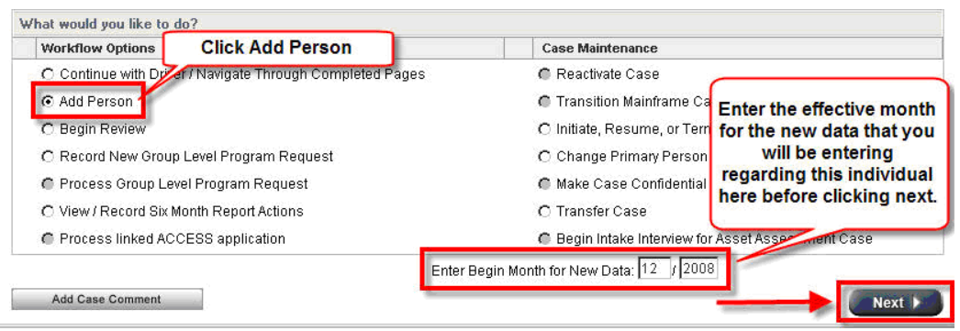
Newborn/Person Add
Using the “Add Person” work flow option from the Case Summary page initiates the driver flow. You can also enter the birth month of the baby into the Begin Month for New Data field at the bottom of the page before clicking next.
2

Slide 5

Select the Add Person option from the Case Summary screen. You may also go directly to the Household Members screen and click to add a person.
Enter the new person’s name and complete the details, and CARES will begin a driver flow.
Be sure to update ALL of the begin dates on program request screens (either baby’s DOB, date a person moved in or day person add is reported, if more than ten days after the event). Please do not change the FS request date if there is a pending application for that program.
After the Gateposts and Summary pages are complete, finish adding any other applicable information such as employment (for person adds) and Absent Parent pages for children/newborns.
3

Slide 6
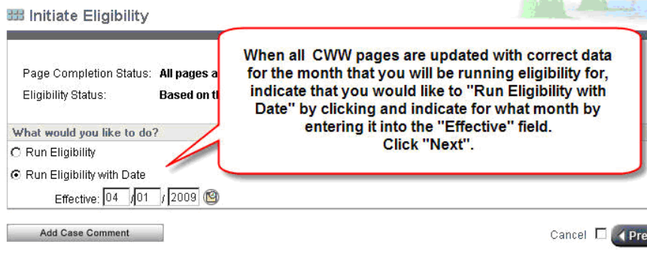
Initiating Eligibility - for both newborn & person adds, you will want to select “Run Eligibility” and run recurring eligibility first (without dates) and confirm. Then run with dates working backwards to baby’s birth month or the month after the person was reported in the household.
Check your results – making sure all months from birth to ongoing are open - MAGB for CENS, MAGC for non CENS
Run the recurring month one more time to leave the case current.
4

Slide 7

Recalculation of Benefits: Auxiliaries
When a change in circumstances occurs that entitles a FoodShare group to an additional monthly benefit, an auxiliary or supplement may be necessary. If you can determine that the change should be impacting a benefit month that has already been issued or confirmed, you may run the case with dates and CARES will calculate the increase.
Remember, we never supplement current month.
Always the month after the report is made, if
verification is timely.
5

Slide 8

Example (change – FS supplement)
Kristen reports a rent increase on March 25th. The increase is extremely high and the worker finds the amount questionable. The case is pended for the verification due April 14th. The verification is not received so the expense is not allowed.
The verification is then received on April 28th. The worker should run the case with May 1st dates as Kristen would be eligible for a supplement beginning the month following the verified amount since the verification was not received timely.
6

Slide 9

Confirming the benefit for a month that has already been issued (or after AA in current month) will not issue FS. You will need to complete an auxiliary to issue the FoodShare benefit.
Example (newborn add- FS only case)
Baby Justin is born March 24th and this is reported March 29th. The supplement is effective April 1st. You can run the case with April 1st date to determine the correct amount of FoodShare for April since this benefit was already confirmed. You would then issue the auxiliary.
7

Slide 10

Example (person add)
Ruby has an open FS case and reports on May 30th that her brother Jack moved in back on April 15th. Ruby would not be eligible for a supplement until June 1st because the change was reported at the end of May. You could run the case with a June 1st date to determine the amount of the supplement and then enter the auxiliary.
8

Slide 11
Issuing Auxiliaries
Go to the Initiate Eligibility screen in CARES.
Click Run Eligibility with Date and enter the effective month for the auxiliary.
Check the Determine Potential FoodShare Supplement box.
Hit enter or next…be sure to review the budget screen when you see it!
You will see the Potential FoodShare Supplement screen. It will show the proposed amount of the auxiliary.
If the amount is correct, Click Issue system calculated Supplement amount.
Click the drop down for Supplement Reason 1 and choose the best code. You may use up to three.
When complete, confirm the benefit. Confirm only the program for which you were determining eligibility.
9
Notes:
Auxiliaries are sometimes only for certain programs – be sure to check!

Slide 12
If your security clearance if less the 50, you will need the supplement approved by a lead worker or supervisor.
IMPORTANT – if there is a FS overpayment on a case, auxiliaries for person adds and changes are applied to the overpayment. An easy way to determine if there is an overpayment is to look for the CLAIM INDICATOR marked Y on the Potential FoodShare Supplement screen. If there is, enter a Y in the “Offset Indicator” field: clicking yes on the Potential FoodShare Supplement screen will apply all of the supplement to the overpayment. If CARES determines that the supplement is greater than the amount owed, it will apply only the amount due, and issue the rest to the client.
One can use the FoodShare Supplement Issuance screen if one desires to issue part of the supplement to the client and offset a portion. The worker will need to create this screen twice, once for the offset and one for the amount that will go to the client.
10

Slide 13
Click the Run eligibility with Date button, enter the date, and then check the Determine Potential FoodShare Supplement box.
11

Slide 14
If CARES determines the correct amount, hit the Issue system calculated supplement amount button and select the supplement reason(s). If you don’t like the determination, Click the Continue with Driver/No supplement or Budget button.
12

Slide 15
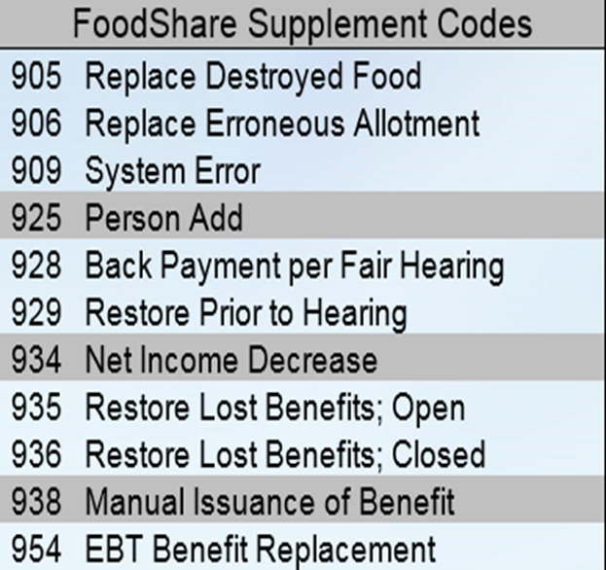
If you wish to issue an auxiliary manually, you may use the screen below. FoodShare supplement codes are to the right. After you complete the details, select add. Always remember to notify your lead worker or supervisor for approval if your security clearance is less then a 50.
13

Slide 16
Running with Dates: CTS Backdating Eligibility
There are situations where we may have to make a CTS payment for past months.
If a child was not correctly included in the grant.
Late reviews - A CTS review is completed more than 1 month past the review month (there is a 1 month grace period with no interruption).
The parent is awarded SSI eligibility for a month or more prior to current eligibility.
If a child that the SSI parent is caring for is added to the case after Adverse Action - note both “Caring For” and “Filling Parental Role” must be selected on HH relationships page.
14

Slide 17
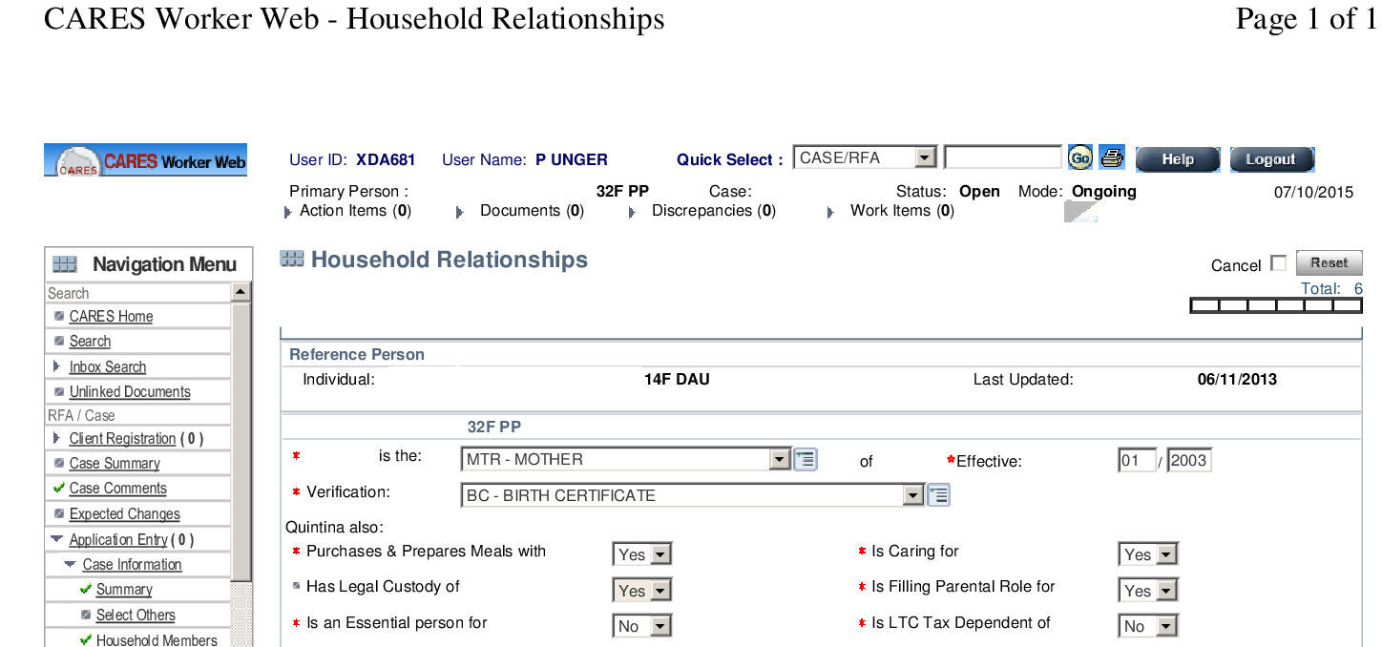
Follow the driver flow through and confirm the case. Watch the number of people in the group. If the individual that you added to the case is CTS eligible, your grant size should increase. If it does not increase, check the non-financial result on the Eligibility Summary screen. If it does not show a failure code, go back and check your household relationships and see if the person is coded as caring for and filling a parental role.
15

Slide 18
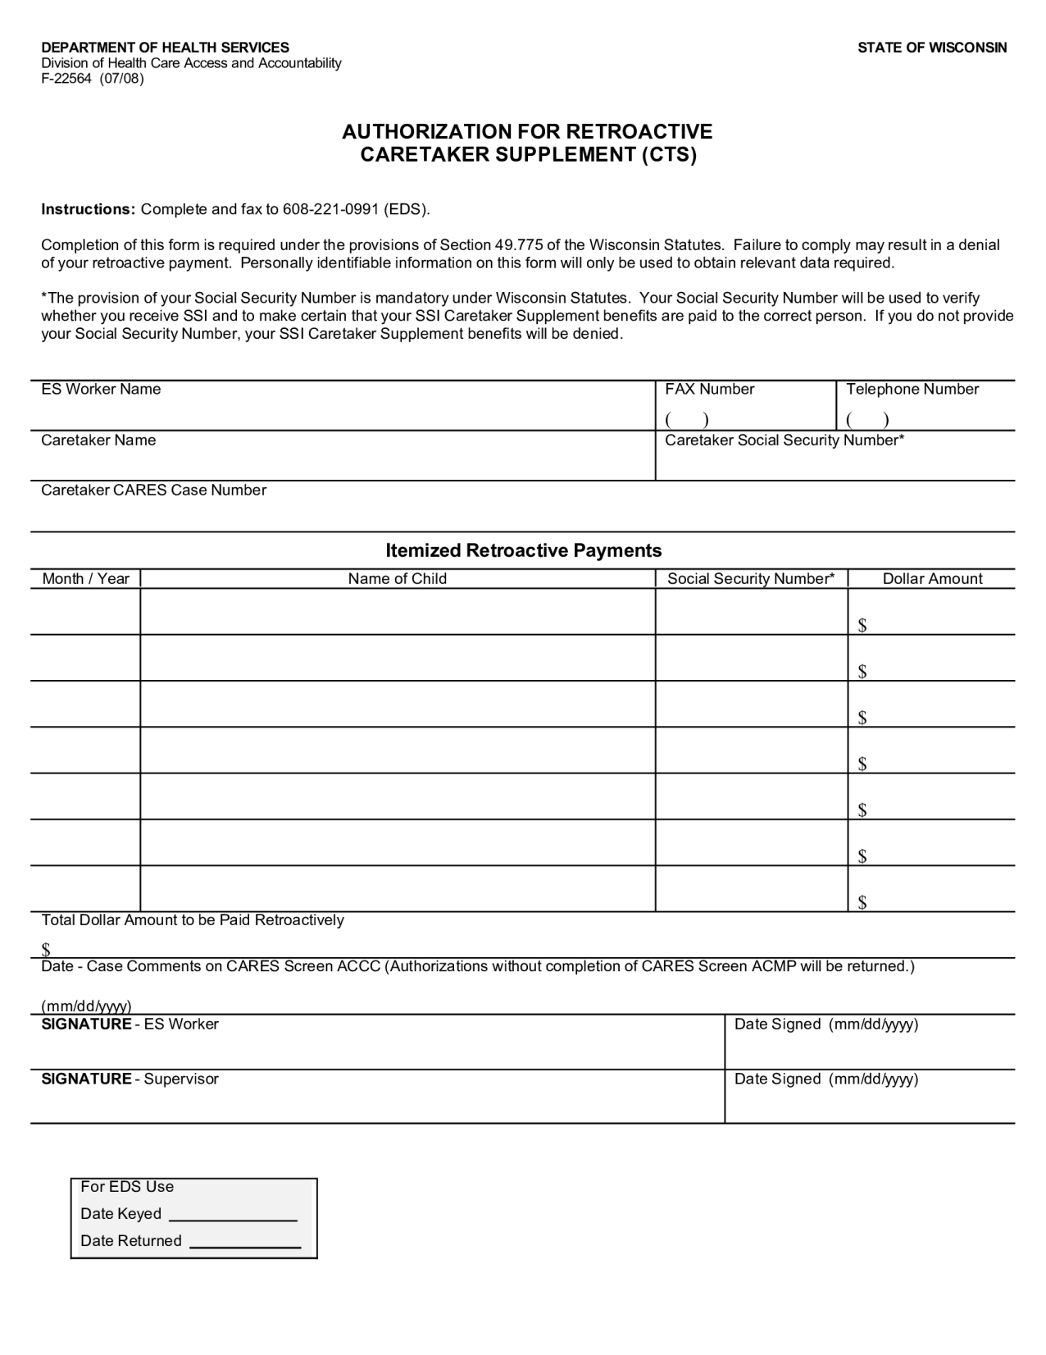
After confirming the recurring month, run eligibility with dates, beginning with the month prior to the month you just ran. After confirming CTS only, you may need to do that for other, earlier months.
Once completed, you will need to complete the Authorization for Retroactive Caretaker Supplement found in the appendix of the CTS Handbook. This worksheet will also remind you to complete screen ACMP in the mainframe. You will need one screen for each month you are paying.
Remember that the addition of a parent who is not receiving SSI may reduce the grant or close it. (CTS Handbook 3.3-Exceptional Eligibility)
16
Notes:
You may need multiple forms for large groups or more than one month.

Slide 19
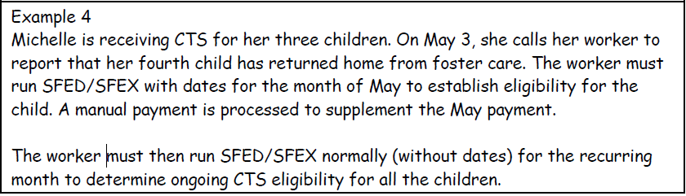
Running with Dates: CTS Child Add
17
Notes:
Always run the recurring month first.

Slide 20
Running with Dates: CTS Late Reviews
Normally, one will not need to run with dates for a late CTS review since there is a 1 month grace period. If renewal is completed in the month after it is due, simply leave your request date as it was, run the review and CARES should go back and reopen CTS at of the date it ended. You will not need to complete the Authorization for Retroactive CTS form nor mainframe screen ACMP.
If you need to run with dates, start with the recurring date, and work backwards. In this situation, you will need to complete the retroactive CTS form, ACMP and case comments.
18

Slide 21
Running with Dates: CTS and Retroactive SSI
There are situations where a client is awarded SSI to a month earlier than the present month.
Workers can begin CTS eligibility with the award month IF the client has had an open case for the entire period.
For a new CTS request, if possible, set the request date for the month SSI began. This may not work if it was more than nine months ago.
19

Slide 22
In the above situation, set the request date to the earliest possible date to get as many months open at one time as you can. You will not need to complete the Retroactive CTS worksheet nor complete mainframe screen ACMP for those months that go through a recurring run.
Run with dates for any other months, working backwards, complete the Retroactive CTS worksheet and mainframe screen ACMP.
Ascertain that the client was awarded State SSI in those months.
20
Notes:
CTS will not be paid if State SSI did not exist for the month.

Slide 23

Running with Dates: Premiums
Premium paid prior to the end of the closure month
Mark the premium as paid (if paid at the agency)
Delete the RRP
Run eligibility without a date and confirm eligibility
Run with date(s) for the month(s) you are re-opening and confirm.
Please do not adjust the request dates.
Example, MAGC closed at Feb AA for non payment of premium, MAGB stayed open. Premium is paid 2/26/16. Run case with a March date & confirm, then without a date and confirm ongoing month (April). If it is the first of the month, run for March and send a premium request. Do not run any further.
21

Slide 24
Premium paid after the last day of the closure month.
Before reopening BCP, the premium of the current month must be collected.
Example, MAGC premium for January 2016 was received 2/20/16 along with the Feb premium. The case closed 1/31/16 for lack of premium.
Go to the premium payment tracking page and mark the January & February premiums as paid. (If payment not rec’d at agency, ensure it was paid).
Go to the BC+ RRP screen & delete the RRP with a LP code (for each individual)
Initiate eligibility and run with no dates (for February), confirm MAGC.
Re-Initiate eligibility and run March, then April and confirm each month.
22

Slide 25
If CARES does not allow you to confirm a prior month, you will need to do a manual certification (with a premium based status code – usually the previous one).
If you receive a late premium at your agency and you cannot confirm the next month’s premium, complete the premium section on page 2 of the Manual certification (F10110).
You will also need to send a manual positive notice for any months where manual certifications were completed.
23

Slide 26
Running with Dates: Decreased Premiums
When a change is reported resulting in a lower premium, it is effective during the month the change occurred if reported within ten days, or in the month of the report.
For example, if a person reports their EI decreased, update the EI page date (to the month of the report), pend the case. If verification is received timely, run the case immediately beginning the month of the report. Then run ongoing months. Review the new premium amounts to ensure the change is effective the month it was reported (if verified timely).
24

Slide 27

Healthcare Running with Dates: Person/Newborn Adds
After adding baby, run eligibility (without dates) and confirm, then run with dates (working backwards) to baby’s birth month, confirming each month. Then run again without dates & confirm.
After adding a person, run recurring month first (without dates), working backwards to current month and then run ongoing again.
25

Slide 28
ChildCare
Workers must run eligibility with dates after adverse action to confirm Child Care closures for the next consecutive month for the following specific reasons:
• Any instance of Child Support non-cooperation;
• When the parent no longer resides in Wisconsin;
• When there are no eligible children in the household; or
• When the required verification was not returned within the seven (7) busi- ness day time frame from the date the Notice of Verification Needed was mailed.
26

Slide 29
When any of these above reasons occur, the agency worker must use the following process to close the Child Care AG for the next consecutive month when running eligibility after adverse action to prevent EBT CSAW benefits from being loaded onto the CC EBT card in error:
STEP 1: Worker must run without dates for recurring months and confirm.
STEP 2: Worker must change the Child Care request on the Child Care Request page in CWW back to “Yes” (leaving the dates as they appear).
STEP 3: Worker must run with dates (using the begin date of the first day of the next consecutive month) to close the Child Care AG for the next consecutive month.
NOTE: If the agency worker accidentally runs for recurring and forgets to change the Child Care request to “Yes,” then when the agency worker runs with dates to confirm the Child Care closure for the next consecutive month, Child Care will fail for “054” reason code and the agency worker will not be able to confirm the Child Care AG closed. To fix this, the agency worker will need to change the Child Care request to “Yes” and then run with dates again to confirm the Child Care closure for the next consecutive month for the correct closure reason.
27

Slide 30
The following screenshot shows a situation in which the worker ran with dates to close a ChildCare case after cutoff.
When on the Confirmed Assistance Group Eligibility History screen, hit the Show Invalid button.
You will see a history of all confirmations.
On this case, January 2017 passed at cutoff.
The worker ran with dates for January to close the case on December 27.
Verification came in later and the case passed.
28

Slide 31
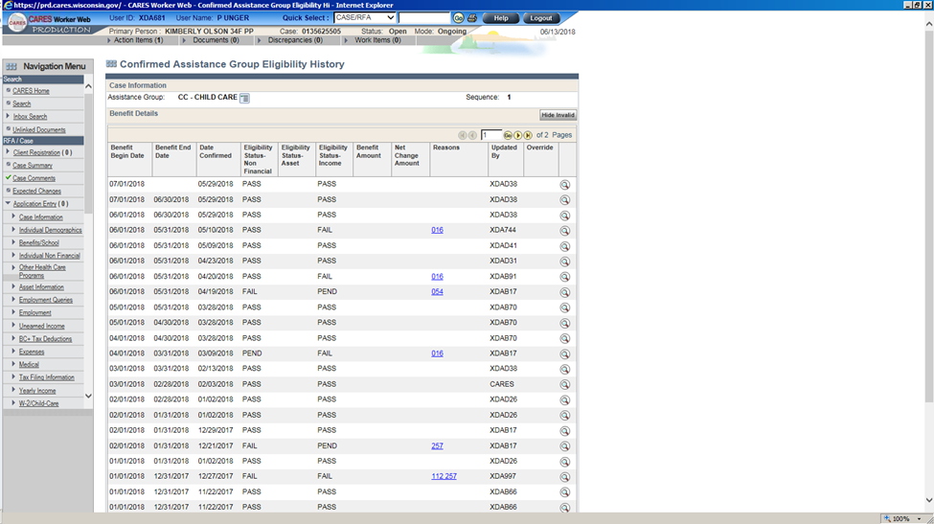
29

Slide 32
Closure Reason Codes: The following closure reason codes will close a Child Care AG when an agency worker is running with dates after adverse action to confirm a Child Care closure for the next consecutive month: Other closure codes will not allow you to confirm the closure, in those circumstances the worker will need to go into EBT CSAW and end the current authorization for the last day of the current month.
30

Slide 33

THINGS TO REMEMBER:
When running with dates, it is important to ensure that the begin months and budget pages are reviewed for accuracy before confirming to make sure the correct income and expenses are listed for the months you are looking at.
Confirming FoodShare benefits while running with dates will NEVER issue the benefit, you must issue an auxiliary.
When you run with dates and confirm, notices are generated. Best practice is to only confirm the benefits you are trying to update. Confirming changes to other programs may generate incorrect notices of eligibility for those other programs. Remember to suppress any incorrect notices generated as a result of running with dates.
31

Slide 34
Continued:
Running and confirming with dates for CTS also does not issue a payment. The worker will need to complete the “Authorization for Retroactive Caretaker Supplement” form that is in 5.3 of The Caretaker Supplement Handbook.
When creating a retroactive CTS payment, the worker needs to complete screen ACMP in the CARES mainframe.
If you are processing an application that is more than thirty days old, make certain that CARES is running benefits back to the application date. If not, contact the PRT for assistance. These cases can be fixed without running with dates.
32

Slide 35
For more information, see:
Process Help 3.7 Running with Dates
Process Help 3.1 Newborn (Baby) Add
Process Help 3.2 Person Add/Non Newborn
Process Help 31.1.2 Issuing Auxiliaries/Supplements Process at a Glance
FS Handbook 6.1.3 Timely Action on Reported Changes During the Certification Period
Process Help 3.7.5 Caretaker Supplement
CTS Handbook 3.3 – Exceptional Eligibility
BadgerCare Plus Handbook 19.10 Premium Changes
OPERATION MEMO 17-4 AND CHILD CARE MANUAL 1.9.4 Running with Dates after Adverse Action to Confirm Child Care Closed for the Next Consecutive Month
33

