Slide 1
SWICA Processing
Joan Corcoran

Slide 2
Capital Tracking Mechanism
All discrepancies are in the “Not Started” status. While the State training includes the “Pending for Ongoing Eligibility” status, we are only going to be changing the status to “complete” by using these two statuses:
Resolved – Eligibility Issue
Resolved – No impact
How are the discrepancies being tracked for follow up?
Pending for Ongoing Eligibility- Worker pends for employment verification to correct future benefit . Follow the normal 10 day work item alert to check for verification or to NV if none is received
Potential Fraud or OP – If once the worker fixes current eligibility going forward and there’s potential for fraud or OP, the worker should send the BRITS referral and the Fraud and OP unit will track the case outside of CARES

Slide 3
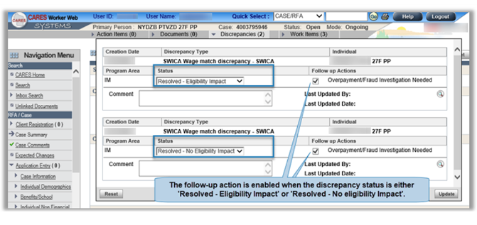
Don’t Check These Boxes!
We will NOT be utilizing this. Please follow the normal OP/Fraud procedures.

Slide 4
SWICA
When are SWICAs generated?
When the earned income listed on the CWW employment screen is different than the wages that were reported to DWD from the employer
Quarterly match
When an AG goes over the reporting requirement FPL for all 3 months in the quarter for any program open during the entire quarter
Wrong SSN? Complete the Wage Correction Worksheet

Slide 5
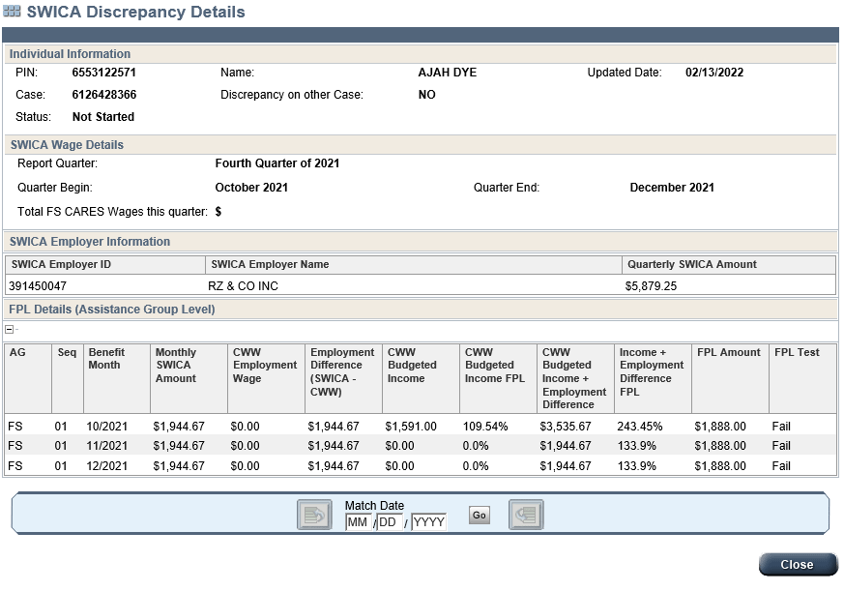
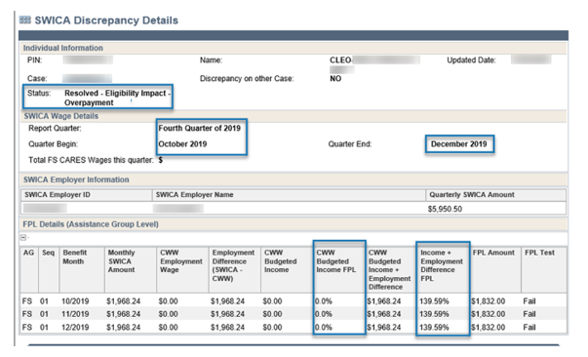
SWICA
Click on Discrepancies on the top menu bar, then click the magnifying glass to view the SWICA details

Slide 6
SWICA

Slide 7
SWICA
Apply change reporting requirements to see if an OP exists. Remember that if income increased above their reporting threshold in month 1, the client has until the 10th of month 2 to report this change and the benefits will be impacted starting in month 3
Example: Income increase over 130% FPL in July. Client must report this change by August 10. Benefits change based on this new income starting September 1

Slide 8
SWICA: Processing Tips
No need to pend for EI verification if the job has ended
If referred for OP and verification is needed, Fraud/OP will request the verification of the previous employment
Make sure that you are using proper begin dates from when the employment actually began
Make sure the case is updated so that ongoing income is budgeted correctly. This helps prevent multiple SWICAs for the same case. You need to also make sure a FEIN number is entered for the employer
Timeline for processing SWICAs is 45 calendar days
Try to process 3-5 SWICAs per day, during your protected time

Slide 9
SWICA: Important Reminders
When clearing the SWICA, you will need to add text to the automatic case comments
Review the information to determine if there is a possibility of an error
Contact the household or collateral contacts to verify the discrepancy
Check the notices for reporting requirements
Make sure that when you end date employment, you are using the month/year that income actually ended

Slide 10
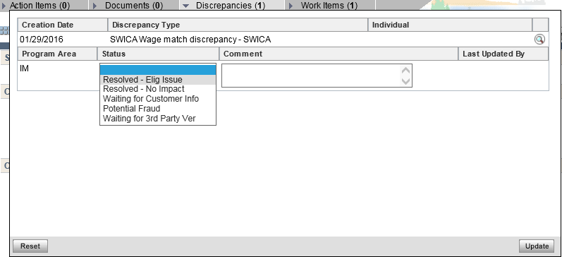
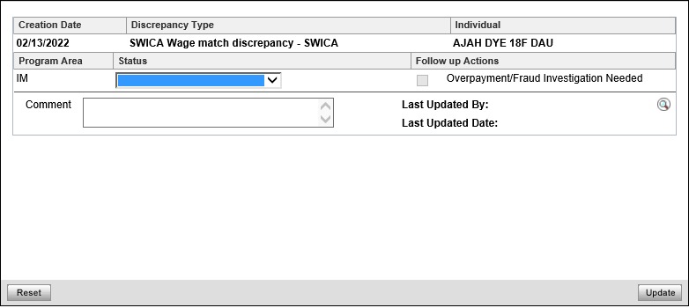
*** Resolve It***
Resolved – Elig Issue
Resolved – No Impact
There are only 2 statuses that you should be using:

Slide 11
RESOLVED!!!
Choose the appropriate discrepancy status:
Resolved – Eligibility Issue
Use this when you have referred the case for OP, or pended the case for ongoing eligibility
Resolved – No impact
Use this when you have NOT referred the case for OP
Both of these codes will remove the SWICA work item completely off the dashboard

Slide 12
RESOLVED!!!
In order to mark a SWICA discrepancy as resolved, worker(s) must:
Review the information to determine if there is a possibility of an error;
Contact the household or collateral contacts to verify the discrepancy, and/or;
Case should be referred to OP, if there’s a possibility OP has occurred. A benefit recovery claim does not have to be established prior to resolved.

Slide 13
SWICA: When to Refer for OP
Guidelines for determining if OP exists:
CC case - refer if the parent failed to report an increase in income that would have impacted eligibility or the subsidy/co-payment amount
FS case - refer overpayments resulting in at least $125
BC only case - only refer MAGS and MAGA cases that exceed 100% FPL
EBD MA case - refer for all unreported income
CTS case - Refer for changes resulting in a loss of eligibility

Slide 14
Resolved Eligibility Issue
When the case has a potential for OP, enter the case into BRITS and Fraud/OP will request the verification
Potential Regular OP –
Select Claim Investigation (normally) – SWICA – Earned Income
Follow the SWICA Case Comment template
Potential Low Priority OP –
Select Claim Investigation (normally) – SWICA – Unresolved Aging Discrepancy. Some examples of low priority are:
MAGC premium only
FS – Monthly allotment of less than $100
Overpayments that are expected to be under $500
1 quarter SWICA’s

Slide 15
BRITS Processes
Almost all SWICA referrals should use a combination of Claim Investigation – SWICA – Earned Income (normal priority)/Unresolved Aging Discrepancies (low priority)
“Fraud Investigation” should only be used when the customer provides clearly misleading information at renewal/SMRF, forging documents, household comp issues, etc.
There is no limit on the OP amount
Do not select “Agency Error” as an option. Instead comment in Brits if it is potentially an agency error
Try to avoid multiple referrals, simply add comments to the pending investigation

Slide 16
Finding A Healthcare Overpayment Amount

Slide 17
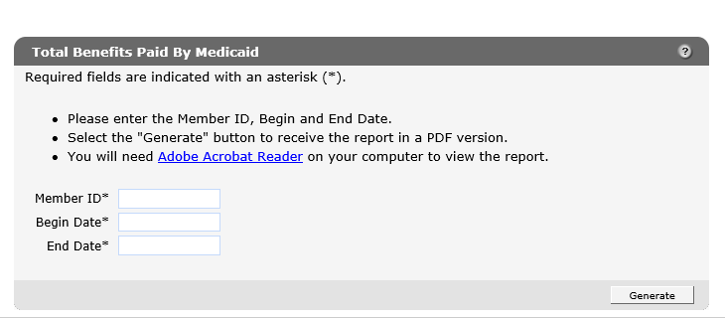
-
Enter the Member ID and the begin and end date. Once this information is entered, select “Generate”. This will bring up a separate report. Add together the “Net Paid Medicaid” and “Net Capitation” amounts. This is the OP amount.

Slide 18
Child Care
There are 3 different situations that may have affected eligibility, subsidy amount, or co-payment amount (CC Handbook 4.3.2)
Household income exceeded 85% of State Median Income (SMI) for 2 consecutive months
The case was in gradual phase out or exit co-payment period, and the income exceeded the next 5% of the FPL above reported income for 2 consecutive months
The case had an initial application or annual renewal in the quarter and the income was $250 or more above reported income for 2 consecutive months

Slide 19
CHILD CARE FLOW CHART

Slide 20
Process Help 44.7.3 SWICA Flow Chart

